Slide 1
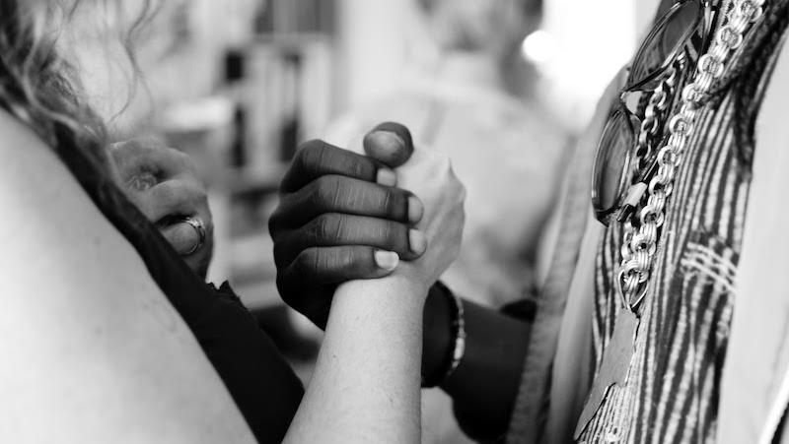
How Do We Talk to Each Other?
Storytelling for Racial Justice
Black and White Dialogue
Freedom Stories, June 12, 2021

Slide 2



Freedom Stories
Unearthing the Black Heritage of Appalachia
This Freedom Stories discussion is being recorded for use by the International Storytelling Center (ISC.) This recording will be owned and managed by ISC and will be used for any educational purpose that ISC deems appropriate. By participating in this public discussion, you acknowledge this recording and its subsequent uses.
Closed captioning is provided today by ACS.

Slide 3

Freedom Stories
Unearthing the Black Heritage of Appalachia
This project is proudly supported by the National Endowment for the Humanities and produced by the International Storytelling Center.

Slide 4










Thanks and appreciation to our supporters:
Appalachian
African-American
Cultural Center
Black / White Dialogue
Langston Education and
Arts Development, Inc.
Northeast Tennessee Tourism
Association (NETTA)
Leadership and Civic Engagement

Slide 5
Thank You!
We have covered a great deal during these twelve public discussions. As we close, I wish to thank each of you for your willingness to engage.
This final PowerPoint is meant to offer a few suggestions for engaging in meaningful dialogues within your own families, communities, or workplaces.
If you are an educator, and wish to aid ISC in creating teaching curriculums for our online Toolkit, or share effective work in facilitating dialogues, please visit the Freedom Stories Toolkit at www.StorytellingCenter.net/FreedomStories.
Alicestyne Turley, Project Director,
ISC Freedom Stories

Slide 6

Only within the open space created by dialogue, whether conducted with our neighbors, with history, with nature or the cosmos, can human wholeness be sustained. We are not born human in any but a biological sense, we can only learn to know ourselves and others and thus be trained in the ways of being human. We do this by immersion in the ocean of language and dialogue fed by the springs of cultural tradition.
President Daisaku Ikeda, SGI
Buddhist Lay Organization for Peace, Culture & Education

Slide 7
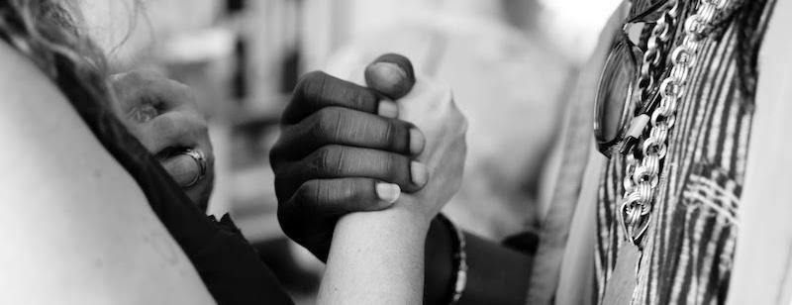
Black and White Dialogue – a Dichotomous Relationship at Best
Difficulty in talking with and to each other has developed unevenly over time, geography and difference.
These dialogues are made even more difficult when filtered through our own experiences and disparate understanding of:
    History
    Culture
    Politics
    Society

Slide 8
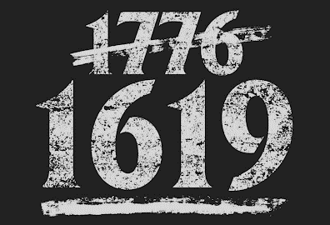
Difficult Dialogues Historically
Historically, we have determined as a society who deserves:
  Slavery vs Freedom
  Inclusion vs Exclusion
  Dialogue vs Silence

Slide 9
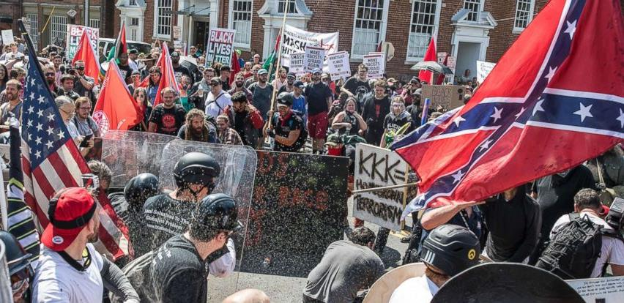
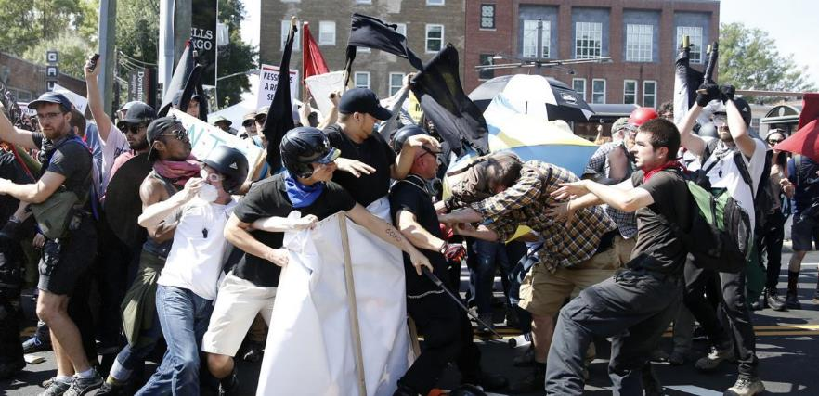
Difficult Dialogues Culturally
Culturally –
  What does it mean to be “American”?
  Who crafted American culture and therefore can claim its privileges, benefits and inheritances?
Charlottesville, Virginia, May 13, 2017

Slide 10
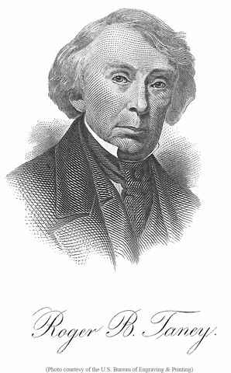
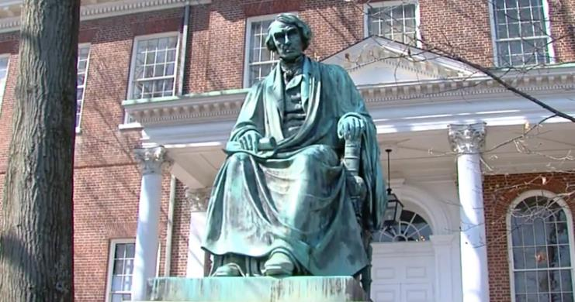
Difficult Dialogues Politically
Politically –
  What voices can and should be heard?
  Who is guaranteed protection under the law?
  Who creates, enforces, and protects the law/s?
“The negro has no rights which the white man is bound to respect...”
US Supreme Court Chief Justice Roger B. Taney; Dred Scott Decision, March 6, 1857
Roger B. Taney Monument, Maryland State House, 2017.

Slide 11
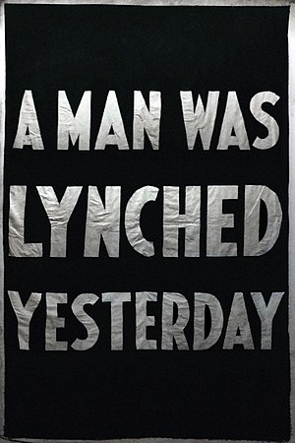
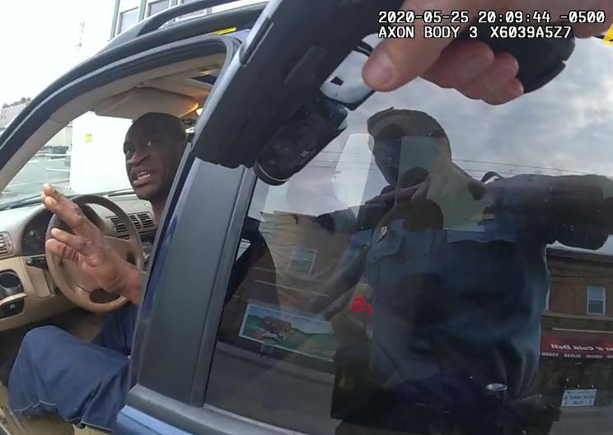
Difficult Dialogues Socially
Socially –
  Who holds the rights and access to:
    education?
    housing?
    public spaces?
    health care?
    religion?
    privilege/opportunity?
    parenting?
    marriage?
    property?
    success?
    privacy?
George Floyd murder, May 25, 2020. To date, there have been 188 police killings since Floyd’s death.
1900s NAACP banner

Slide 12
Critical Race Theory
A concept which identifies racism as a social construct embedded in legal systems and public policy, and not merely the product of individual biases and prejudices.
A study of how institutions, organizations, and systems favor white people and disadvantage people of color.
Emerged from a framework of legal analysis in the 1970s
Teaching critical race theory is currently under heavy criticism by many state legislatures. As of May 29, 2021, sixteen states have either severely limited or outright banned its teaching, including:
  Arizona, Arkansas, Idaho, Iowa, Louisiana, Mississippi, Missouri, New Hampshire, North Carolina, Ohio, Oklahoma, Rhode Island, South Carolina, Tennessee, Texas, and West Virginia.

Slide 13
Social Justice Theory
Acknowledges and explores institutional, interlocking systems of oppression often invisible to the naked eye because they are such an important, established, and integral part of our daily lives, our “culture.”
Acknowledges and expresses a desire to challenge the unequal distribution of resources that have provided unfair advantages to some members of society to the detriment of others.
Fosters a commitment toward changing systems and structures of inequality.
Teaches that unacknowledged hurt and injuries generate anger.

Slide 14
Social Justice Competency
Involves developing:
Self-Awareness – developing consciousness of social identities, cultures, biases, and perspectives.
Understanding and valuing others – acquiring knowledge and appreciation for those different from ourselves.
Gaining knowledge of social inequities – understanding the larger socio-political and historical context of which we are all a part.
Developing skills to effectively interact with diverse groups – creating the ability to embrace, integrate and adapt to diverse groups and situations.
Developing skills to foster equity and inclusion – mastering the ability to create change and continual self-development.

Slide 15
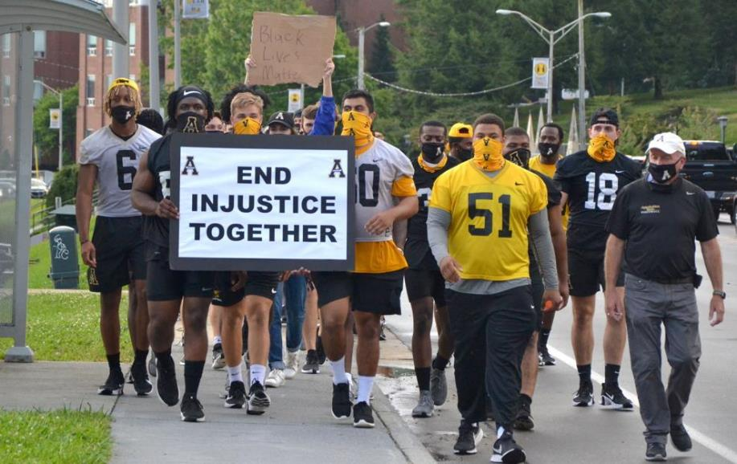
Why These Conversations Are Important
The art of facilitating difficult dialogues suggests:
Sorting through causes or reasons for social inequalities
Having difficult conversations can help establish safer “ground rules,” lead to more open dialogues, and establish safer society for everyone.
Members of the Appalachian State University football team participate in a Black Lives Matter march. Boone, North Carolina, 2020.

Slide 16
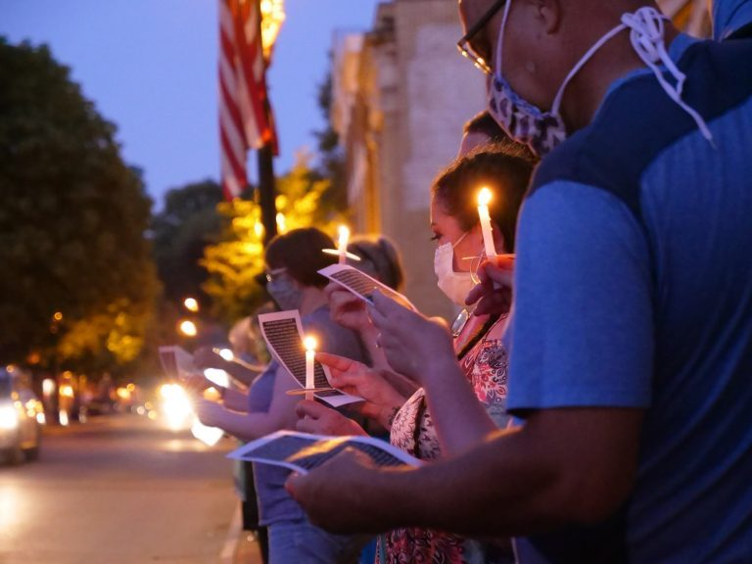
Where Do We Begin?
Good conversations often begin with:
  safe spaces
  agreed-upon ground rules
  meaningful introductions
  shared goals
  articulated outcomes (what do I wish to accomplish, understand, undertake from this dialogue)
  a formulated plan of action or solution
A Black Lives Matter vigil in Jonesborough, Tennessee. Photo by Elliott Childress, 2020.

Slide 17
Establish Ground Rules
For example:
  Speak for yourself – from your own personal experiences and opinions.
  Listen to understand, not to respond.
  Maintain confidences and conversations.
  Know when to “step-up” and when to “step-back.”
  Acknowledge internally that it’s okay to be uncomfortable.
  Disagree without being disagreeable.
  Challenge yourself by choice.
  Address conversational “Oops” and “Ouch” moments.
  No blaming or scapegoating.

Slide 18
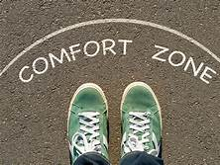
Comfort Zones
We All Have Them!
When inside our comfort zones we do not feel challenged to change.
Challenge creates opportunities for dialogue.
When we are on the edge of our comfort zones, we are also in the best position to expand our understanding, perspectives, and stretch awareness.

Slide 19
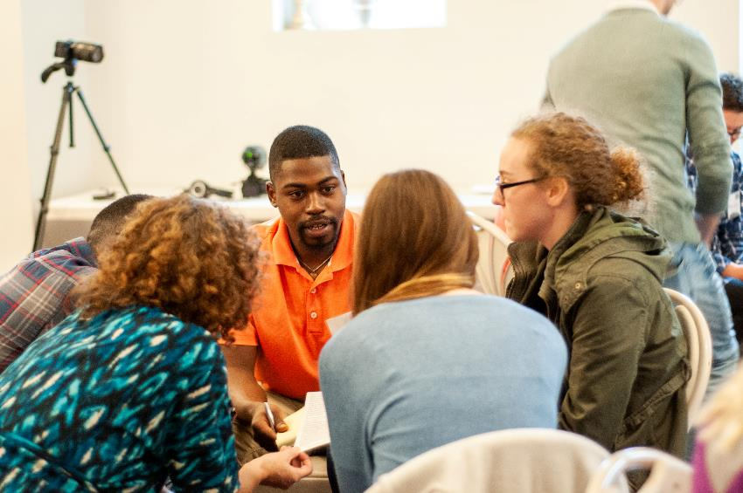
Let Me Introduce Myself!
When beginning dialogues, take a few moments for group or individual introductions to:
  garner participation
  introduce conversational frame work
  gain agreement or acceptance of the guidelines
  establish individual social and group membership.
Dialoguing at the Young Appalachian Story Summit. Photo by Whitney Williams, 2019.

Slide 20
An Introductory Technique
Ask participants to find a partner or break out into small groups, then ask each person to take 2 minutes to share:
  their name and work
  what led them to be concerned about social justice, Freedom Stories public discussions, etc.
  share expectations or anxieties about the conversation
  share other social justice or human rights activities in which they may have participated
Return to the larger group and let each person briefly introduce themselves and what they hope to gain from the conversation.

Slide 21
Establish Learning Goals
Learning goals could be as simple as:
  I want to talk with someone different from me.
  I learned new information during the Freedom Stories Public Discussions which I want to discuss with someone.
  I want to be more open and educated about social injustice in America.
  I want to learn more about oppressed or under-represented groups in American society.
  I want to make new friends outside my race, gender category, or social class.
  I want to become a change maker in my family, community, social group, etc.

Slide 22
Articulate Desired Outcomes
At the end of our conversation/participation, I am going to...
  Actively respect different experiences and perspectives.
  Make time to read one book or attend one lecture on social justice.
  Speak to others in my community about what can be done for under-represented groups in my community.
  Participate as a volunteer in social justice initiatives.
  Continue to educate others and myself on what I have learned.
  Become an advocate or ally to under-served populations.
  Establish a social justice group in my neighborhood, city, school, etc.
  Changes in social policy.
  The list goes on!

Slide 23
Possible Conversation Starters
“I was surprised to learn during Freedom Stories that . . .”
“I have always been curious or wanted to understand . . .”
“I would like to talk more about . . .
  why a wish for a colorblind society is considered flawed thinking.”
  why discussions of racial difference make you feel uncomfortable.”
  how I am supposed to break down racial barriers when people tell me, ‘It’s not my job to teach you about race?’”
  what actions have been taken lately to bridge the racial divide.”
  what are your greatest fears regarding race?”

Slide 24
Examples of Conversation “Triggers”
Which should generally be avoided:
  “I don’t see the differences: people are people to me.”
  “What do you people want anyway?”
  “I feel so sorry for people with disabilities. It’s such a tragedy.”
  “If everyone just worked hard and played by the rules, they would achieve.”
  “Unemployed people prefer their life; they have it pretty good with welfare.”
  “I think people of color are blowing things way out of proportion.”
  “Women who wear tight clothes are asking for it.”
  “All lives matter.”
  “Black folks are always playing the race card; everything is not always about race.”
  (Note: If you don’t know why these are triggers, ask about them.)

Slide 25
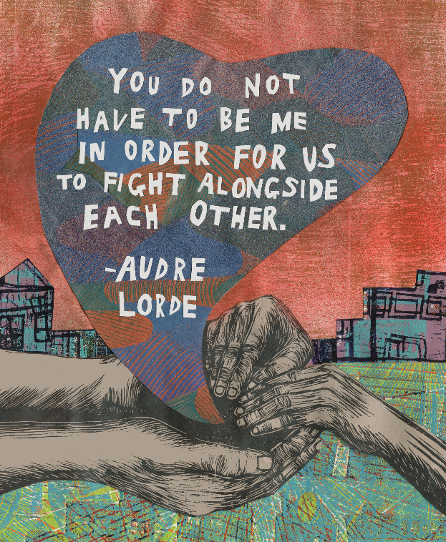
Formulate Actions, Solutions, or
Continuing Dialogue
“I plan to attend a storytelling festival or an African-American history museum or a Pride march or [______________] this year to...”
“I am going to establish a teaching curriculum to educate my students about social justice.”
“I am going to establish a social justice discussion group at my church, community center, etc.”
A printable poster from Learning for Justice

Slide 26
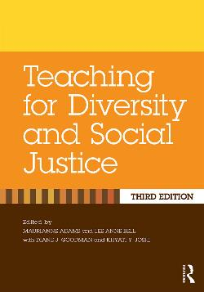
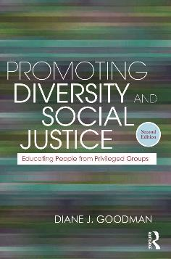
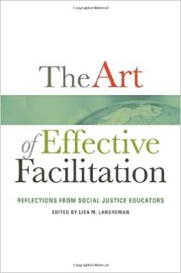
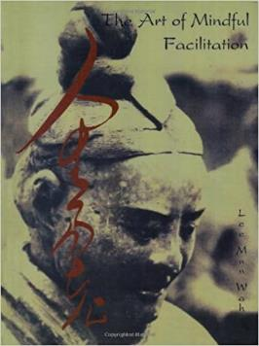
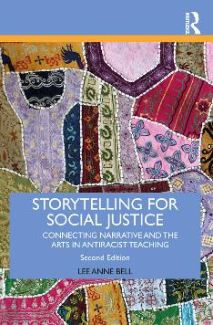

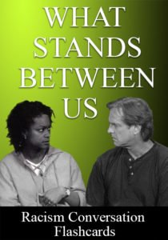
Suggested Texts
Teaching for Diversity and Social Justice, Maurianne Adams and Lee Anne Bell, ed. Routledge: New York, 2008.
Promoting Diversity and Social Justice: Educating People from Privileged Groups by Diane J. Goodman. Routledge: New York, 2011.
The Art of Effective Facilitation, Reflections from Social Justice Educators, Lisa M. Landreman, ed. Stylus: Sterling, VA, 2013.
The Art of Mindful Facilitation, by Lee Mun Wah. StirFry Seminars & Consulting: Berkeley, 2004.
Storytelling for Social Justice, by Lee Anne Bell. Routledge: New York, 2020.
Speak Peace, compiled by Lyn Ford and Sherry Norfolk. Parkhurst Brothers: Chicago, 2019.
What Stands Between Us: Racism Conversation Flashcards. StirFry Seminars & Consulting: Berkeley, 2021.

Slide 27
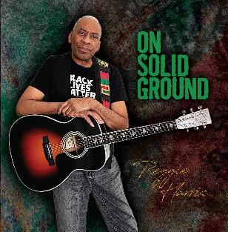
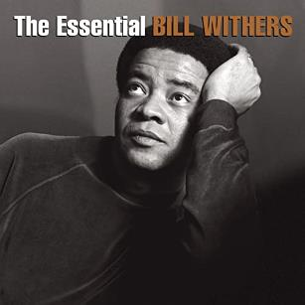
Today’s Music
“Standing In Freedom’s Name,” written and recorded by Reggie Harris. From On Solid Ground. © 2021, Reggie Harris.
“Lean On Me,” written and recorded by Bill Withers. From The Essential Bill Withers. © 2013, Columbia/Legacy.

Slide 28
Thank you for joining us today.
We are partnering with the National Humanities Alliance to document the impact of the Freedom Stories initiative. Your feedback is very important in this regard. Please visit www.StorytellingCenter.net/FreedomStories
to complete this important survey!
Responses are voluntary and confidential. Thank you!

Slide 29
To access a copy of this presentation as well as other Freedom Stories resources, please visit the Freedom Stories Toolkit:
www.StorytellingCenter.net/FreedomStories
Thank you for joining us for the culminating public discussion in our Freedom Stories initiative.

Slide 30
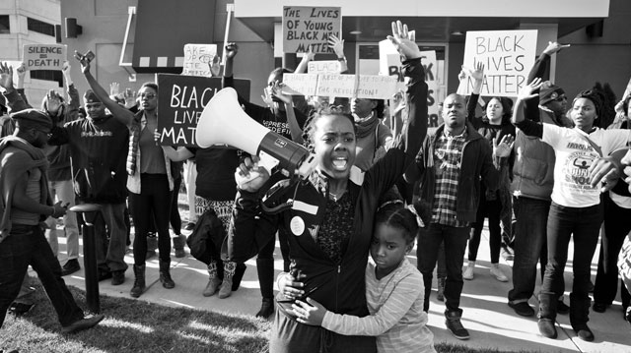
How Do We Talk to Each Other?
Storytelling for Racial Justice

