Slide 1
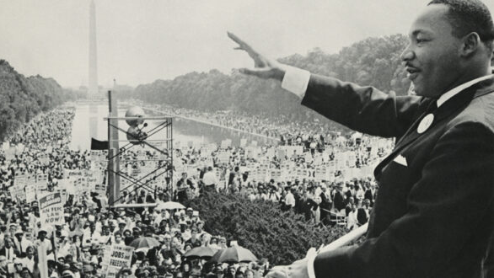
The Civil Rights Movement: It Still Remains
Freedom Stories
Saturday, May 8, 2021
Dr. Martin Luther King addresses the crowd from the steps of the Lincoln Memorial during the March on Washington for Jobs and Freedom, 1963. Photo from the Library of Congress.

Slide 2



Freedom Stories Unearthing the Black Heritage of Appalachia
This Freedom Stories discussion is being recorded for use by the International Storytelling Center (ISC.) This recording will be owned and managed by ISC and will be used for any educational purpose that ISC deems appropriate. By participating in this public discussion, you acknowledge this recording and its subsequent uses.
Closed captioning is provided today by ACS.

Slide 3

Freedom Stories Unearthing the Black Heritage of Appalachia
This project is proudly supported by the National Endowment for the Humanities and produced by the International Storytelling Center.

Slide 4










Thanks and appreciation to our supporters:
Appalachian
African-American
Cultural Center
Black / White Dialogue
Langston Education and
Arts Development, Inc.
Northeast Tennessee Tourism
Association (NETTA)
Leadership and Civic Engagement

Slide 5
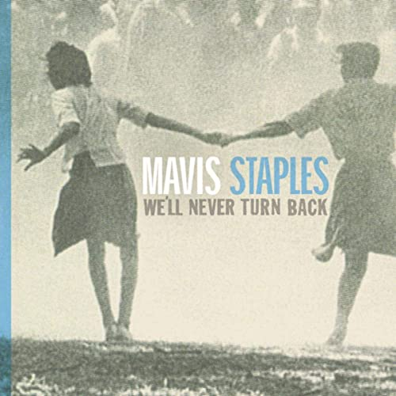
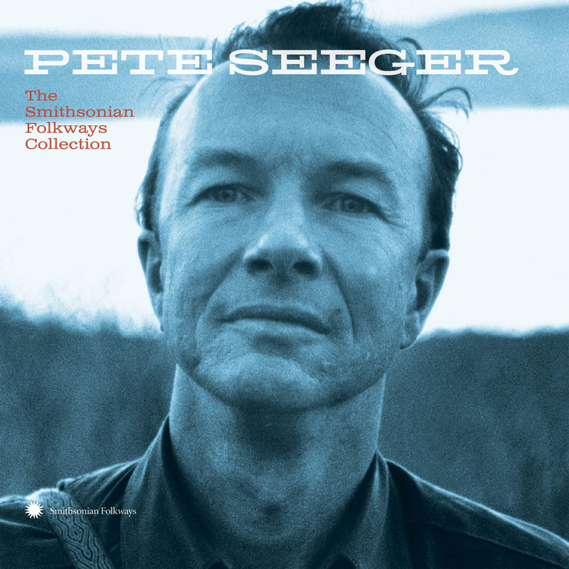
Today’s Presentation Features:
“We Shall Not Be Moved,” arranged and recorded by Mavis Staples. From We’ll Never Turn Back, 2007. © 2007, Anti Inc.
“We Shall Overcome,” arranged and recorded by Pete Seeger. From Pete Seeger: The Smithsonian Folkways Collection, 2019. © 2019, Smithsonian Folkways Recordings.

Slide 6
In the interest of time, today’s presentation will go somewhat quickly. There will likely not be enough time to read every piece of information on every slide.
However, this presentation, as with all Freedom Stories resources, will be made available in the Freedom Stories toolkit. There, you will be able to find a recording of the discussion, and a download of this presentation.

Slide 7
Please know, today’s presentation contains information and images regarding racial violence, including lynching and police killings, and may not be suitable for all viewers.
We recognize this is an extremely heinous, yet extremely important, part of our collective story.

Slide 8
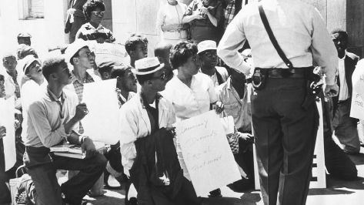
The Black Struggle for Civil Rights
1619-1865
Abolitionism/Civil War
1865-1950
Reconstruction/Jim Crow
1964-2021
Modern Civil Rights Movement

Slide 9
Lynching as American Justice
Lynching: a murder outside of the judicial process—including but not limited to hangings, typically done by a mob.

Slide 10
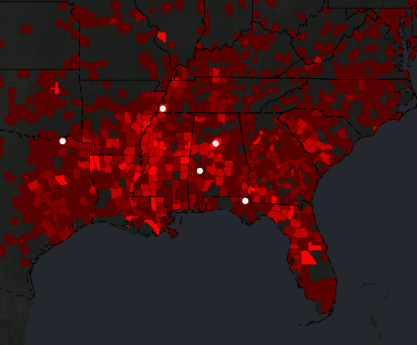
Lynching as “Justice”
Between 1877 and 1950, the Equal Justice Initiative in Montgomery, Alabama documented 4084 lynchings of Black people in Alabama, Arkansas, Florida, Georgia, Kentucky, Louisiana, Mississippi, North Carolina, South Carolina, Tennessee, Texas, and Virginia. Their data reveals telling trends across time and regions, including the fact that lynching peaked between the years 1880 and 1940.
EJI map showing lynchings by county.

Slide 11
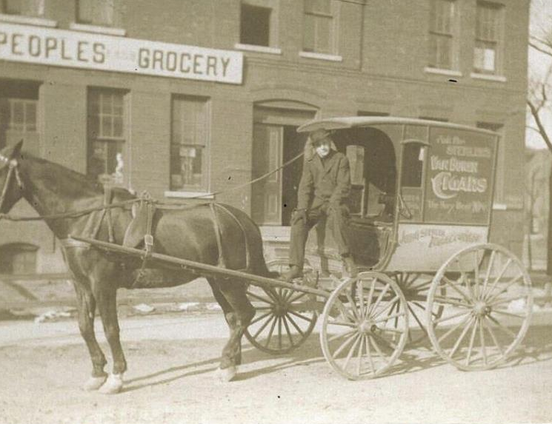
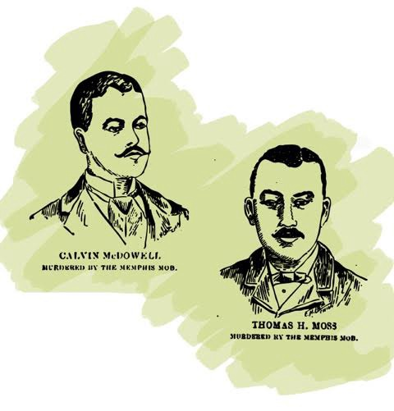
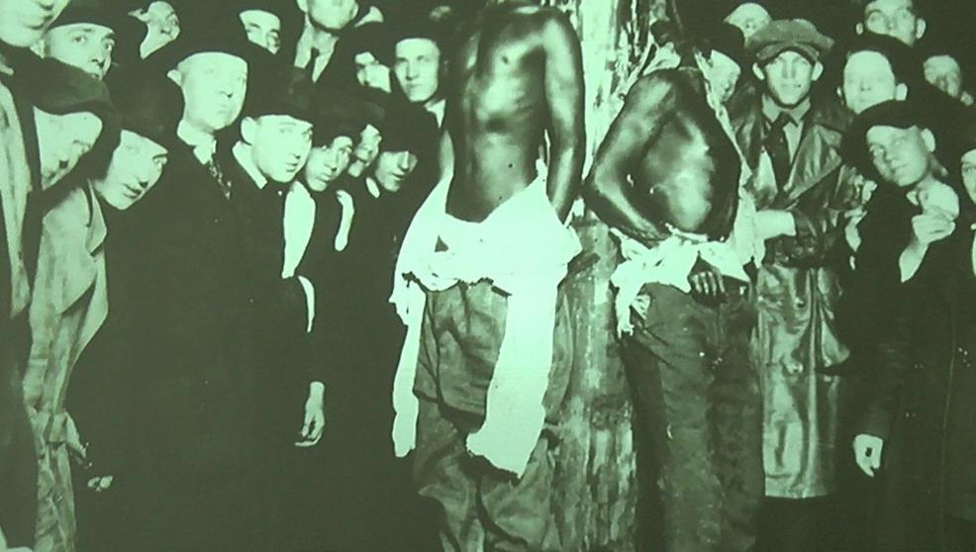
Memphis, Tennessee: March 9, 1892
People’s Grocery lynching of store owners Thomas Moss, Will Stewart, and Calvin McDowell
The bodies left to rot in the Chesapeake & Ohio railroad yard a mile outside of Memphis, Tennessee
Investigated by journalist Ida B. Wells, who was then forced to flee Memphis.

Slide 12
Equal Justice Initiative Data
According to data of the EJI, the number of African Americans Lynched Annually Per 100,000 African American Residents in Southern States, 1880 to 1940 State Per capita rate:
Arkansas 1.994
Florida 1.655
Mississippi 1.151
Louisiana 1.090
Kentucky 0.957
Fulton County, KY (19) 2.44
Georgia 0.907
Texas 0.803
Tennessee 0.776
Lake County, TN (13) 2.66
Moore County, TN (8) 2.60
Alabama 0.693
South Carolina 0.390
North Carolina 0.269
Virginia 0.207

Slide 13
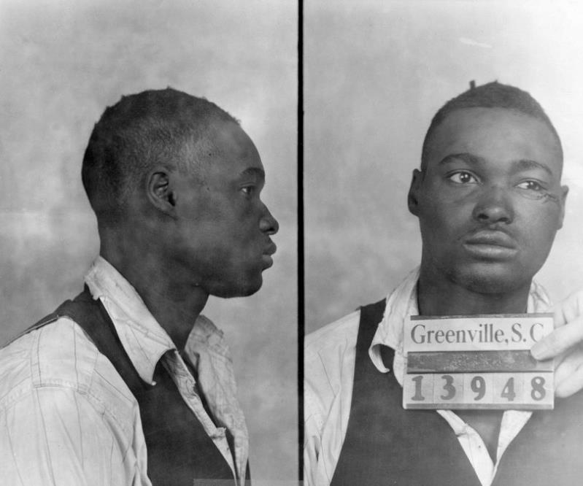
A Lynching in Central Appalachia
Considered the largest lynching trial in SC (the trial was covered by Time Magazine and The New Yorker,) Willie Earl was pulled from his Greenville jail cell and lynched by an angry mob on February 16, 1947. Three months later, an all-white jury acquitted all 31 defendants of the crime. The trial inspired the writing of the play, “The Last Lynching,” in 2014.

Slide 14
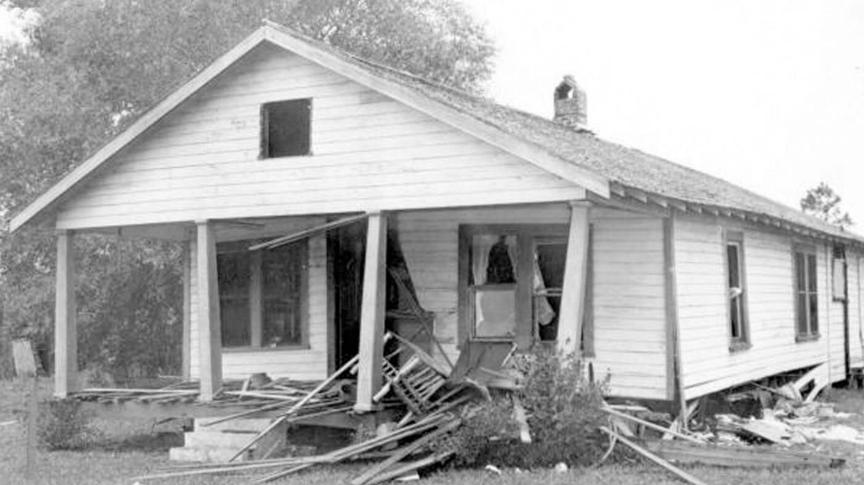
Mims, Florida: December 25, 1951
The bombed home of NAACP organizers Harry and Harriette Moore.
Both were killed in the bombing; considered the first martyrs of the modern Civil Rights Movement.
Considered the first bombing of the modern Civil Rights Movement.
https://cropper.watch.aetnd.com/cdn.watch.aetnd.com/sites/2/2020/08/Harry-Harriette-Moore-House-Bombing.jpg?w=1400

Slide 15
Beginnings of a Modern Movement
Emmett Till, born July 25, 1941, Chicago, Illinois

Slide 16
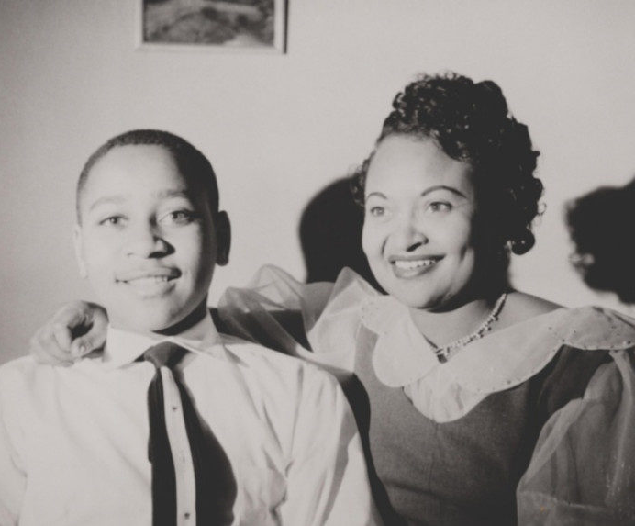
The Murder of Emmett Till
Sunday, August 28, 1955 in the Crossroads community of Money, Mississippi
Dwight D. Eisenhower was president
Chuck Berry’s Maybellene, Haley and the Comet’s Rock Around the Clock were in the Top-Ten on the American Pop-Chart
The book, Something of Value, by Robert Ruark was #1 on the American Bestseller List
Emmett Till and his mother, Mamie Bradley, 1950

Slide 17
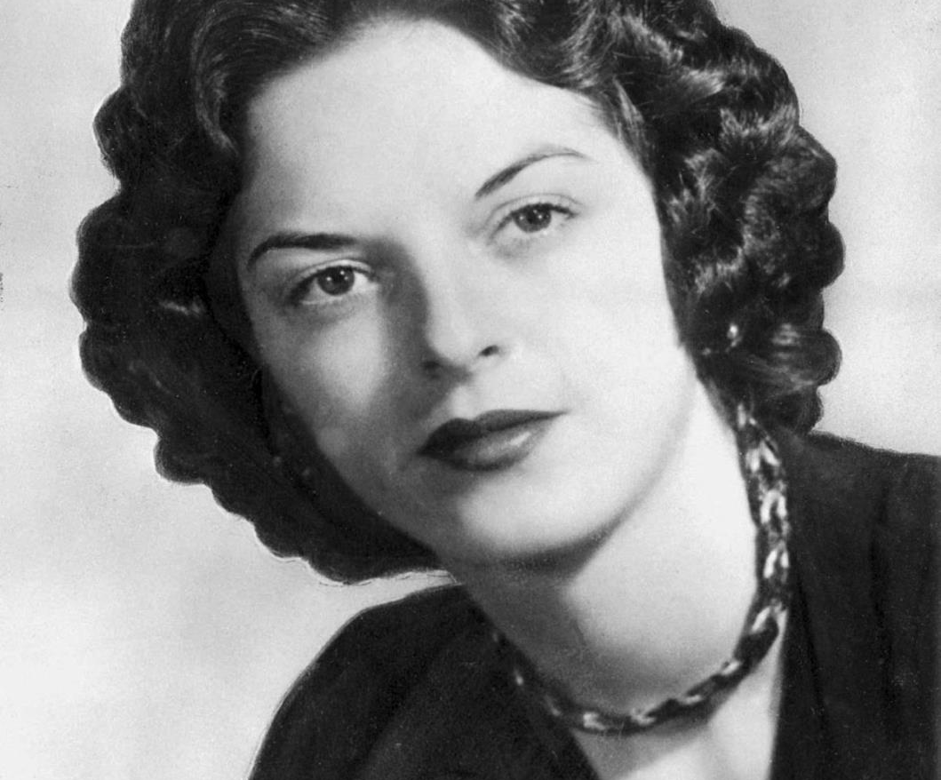
The Crime:
August 24, Emmett Till was accused of whistling at a white woman.
August 28, 2:30 a.m. Till was ripped from the home of his great uncle Moses Wright by the woman’s husband and half-brother—made to carry a 75-pound cotton gin fan to the bank of the Tallahatchie River, and ordered to take off his clothes.
The two men then beat him nearly to death, gouged out his eye, shot him in the head, and threw his body, tied to the cotton gin fan with barbed wire, into the river.
Till purchased bubble gum, and some of the kids with him would later report he either whistled at, flirted with, or touched the hand of the store’s white female clerk—and wife of the owner—Carolyn Bryant.

Slide 18
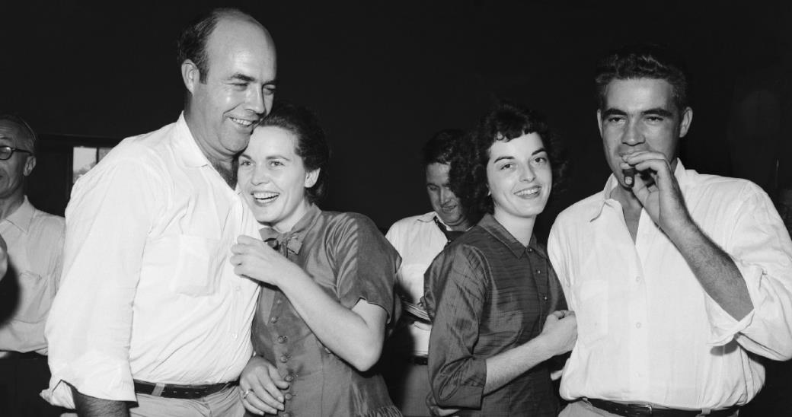
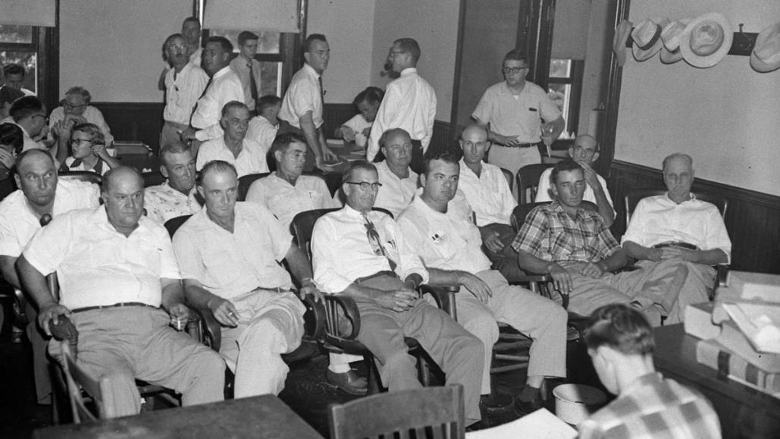
The Trial: September 19, 1955
Carolyn Bryant, second from right, was born in 1934, the daughter of a plantation manager and a nurse in Indianola, Mississippi.
African Americans barred from jury duty by Mississippi law.
The accused, Roy Bryant, Carolyn’s husband, and his half brother J.W. Milam tried before an all-white, all-male jury.
Both men found “not guilty” of all charges following 67 minutes of jury deliberation.
Bryant’s and Milam’s all-white, all-male jury.

Slide 19
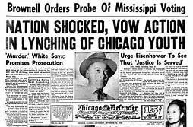
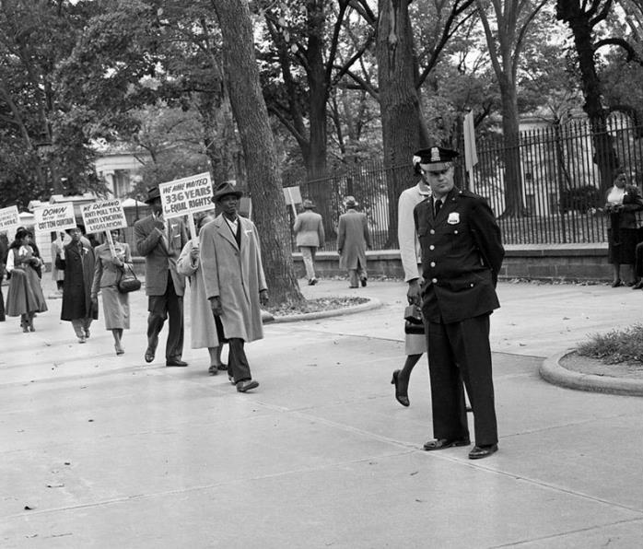
The Verdict: Sparks Nationwide Protest
Young people throughout the nation were outraged by the Emmett Till verdict.
January 1956: Bryant and Milam admitted to committing the crime.
Protected by double jeopardy laws, they told the whole story of how they kidnapped and killed Emmett Till to Look Magazine for $4,000.

Slide 20
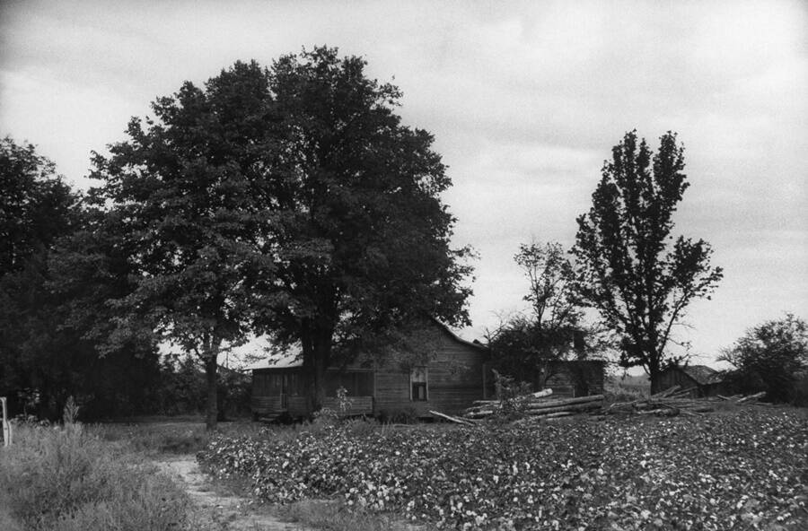
2007: “It was all a lie” admits 72-year old
In 2007, Carolyn Bryant Donham recanted parts of her story. Speaking to a historian, then 72-year-old Donham admitted Till hadn’t grabbed her. “Nothing that boy did could ever justify what happened to him,” she told Timothy B. Tyson, who wrote a book about the case, The Blood of Emmett Till. The revelations weren’t made public until 2017, when the book was released.
In 2018, following Donham’s admission, the Justice Department opened a new inquiry into the case.
Interview URL: https://youtu.be/WxcXpD078pw
The site of Emmett Till’s kidnapping in Money, Mississippi. Ed Clark/The LIFE Picture Collection via Getty Images. Tyson remains the only person to have ever interviewed Carolyn Bryant Donham.

Slide 21
Young People Rise Up

Slide 22
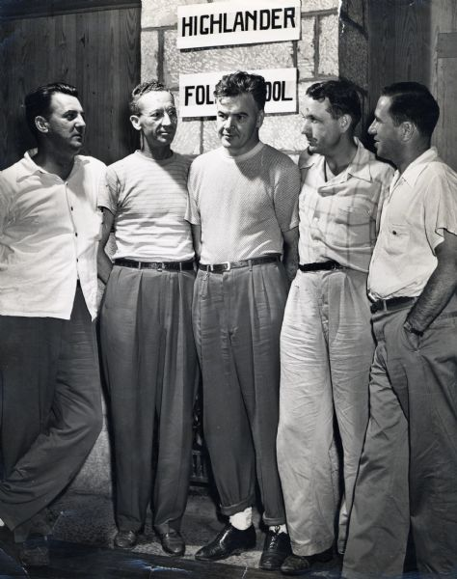
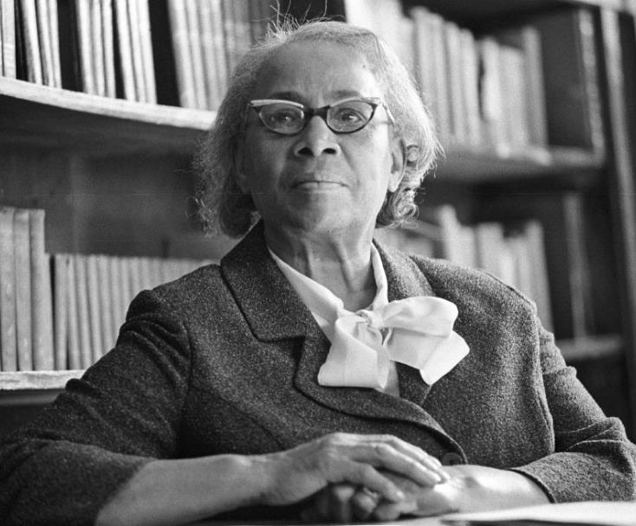
The Highlander Folk School Grundy County, TN
1956: Septima Clark was fired from the Charleston, SC school system.
Highlander then hired her to direct integration workshops. She eventually became the full time workshop director.
When Clinton High School struggled to integrate their schools, Clark and Highlander staff invited the African American students to come to the secluded school for a weekend retreat.
Established in 1932 by landowners Myles Horton and Don West with a main focus on labor relations.
Labeled a “communist” stronghold by opponents in the American press.
Became a training ground for modern Civil Rights activists.
1961: Tennessee Supreme Court revoked Highlander's charter and ordered the school closed.
Highlander School staff
Another black woman takes the lead –
Septima Clark (1898-1987)

Slide 23
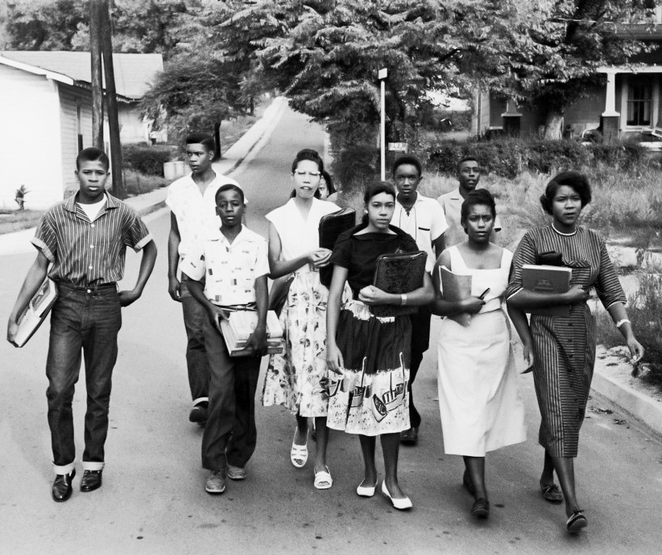
The Clinton 12: August 26, 1956
Clinton, TN
The first students to desegregate a state-supported high school in the South (from left to right)
Bobby Cain
Robert Thacker
Maurice Soles
Gail Ann Epps Upton
Alvah McSwain (behind Gail Ann)
Jo Ann Crozier Allen Boyce
Ronald Gordon “Poochie" Hayden
Alfred Williams
Regina Turner-Smith
Minnie Ann Dickey Jones
Anna Theresser Caswell (not pictured)
William R. Latham (not pictured)

Slide 24
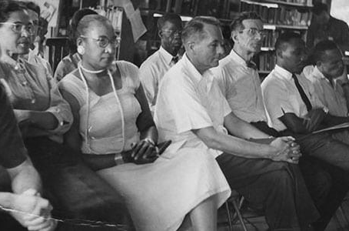
SCLC: September 2, 1957
Martin Luther King, Jr. joins staff of the Highlander School
Develops plans for establishing the Southern Christian Leadership Conference (SCLC)
On 2 September 1957, Martin Luther King, Jr. (second from right) joined the staff and participants of a leadership training conference at Highlander Folk School to celebrate its 25th anniversary. In his closing address to the conference, King praised Highlander for its “noble purpose and creative work,” and contribution to the South of “some of its most responsible leaders in this great period of transition.”

Slide 25
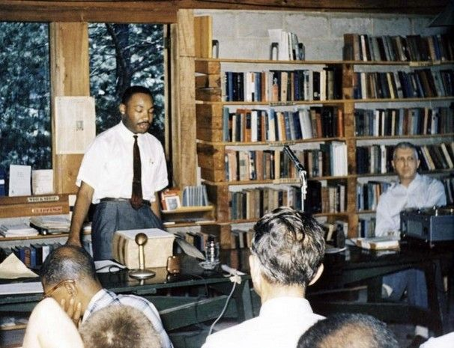
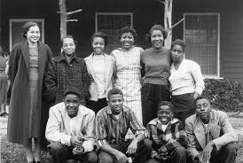
Highlander School: 1954-1961
In 1959, the school was raided and four staff were arrested and charged with possession of alcohol, drunkenness, and resisting arrest. Through this, Highlander continued workshops as planned.
Left: Martin Luther King, Jr. leads a workshop.
Highlander becomes an adult education center during the Civil Rights Movement.
1954: Septima Clark, along with other participants, attended Highlander workshops. Here participants developed topics to deal with common community issues, one of which included inability of many African Americans to vote due to voting law restrictions requiring voters to pass literacy tests.
1955: Rosa Parks attends Highlander classes.
During this time, Highlander also began a Youth Project in 1960 and 1961. Much like the adult sessions, white and black students participated in sessions about school integration.
Right: Rosa Parks attends a training session with members of the Clinton 12.

Slide 26
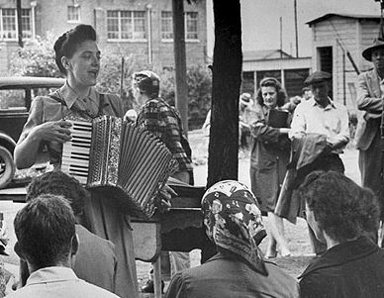
NAACP: “We Shall Overcome”
A song reborn at the Highlander School.
Horton introduced the song to folk singer Pete Seeger in the 1950s and he performed the most well-known rendition at the school’s 25th anniversary gathering. In the crowd were Dr. Martin Luther King, Jr., Rosa Parks, and the Rev. Ralph Abernathy.
King was so moved by the song that he recited the lyrics in his final Memphis speech in 1968 just before his assassination.
The hymn was also played during his funeral in Atlanta.
Zilphia Horton, music director at Highlander Folk School, first heard the song in 1946 from South Carolina tobacco workers. She was struck by the simplicity of the old spiritual and how one activist, Lucille Simmons, sang it very slowly and powerfully.

Slide 27
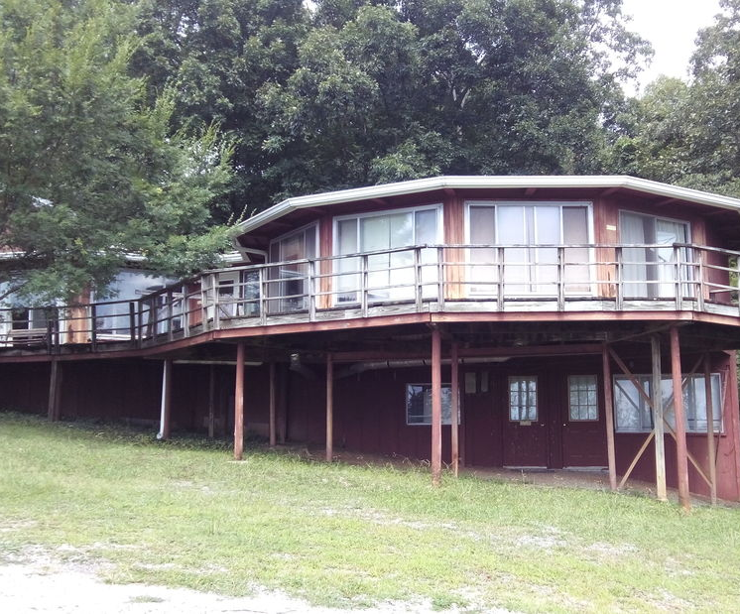
Highlander School Today New Market, TN
The Highlander Folk School legacy lives on as the Highlander Research and Education Center.
In 2014, the Tennessee Preservation Trust purchased 8.5 acres of the old Grundy County campus, including the library where “Citizenship” workshops took place.
The building has been restored to its original 1948 appearance and is open to the public. To learn more, visit preservetn.org.

Slide 28
Modern Civil Rights Movement
1964-2021

Slide 29
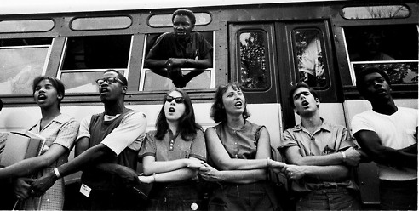
CORE Freedom Riders
Congress on Racial Equality (CORE) established in 1942
Headquartered in New York, NY
The first Freedom Ride left Washington, DC on May 4, 1961.
436 individuals participated in at least 60 separate Freedom Rides.
The Rides challenged non-enforcement of the United States Supreme Court decisions Morgan v. Virginia (1946) and Boyton v. Virginia (1960), which ruled segregated public buses unconstitutional.

Slide 30
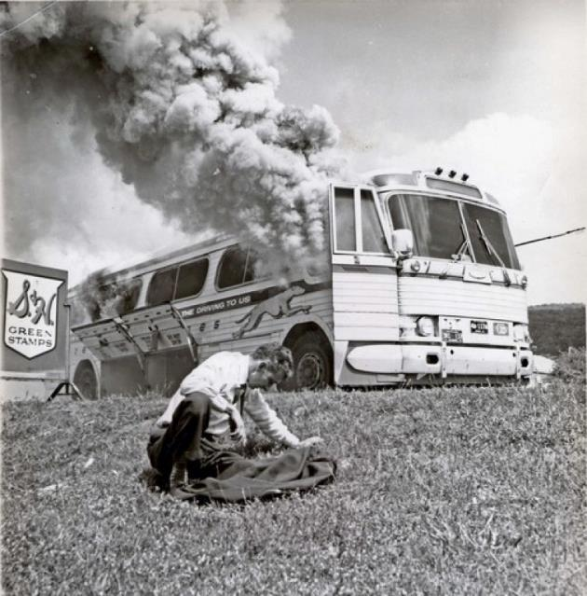
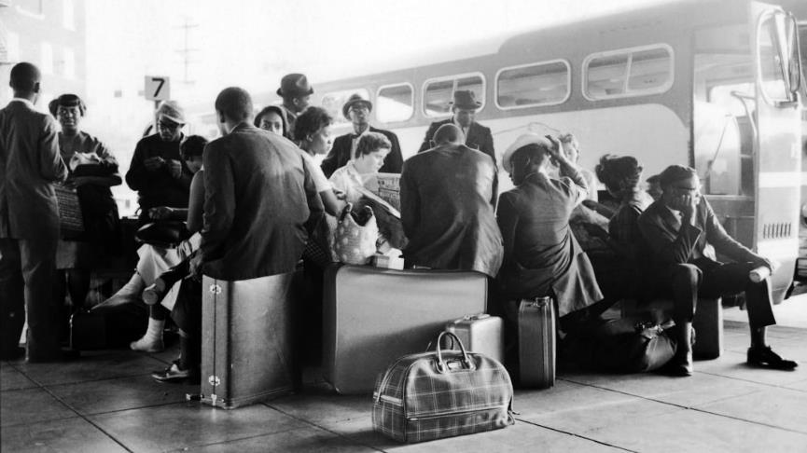
Freedom Riders: May 4-December 10, 1961
Members of Eastview Klavern #13 (the most violent Klan group in Alabama,) were given fifteen minutes to attack the Freedom Riders without arrests.
The Birmingham, Alabama, Public Safety Commissioner, Bull Connor, together with Police Sergeant Tom Cook (an avid Ku Klux Klan supporter), organized violence against the Freedom Riders with local Klan chapters.
The pair made plans to bring the Rides to an end in Alabama.
The plan was to allow an initial assault on Freedom Riders in Anniston, with a final assault taking place in Birmingham.

Slide 31
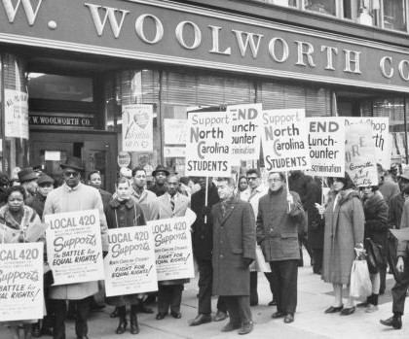
SNCC: 1960-1966
Student Nonviolent Coordinating Committee organized by Ella Baker in 1960.
Considered the principal channel of student non-violent commitment during the Civil Rights Movement.
Organized lunch counter sit-ins throughout the US including in Nashville, TN and Greensboro, NC

Slide 32
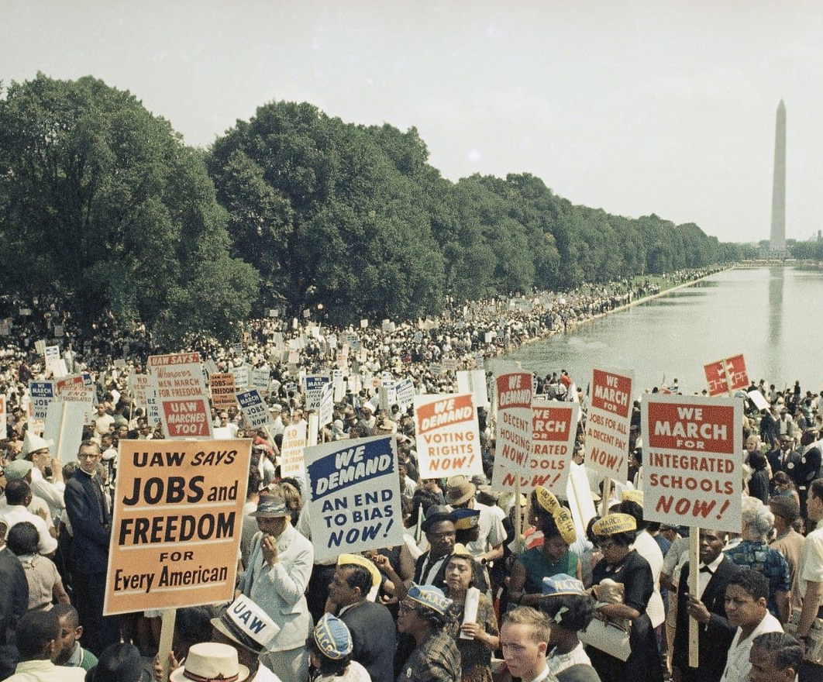
2nd March on Washington: August 28,1963
Organized by the SCLC, the march was officially called the March on Washington for Jobs and Freedom.
Some 250,000 people gathered at the Lincoln Memorial, and more than 3,000 members of the press covered the event.

Slide 33
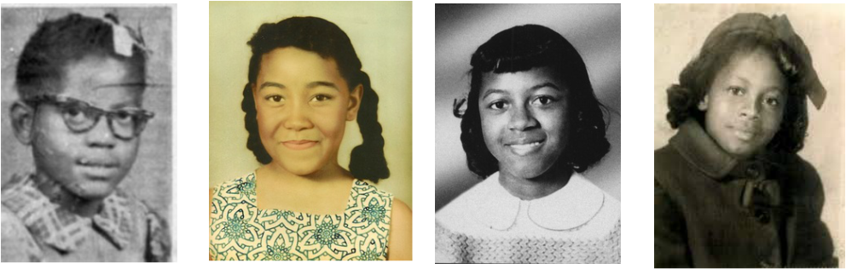
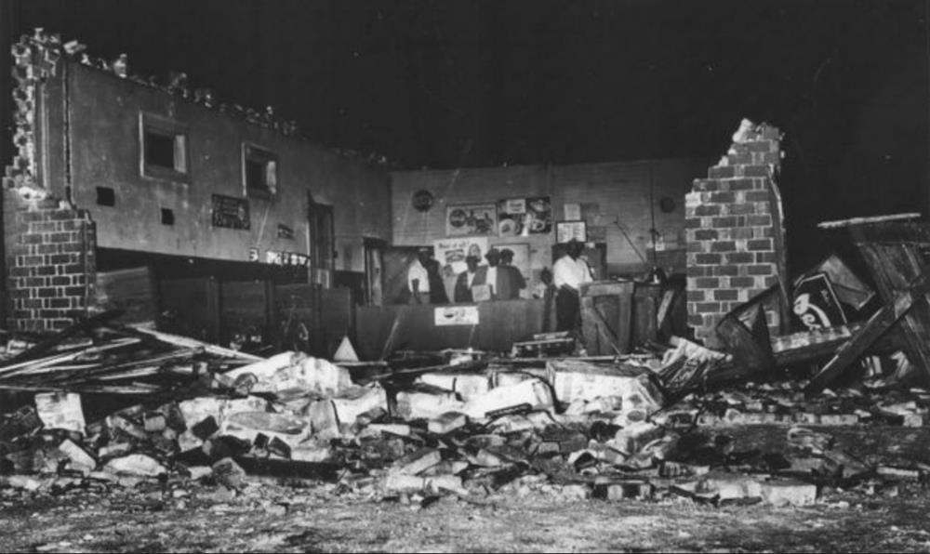
Bombing of 16th Street Baptist Church
Birmingham, AL
Sunday, September 15, 1963, 10:22 a.m.
4 members of the Ku Klux Klan planted 19 sticks of dynamite attached to a timer beneath the east side steps of the church.
14-22 people injured
4 people killed
Martin Luther King, Jr. addresses 3,300 funeral mourners.
Addie Mae Collins, 14
Carole Robertson, 14
Cynthia Wesley, 14
Denise McNair, 12
Above, the four girls killed in the bombing.
Right, aftermath of the bombing.

Slide 34
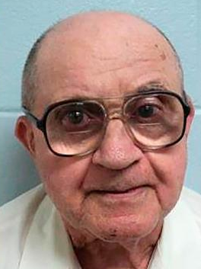
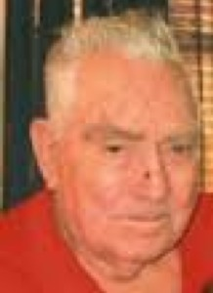
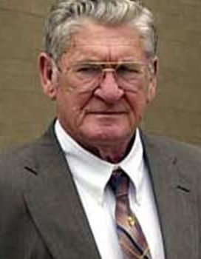
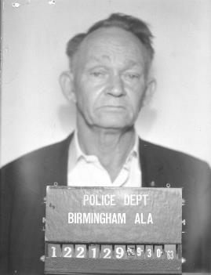
16th Street Bombing Convictions
FBI concluded bombing had been committed by four known Klansmen and segregationists:
Thomas Edwin Blanton, Jr.
Herman Frank Cash
Robert Edward Chambliss
Bobby Frank Cherry
Prosecutions were not conducted until 1977, when Robert Chambliss was tried and convicted of the first-degree murder of Denise McNair.
Thomas Edwin Blanton Jr. and Bobby Cherry were each convicted of four counts of murder and sentenced to life imprisonment in 2001 and 2002, respectively.
Herman Cash died in 1994, and was never charged with his involvement in the bombing.
Thomas Blanton, Jr.
Herman Frank Cash
Bobby Frank Cherry
Robert Chambliss

Slide 35
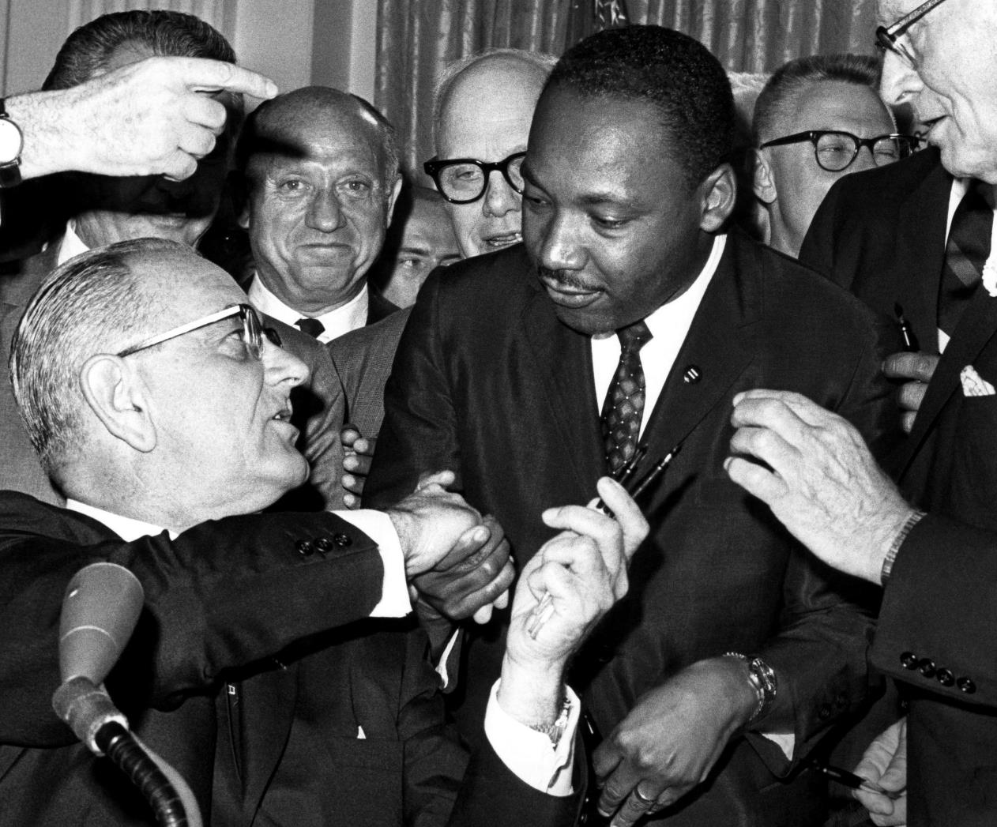
Civil Rights Act 1964
The 16th Street Church bombing prompted signing of the Civil Rights Act by President Lyndon B. Johnson, July 2, 1964.
Considered the most sweeping civil rights legislation passed by Congress since post-Civil War Reconstruction era.
The Act prohibited racial discrimination in employment and education and outlawed racial segregation in public places such as schools, buses, parks and swimming pools.

Slide 36
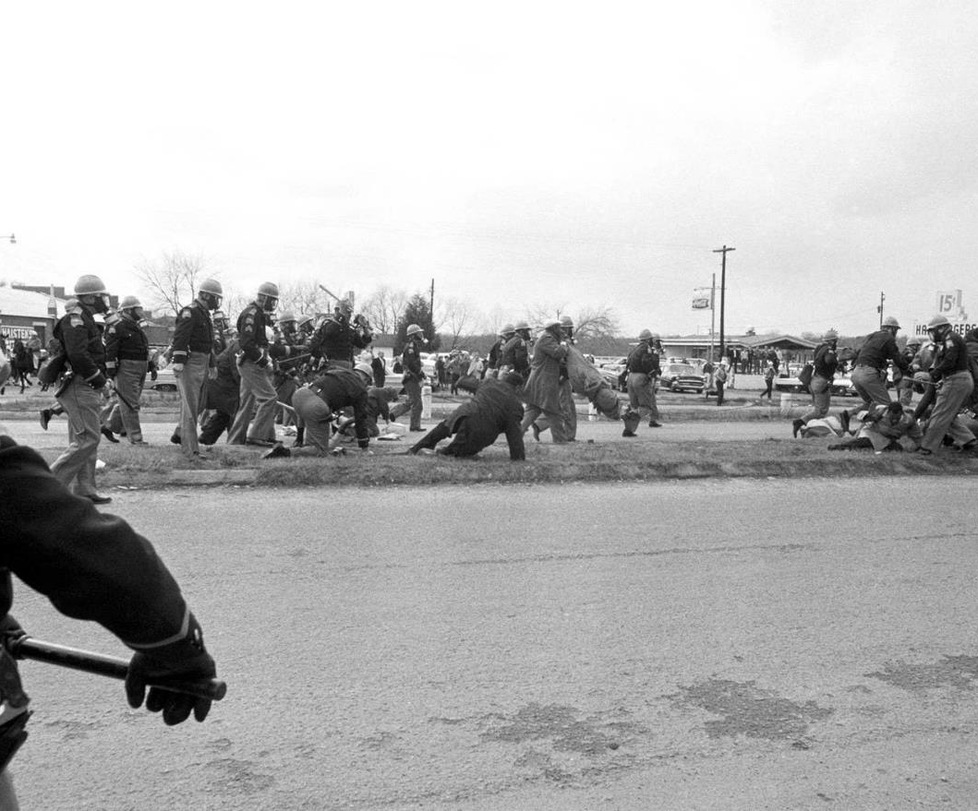
Selma to Montgomery March: 1965
March for voting rights organized by SCLC and SNCC.
Occurred in three stages:
“Bloody Sunday,” on the Edmund Pettus Bridge, March 7
“Turn-Around Tuesday,” March 9
2000 people completed the March to the state capitol of Montgomery, March 21-25
March secured passage of the 1965 Voting Rights Act first awarded African Americans by the 15th Amendment, February 3, 1870.
The 1965 Voting Rights Act banned literacy tests as a requirement for voting, mandated federal oversight of voter registration in areas where tests had previously been used, and gave the U.S. Attorney General the duty of challenging the use of poll taxes for state and local elections.

Slide 37
The Movement Remains
1964-2021

Slide 38
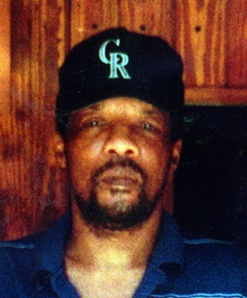
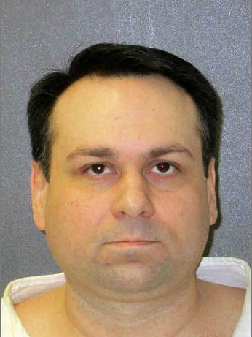
Jasper, Texas June 7, 1998
James Byrd, Jr., 49, drug three miles behind a pickup truck along an asphalt road by 3 white supremacists: Shawn Berry, Lawrence Brewer, and John King.
Byrd remained conscious for much of his ordeal.
The murderers then drove another 1½ miles before dumping his torso in front of a black church.
April 24, 2019: John William King (right) became the last man executed for the dragging death of James Byrd, Jr. Byrd’s death resulted in congressional passage of the Matthew Shepard and James Byrd Jr. Hate Crimes Prevention Act signed into law by President Barack Obama, October 28, 2009.

Slide 39
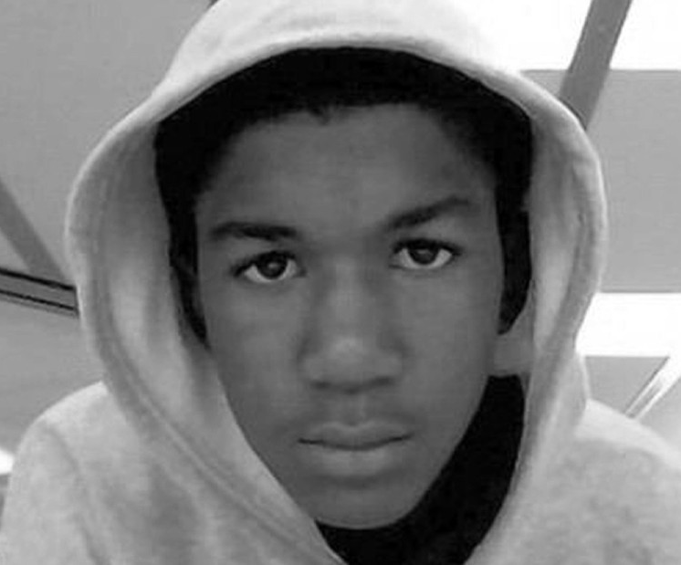
Sanford, Florida February 26, 2012
Trayvon Martin, 17, killed by neighborhood watch captain George Zimmerman, after Zimmerman was advised by police not to follow or harass Martin.
July 1, 2013: Zimmerman found not guilty on all charges by six white female and one mixed-race juror.
Image by Jerome Horton

Slide 40
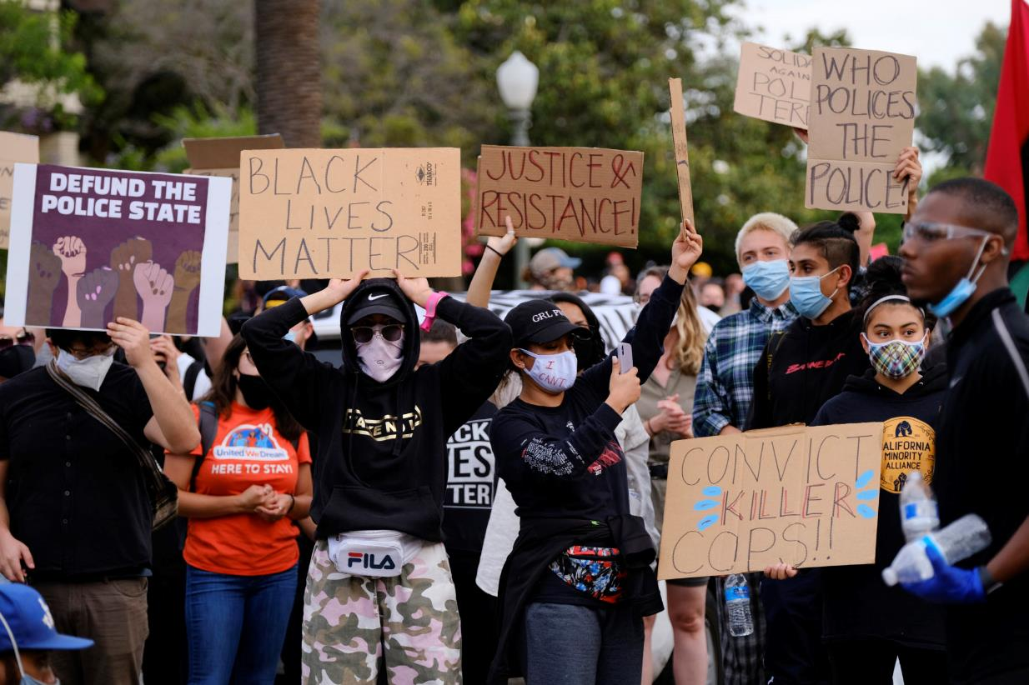
2013: #BlackLivesMatter is Born
The same month Zimmerman went free, the hashtag #BlackLivesMatter was born. The phrase became the rallying cry for justice when Black Americans are killed.
Defined the goals of a fiercely committed new generation of civil rights activism aimed at ending a legacy of hate, violence and callous disregard for human life.
“When Trayvon Martin was first shot, I said that this could have been my son... I think it’s important to recognize that the African American community is looking at this issue through a set of experiences and a history that doesn’t go away.”
— 2013 comments by President Barack Obama

Slide 41
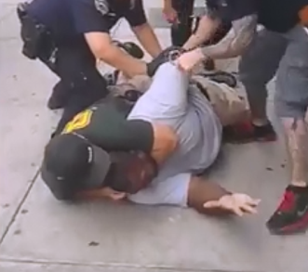
New York, New York: July 17, 2014
Eric Garner, 44, killed outside a Staten Island convenience store by New York police officers Daniel Pantaleo and Justin D'Amico through use of a prohibited police chokehold.
Pantaleo fired from NYPD August 2019.
Family receives a $5.9 million out-of-court settlement.

Slide 42
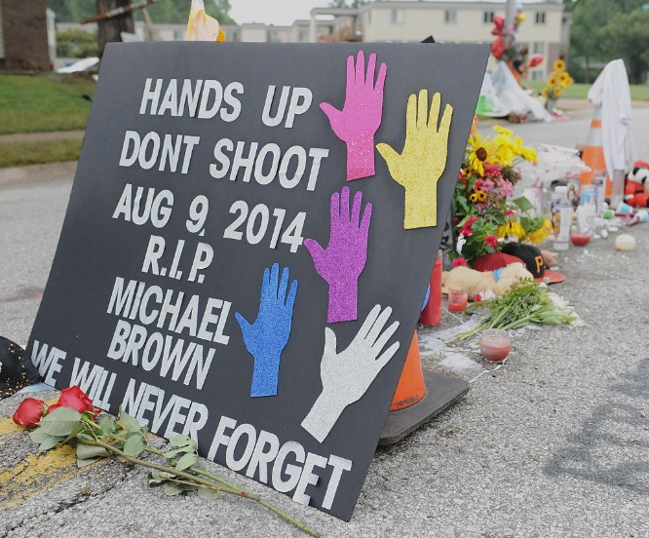
Ferguson, Missouri: August 9, 2014
Michael Brown, 18, killed by Ferguson, Missouri, police officer Darren Wilson.
Witnesses stated Wilson shot Brown while his hands were in the air. Wilson stated Brown attacked him and he feared for his life.
St. Louis County prosecutor fails to bring charges against Wilson.
Image by Raja Razek, CNN

Slide 43
2015 Statistics of Black Male Police Killings by State
**States not listed have no reported police killings as of June 22, 2015** California, Florida, Texas have the highest number of police killings of black males since January 1, 2015.
The average killing per state represented is 4.6 killings since January 1, 2015. Compiled by Berea College Carter G. Woodson students.

Slide 44
2015 Statistics of Black Male Police Killings
Compiled by Berea College, Carter G. Woodson students.

Slide 45
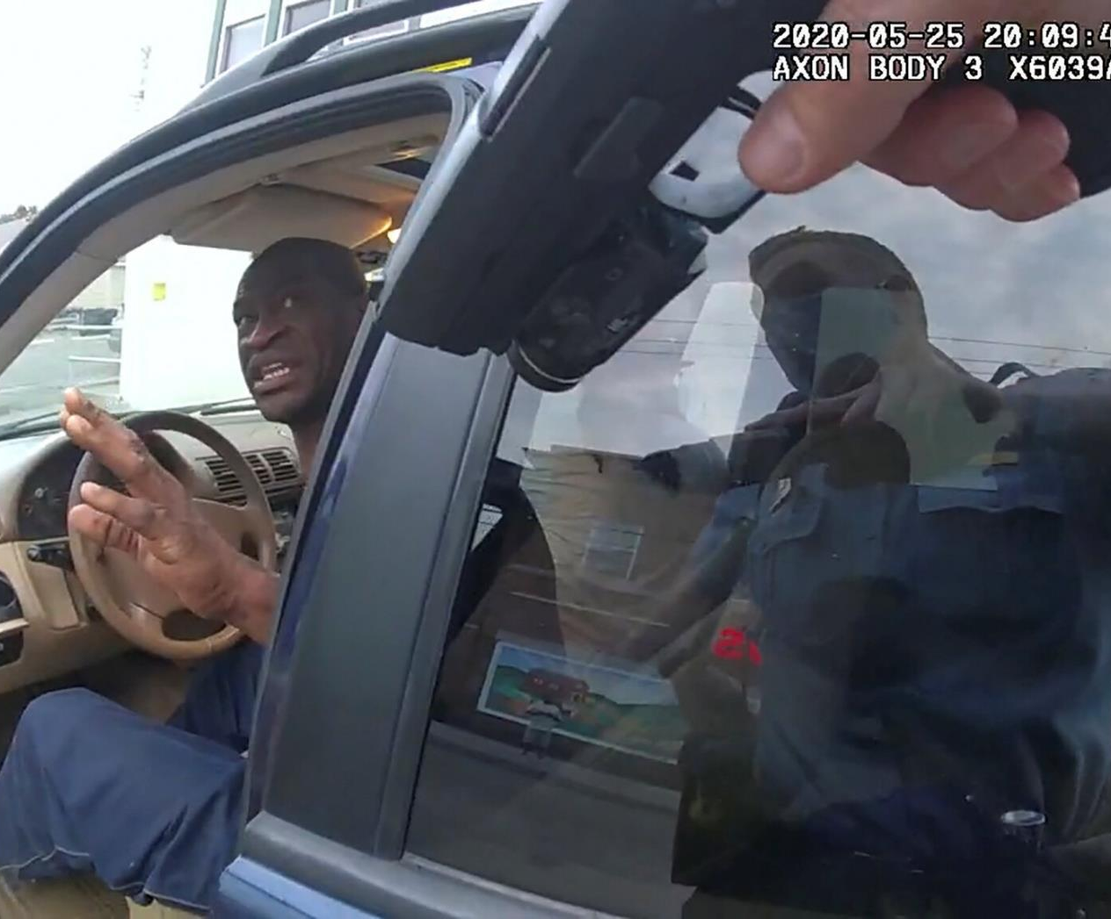
Minneapolis, Minnesota: May 25, 2020
George Floyd, 46, killed by Minneapolis police officers Thomas Lane, Tou Thao, J. Alexander Kueng, and Derek Chauvin who held his knee on Mr. Floyd’s neck for 9 minutes and 24 seconds.
April 20, 2021: Officer Derek Chauvin found guilty of second-degree murder, third-degree murder, and second-degree manslaughter.

Slide 46
Thank you for joining us today.
We are partnering with the National Humanities Alliance to document the impact of the Freedom Stories initiative. Your feedback is very important in this regard. Please visit www.StorytellingCenter.net/FreedomStories
to complete this important survey!
Responses are voluntary and confidential. Thank you!

Slide 47
For more information on this and other Freedom Stories events, please contact us.
Web: www.StorytellingCenter.net/FreedomStories
Email: FreedomStories@StorytellingCenter.net
Join us again Saturday, June 12 at 1:00pm (Eastern) for the culminating public discussion in our Freedom Stories initiative.

Slide 48
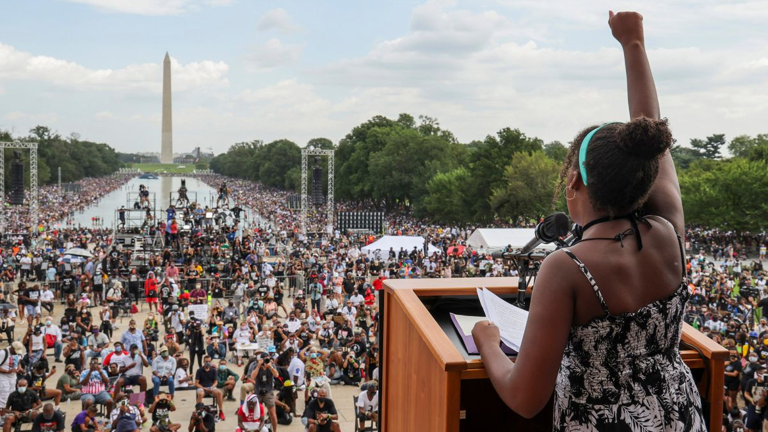
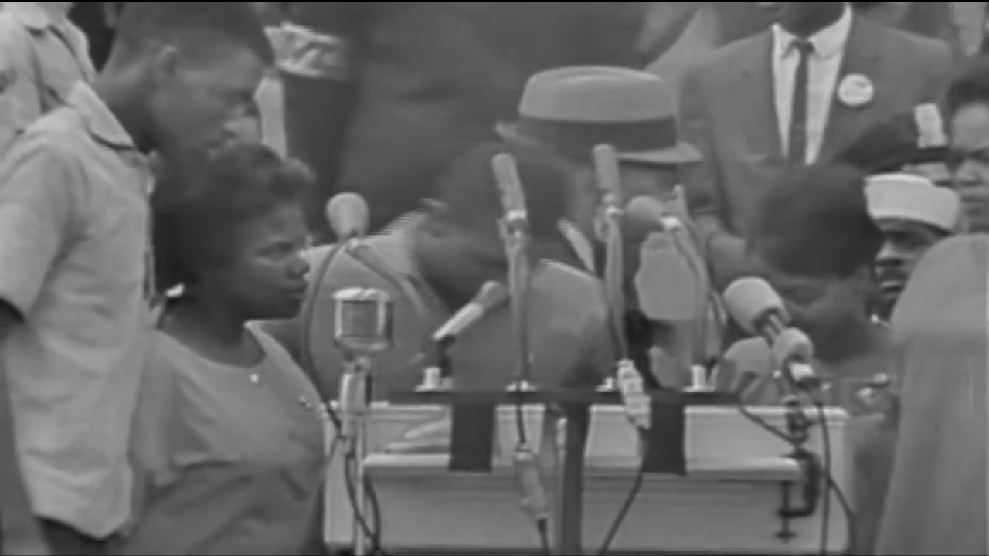
The Freedom Singers: “We Shall Not Be Moved” Performed at the March on Washington for Jobs and Freedom, 1963
The Struggle Remains
Freedom Stories
Saturday, May 8, 2021
Public domain footage from the National Archives and Records Administration
Yolanda King, granddaughter of Dr. Martin Luther King, delivers a speech from the steps of the Lincoln Memorial during the Commitment March, 2020. Photo by Jonathan Ernst.

