Slide 1
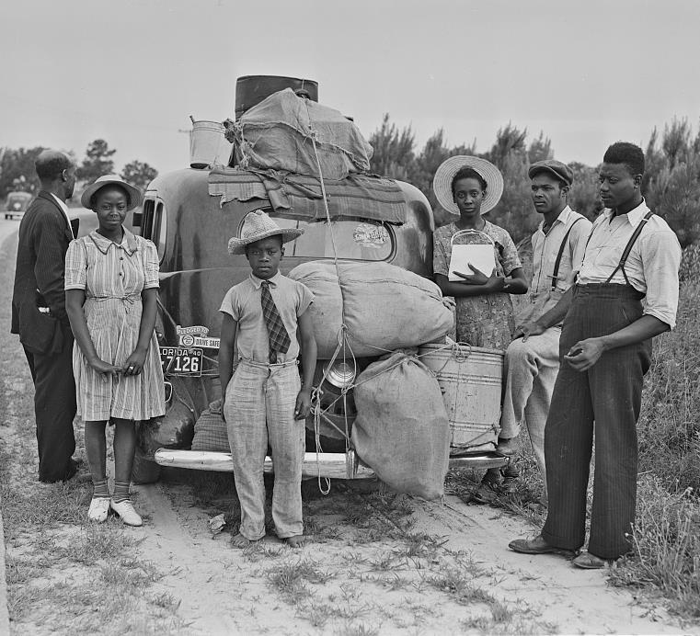
Out-Migration: Spreading Appalachia Abroad
1910-1960
Freedom Stories
Saturday, April 10, 2021
1 – 2:30 p.m.

Slide 2



Freedom Stories
Unearthing the Black Heritage of Appalachia
This Freedom Stories discussion is being recorded for use by the International Storytelling Center (ISC.) This recording will be owned and managed by ISC and will be used for any educational purpose that ISC deems appropriate. By participating in this public discussion, you acknowledge this recording and its subsequent uses.
Closed captioning is provided today by ACS.

Slide 3

Freedom Stories
Unearthing the Black Heritage of Appalachia
This project is proudly supported by the National Endowment for the Humanities and produced by the International Storytelling Center.

Slide 4



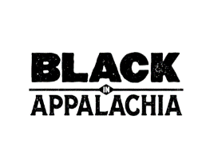


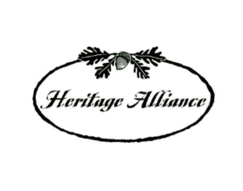
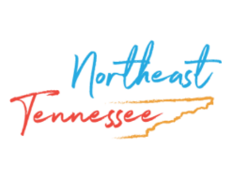


Thanks and appreciation to our supporters:
Appalachian
African-American
Cultural Center
Black / White Dialogue
Langston Education and
Arts Development, Inc.
Northeast Tennessee Tourism
Association (NETTA)
Leadership and Civic Engagement

Slide 5
Please know, today’s presentation contains information and images regarding lynching. Viewers will likely find the image disturbing. We recognize this is an extremely heinous, yet extremely important, part of our collective story.

Slide 6
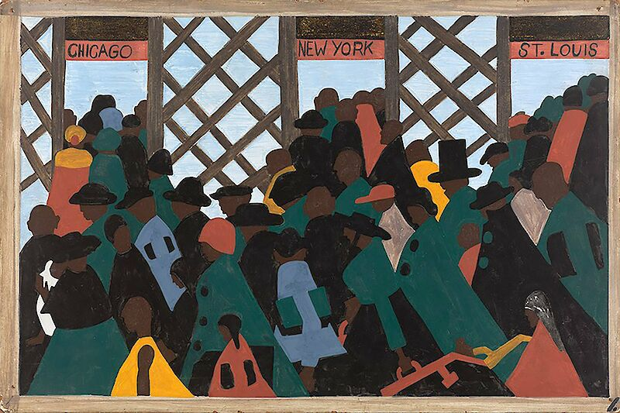
Today’s presentation features the art of southern migrant, Jacob Lawrence
and his “Great Migration” series, 1940-41
1. During World War I there was a great migration north by southern African Americans. 1940-41

Slide 7
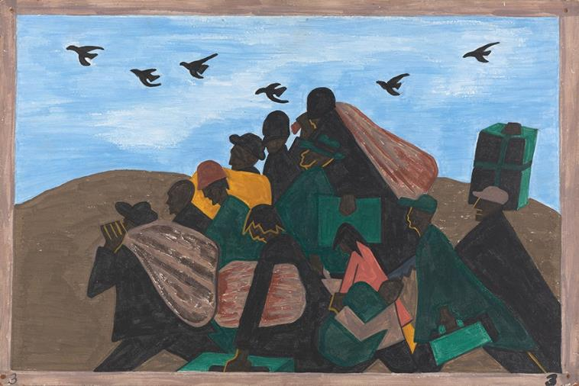
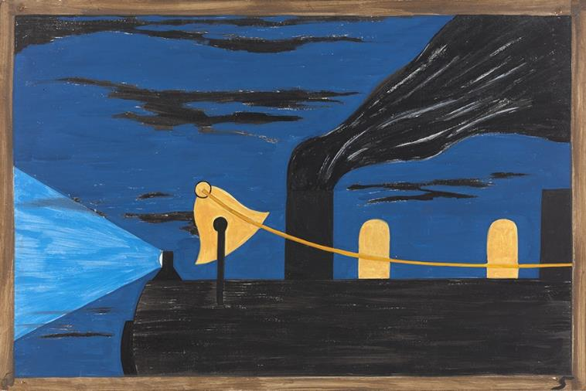
Introduction
Routinely, academic emphasis has been placed upon white Appalachian out-migration. Following the Civil War, African Americans also fled the Jim Crow South in record numbers, relocating to industrial centers like Cincinnati, Dayton, Cleveland, Detroit, St. Louis, Pittsburgh, and Chicago where they found work and a level of social acceptance.
3. From every southern town migrants left by the hundreds to travel north. 1940-41
5. Migrants were advanced passage on the railroads, paid for by northern industry. Northern industry was to be repaid by the migrants out of their future wages. 1940-41

Slide 8
Out - Migration
Between 1910 and 1960, millions of Southerners, black and white, left their home states of Tennessee, Kentucky, the Carolinas, Virginia, and West Virginia.
Black migration from the South saw 6 million African Americans relocate to the urban Northeast, Midwest, and West.
Out-migration saw Appalachians taking foodways, music, stories, social and cultural norms to their new hometowns and cities.
The out-migration of African Americans helped seal the image of Appalachia as a “white man’s country.”

Slide 9
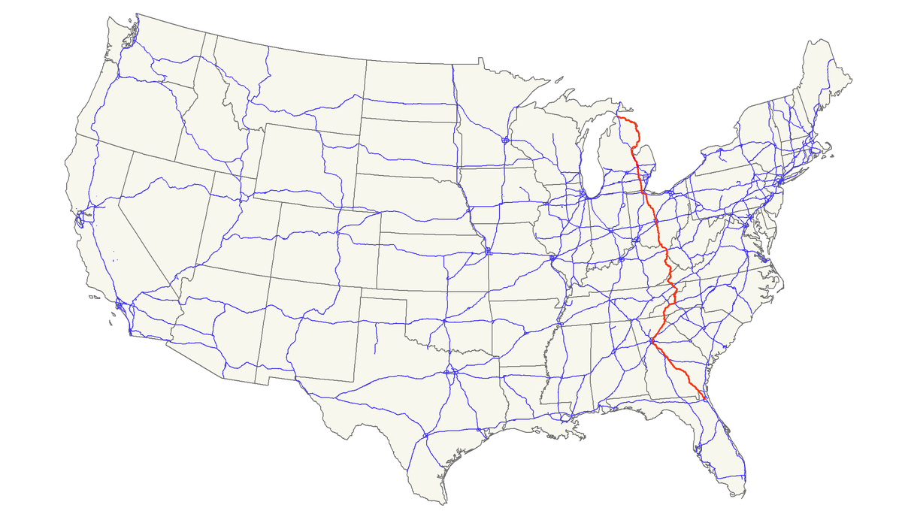
“Hillbilly Highway”
“The Hillbilly Highway” - a parallel to the African-American “Great Migration” from the South.

Slide 10
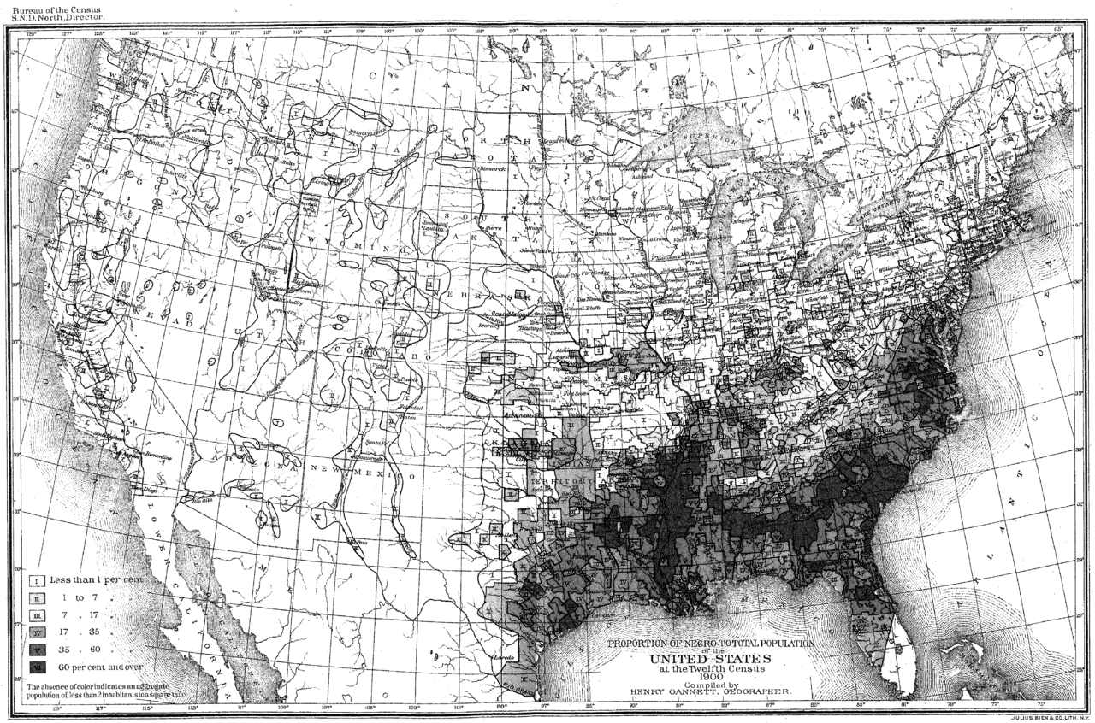
America’s Black Population -1910 Census
1780-1910
90% of all African Americans lived in the South. By the 1970s, African Americans had established a new social and economic base outside the South within many American urban centers.

Slide 11
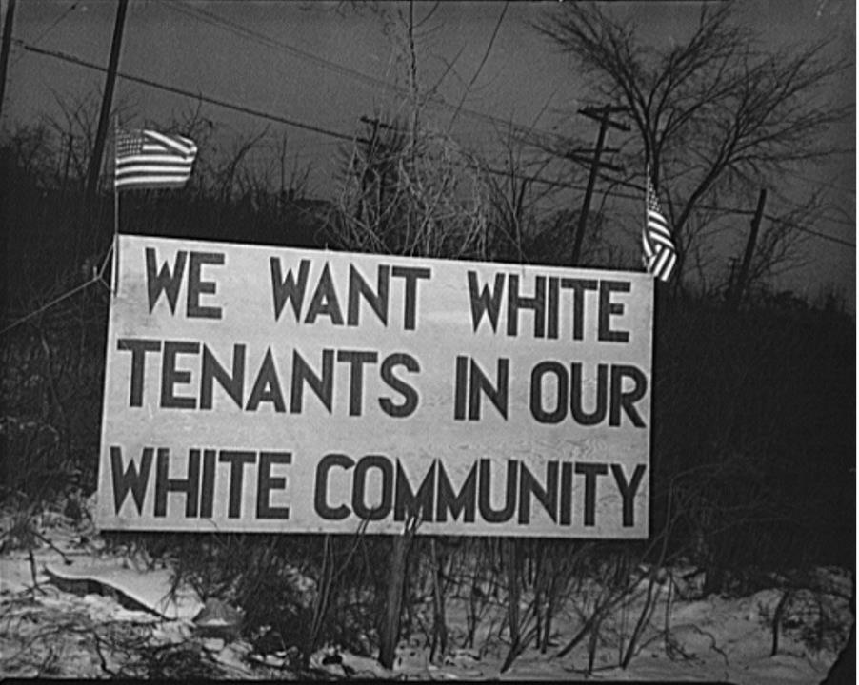
Examples of Where
African Americans established new, influential communities.
Metro Detroit and Flint, Michigan home to the nation’s largest black Appalachian populations, primarily from Kentucky.
Racism divided working class Detroit, culminating in the 1943 Detroit race riot. 25 African-Americans were murdered, hundreds injured, mostly at the hands of white police officers.
The riot was suppressed with 6,000 federal troops.
Sign posted in response to proposed Detroit Sojourner Truth Housing Project, February 1942. Image courtesy Arthur S. Siegel -https://commons.wikimedia.org/w/index.php?curid=20143418

Slide 12
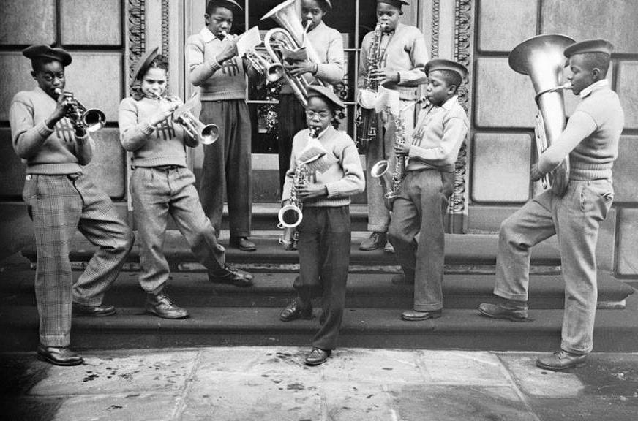
Where, cont’d
Pittsburgh, Pennsylvania African American/Multiracial Settlements:
  Hill District, up to World War I, the cultural center of black life in Pittsburgh
  Homewood, 98.3% African American
  Lincoln-Lemington-Belmar
  Larimer, East Hills, and Hazelwood
Pittsburgh’s “The Young Patriots” grew out of a hillbilly street gang known as the Peace Makers who initially wore the Confederate flag, but eventually stopped wearing the flag out of respect for the Black Panthers.
https://www.visitpittsburgh.com/blog/jazz-history/

Slide 13
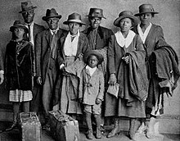
Where, cont’d
The culture of Chicago was significantly influenced by the racially mixed culture and politics of Appalachia.
By the 1950s and 1960s, the Uptown neighborhood of Chicago gained a reputation as a "Hillbilly Heaven". There was still a substantial Appalachian presence in Uptown in the 1970s; by the 1990s the Appalachian community had largely dissipated.
1930s Chicago arrivals

Slide 14
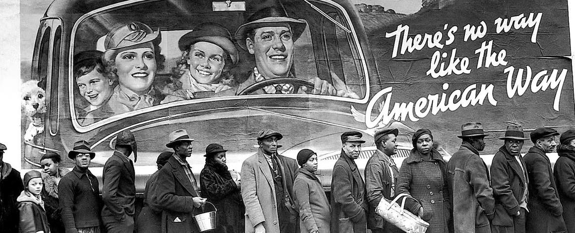
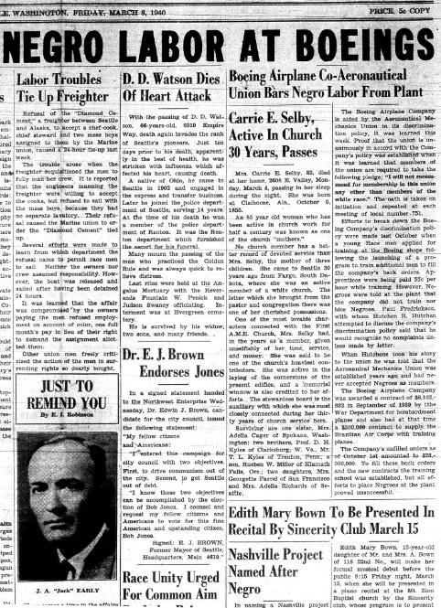
Jim Crow Laws

Slide 15
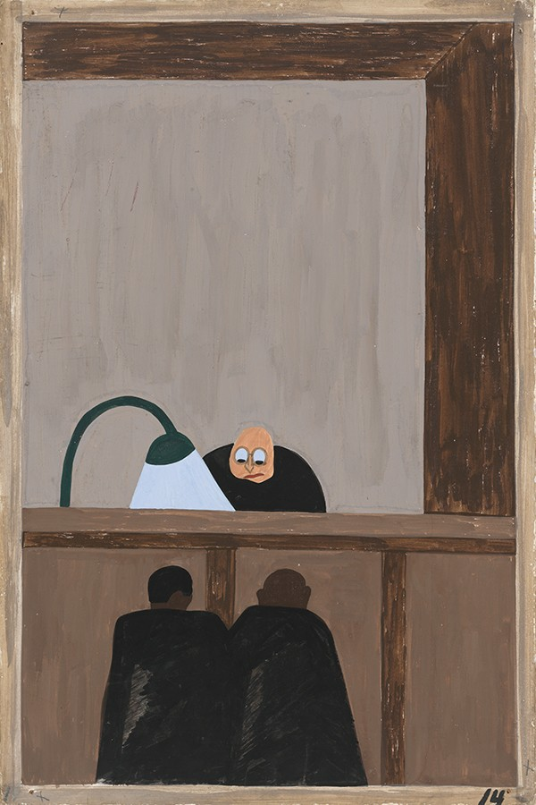
The Why
Causes of black out-migration:
  Racial Segregation
  Jim Crow laws
  Increased social, political, and physical violence
  Land loss
  Lack of upward mobility
  Unemployment
14. For African Americans there was no justice in southern courts. 1940-41

Slide 16
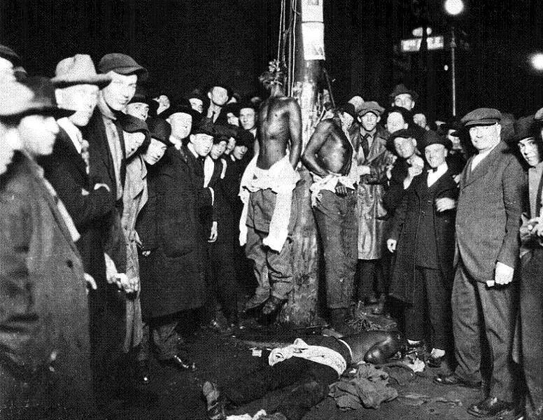
Racial Violence
Nearly 3,500 African Americans were lynched between the years 1888 and 1968.
1877-1950: Central Appalachia Lynchings:
  Kentucky 168
  Tennessee 233
  North Carolina 123
  Virginia 84
1900: NC Congressman George White introduces America’s first anti-lynching bill.
A white mob lynched three black circus roustabouts, Elias Clayton, Elmer Jackson, and Isaac McGhie in Duluth, Minnesota, in 1920.

Slide 17
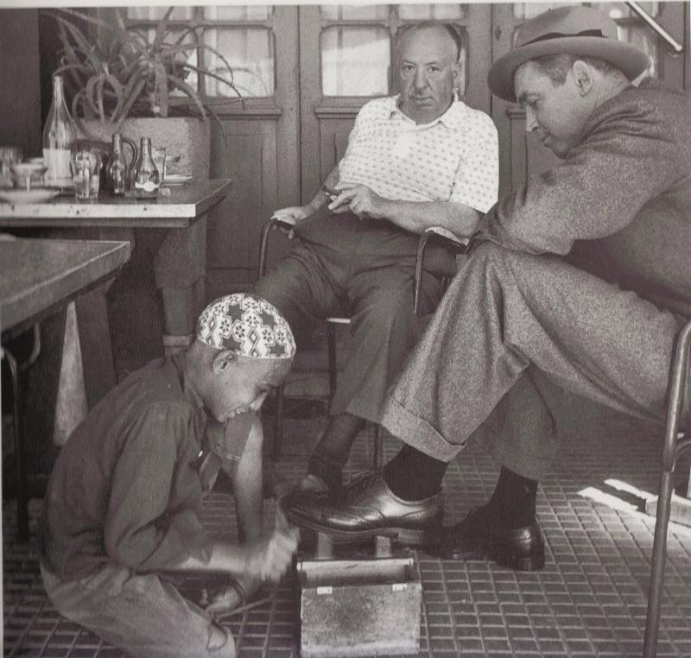
Psychological Impact
The traumatic experience of surviving mass violence creates “insecurity, mistrust, and disconnection from people”—psychological harms that were amplified by the dangers inherent in navigating American racial boundaries.
African American migrants faced institutional inequality, continued marginalization, and unaddressed histories of trauma, which created a legacy of chronic generational poverty, persistent urban distress, debilitating violence, and limited educational opportunities.

Slide 18
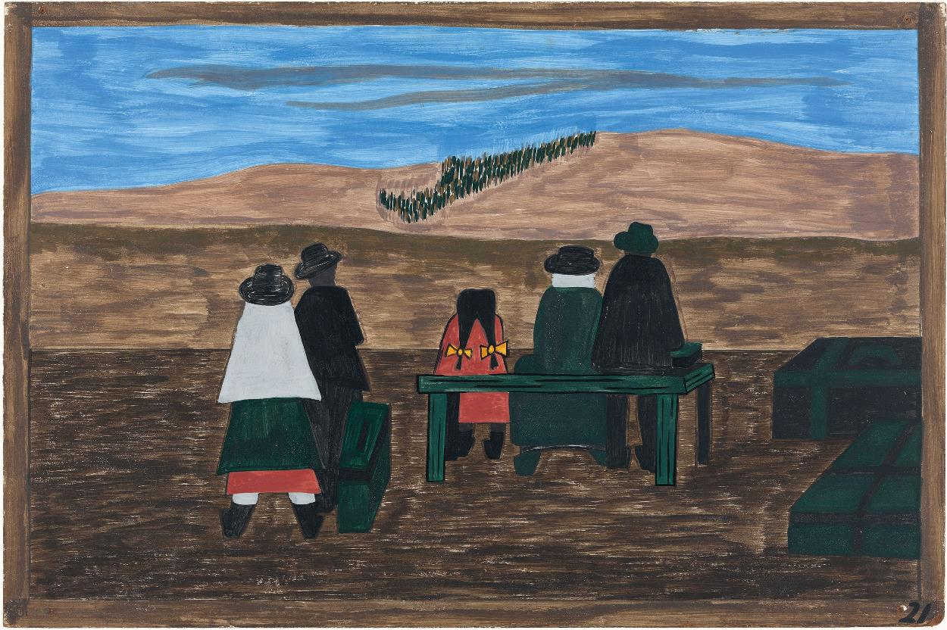
Transplanting Folkways
21. Families arrived at the station very early. They did not wish to miss their trains north. 1940-41

Slide 19
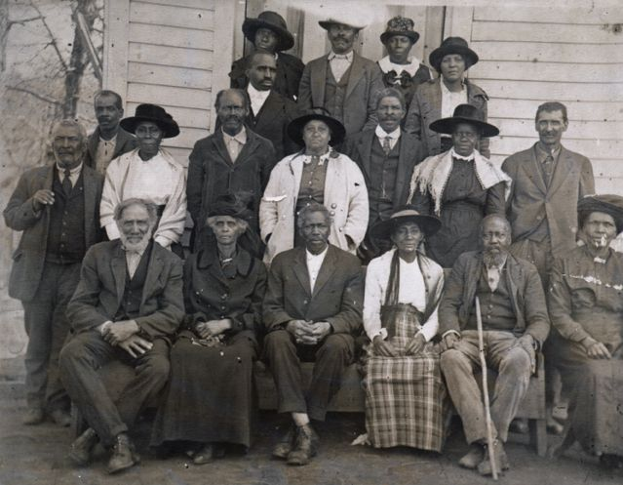
Religion
A 1973 New York Times article claimed that churches were a unifying gathering place for Appalachian people, referring to "the city's fundamentalist churches that perpetuate the frontier faith of the hills", alluding to Protestant and Evangelical denominations of Christianity such as Pentecostalism which involve emotionally expressive forms of worship, faith healing, and belief in literal notions of Heaven and Hell.

Slide 20
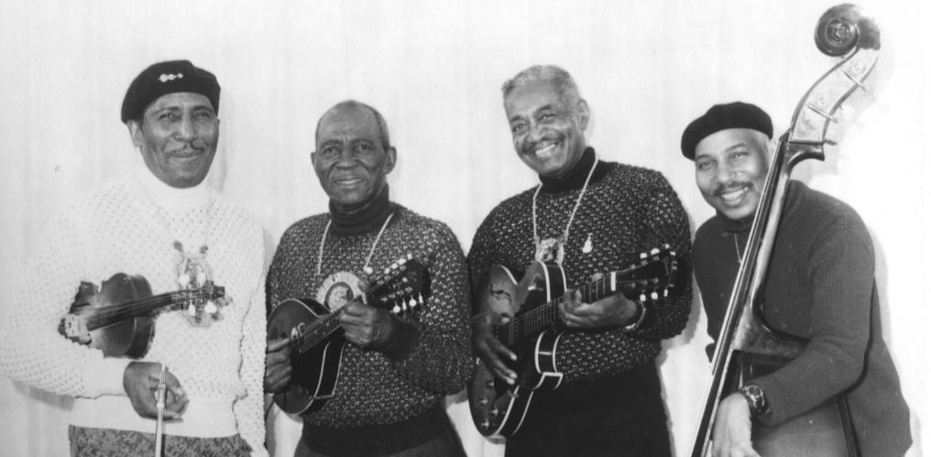
1934-Present, National Folk Festival
National Folk Festival founded in St. Louis, MO 1934
Popular Folk Festival headliner Appalachian String Band Martin, Bogan and Armstrong, Knoxville, TN
The men met in 1930 in Knoxville, Tennessee, then a gathering place for street musicians and string bands.
1974 National Folk Festival - Carl Martin, Big Stone Gap, VA on guitar and mandolin; Ted Bogan, Spartanburg, SC on sock-style rhythm guitar; Howard Armstrong, Dayton, TN on fiddle and mandolin, and Howard’s son Tom on bass.

Slide 21
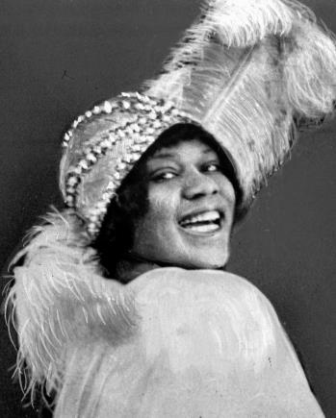
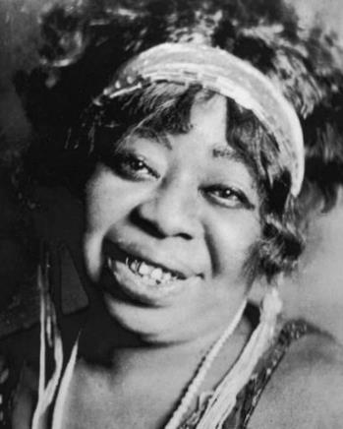
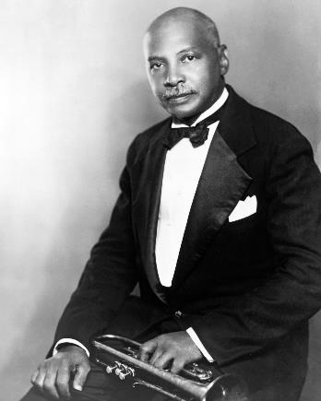
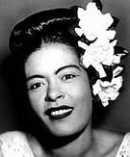
Music of the Day
Blues, Jazz, Ragtime
Bessie Smith (1894-1937) “Empress of the Blues,” Chattanooga, TN
W. C. Handy “Father of the Blues,” (1873-1958), Memphis, TN
Gertrude Pridgett aka “Ma Rainey” (1886-1939), Columbus, GA
Billie Holiday aka “Lady Day” (1915-1959), Philadelphia, PA
Bessie Smith
“Ma Rainey”
W. C. Handy
Billie Holiday

Slide 22
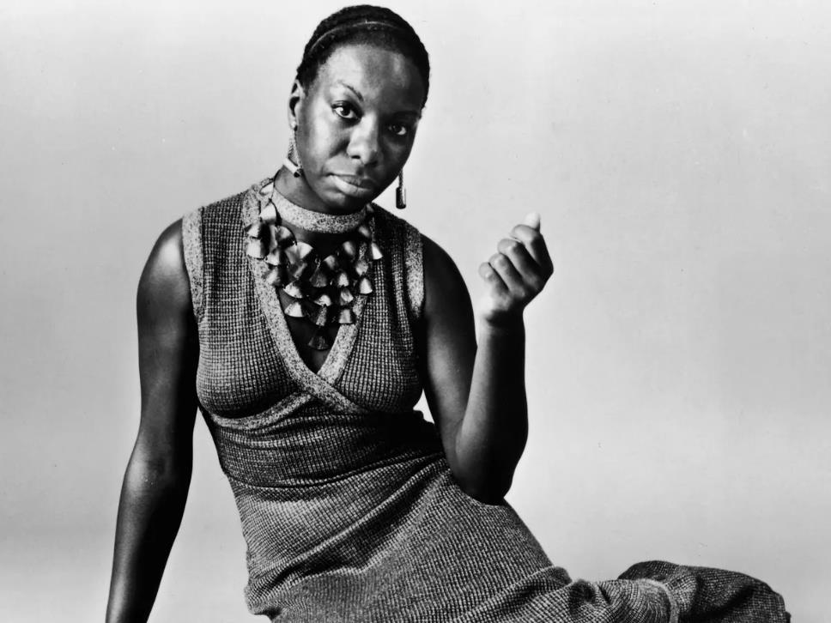
Modern Artists
Nina Simone (1933-2003), birth name Eunice Kathleen Waymon, born in Tryon, NC with today’s population total of about 1600 people.
Born into a poor family, the sixth of eight children. Waymon (Simone) went on to become one of the world’s most celebrated musical artists, performers, and civil rights activists.

Slide 23
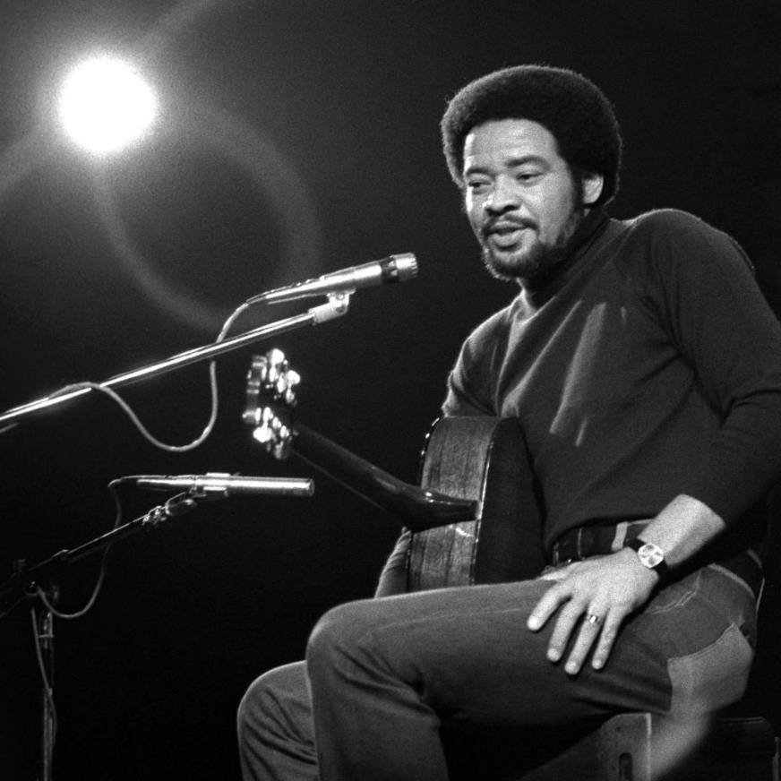
Modern Artists, cont’d
Bill Withers (1938-2020), born in Slab Fork, West Virginia, a town of about 200 residents.
The youngest of six children, Withers was raised in nearby coal mining town of Beckley. Withers’ father, a miner, died when Withers was 13.
At 17, Withers’ enlistment in the U. S. Navy was his ticket out of Appalachia.

Slide 24
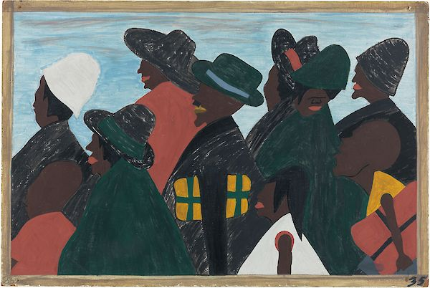
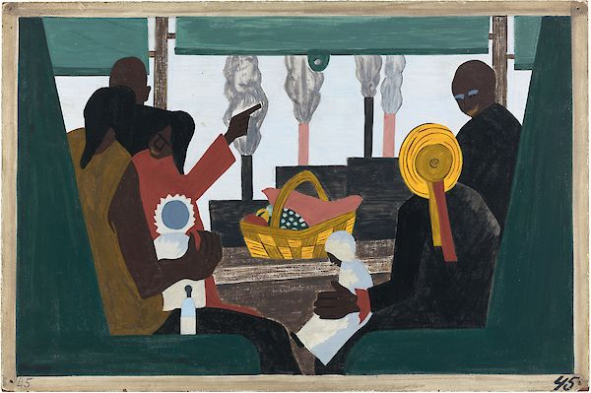
New Economic and Social Opportunities
35. They left the South in great numbers. They arrived in the North in great numbers. 1940-41
45. The migrants arrived in Pittsburgh, one of the great industrial centers of the North. 1940-41

Slide 25
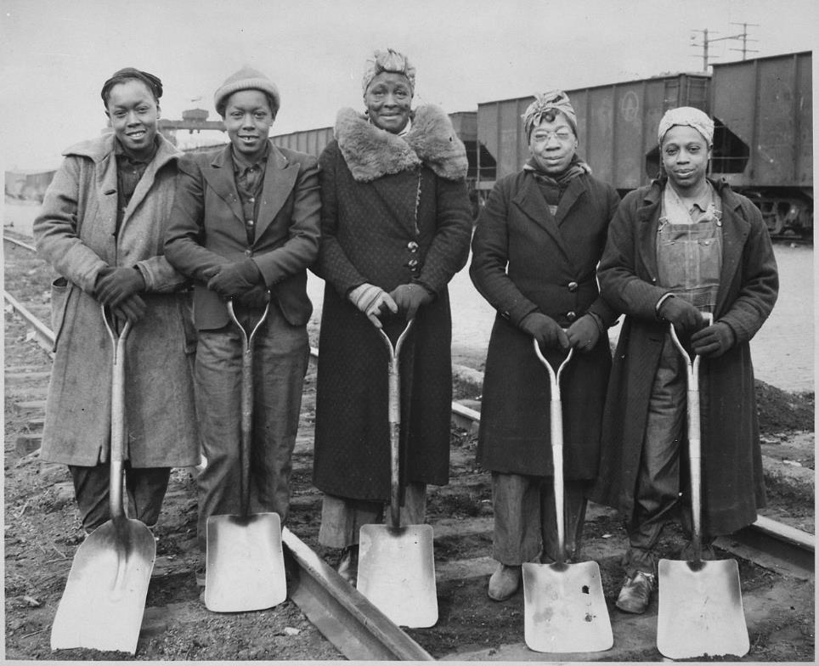
Women in the Labor Market
The “mine wars” in Mingo and Logan counties, West Virginia from 1919 to 1921 produced the largest armed confrontation in U.S. labor history.
Logan County Sheriff Don Chaffin was paid $32,700 a year (worth about $400,000 today) by mine owners to keep out union organizers.
1943 Track Women, Baltimore & Ohio RR

Slide 26
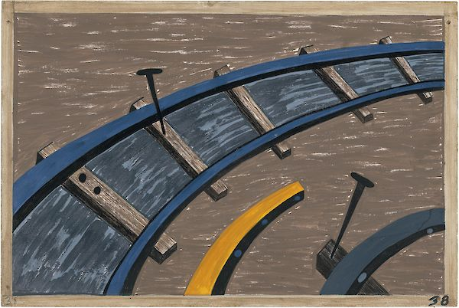
Labor Wars
By 1930 there were over 55,000 Black coal miners, which made up 53% of Alabama’s coal diggers.
By the 1930s, 22,000 African Americans were employed in West Virginia coal mines.
Black and white coal miners fought side-by-side in Appalachian coal mining wars and union organizing efforts.
Industrial growth drew black Appalachians from the region and mining, to the North.
38. They also worked on the railroads. 1940-41

Slide 27
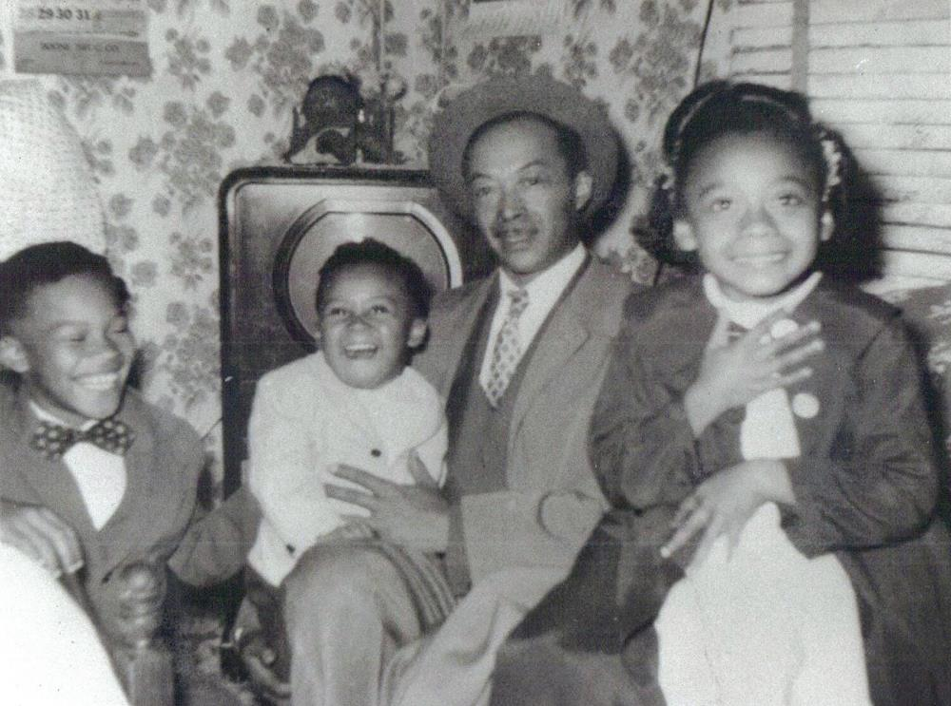
Birth of Urban Reformers
Newcomers to cities were oppressed by overcrowding, poverty, slums, and crime.
Social conditions gave birth to a new generation of black reformers.
By 1913, African Americans supported 100 orphanages in the United States, had established “law and order” leagues to curb crime and regulate saloons, and established social organizations to aid black education, healthcare, housing.

Slide 28
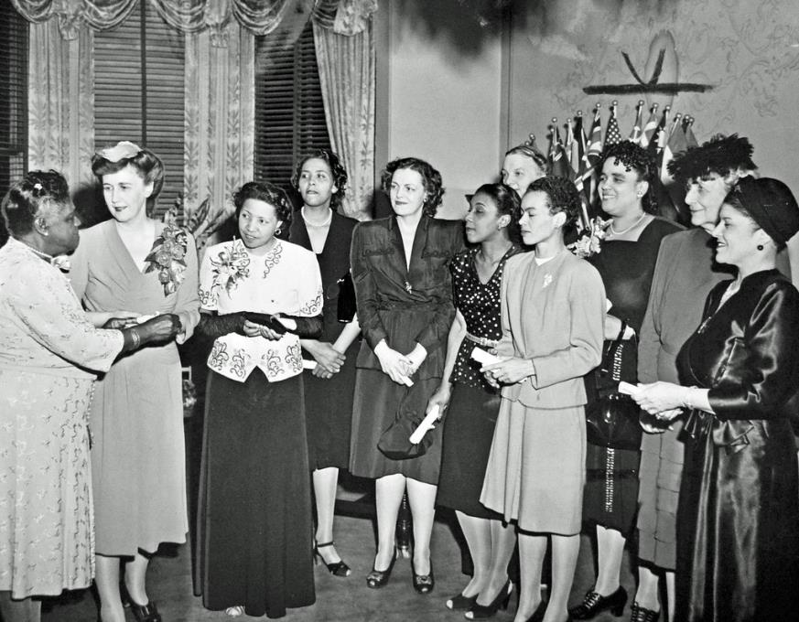
National Council of Negro Women
A nonprofit organization founded in 1935 with the mission to advance the opportunities and the quality of life for African American women, children, their families, and communities.
Founded by Mary McLeod Bethune to encourage the participation of Negro women in civic, political, economic, and educational activities and institutions.
Served as a clearing house for the dissemination of activities concerning black women.
1946 awardees of the “Public Good” Award by Bethune.

Slide 29
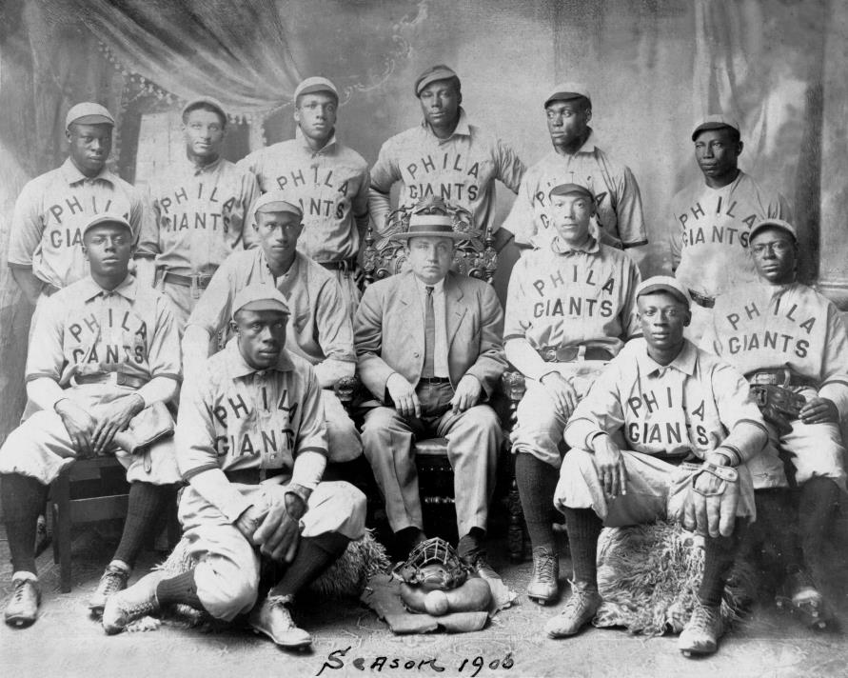
1920-1958 Negro Baseball League
Immediately following the Civil War, black baseball formed in the East and Mid-Atlantic states.
Comprised mainly of ex-soldiers and promoted by some well-known black officers, the Albany Bachelors, Philadelphia Excelsiors, and Chicago Uniques started playing each other and any other team willing to play against them.

Slide 30
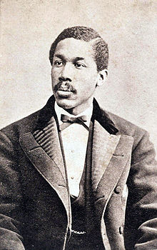
Negro Baseball League, cont’d
By the end of the 1860s, the black baseball mecca was Philadelphia.
Octavius Catto, the promoter of the Philadelphia Pythians, was denied membership in the National Association of Base Ball Players. However, “Blackball” thrived earning their income from playing white independent “semipro” clubs.
Octavius Catto (1839-1871)

Slide 31
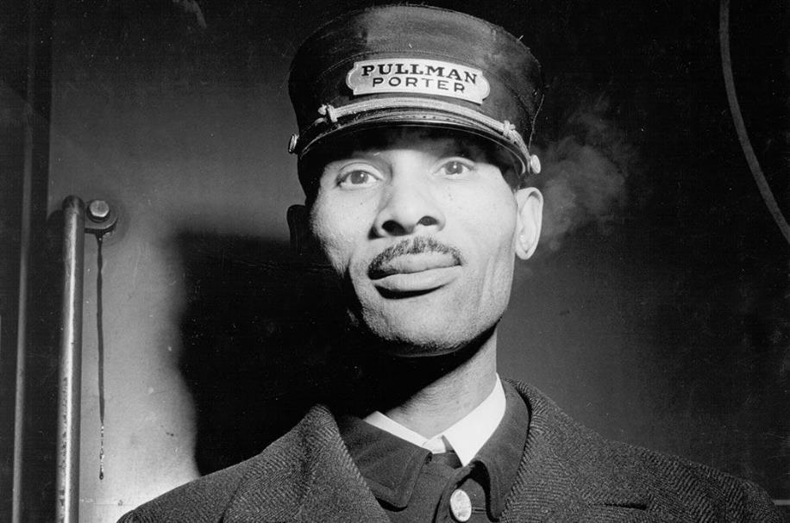
1867–1969 Pullman Porters and Civil Rights
America’s first all-black Union
By the mid-1890s, the American Railway Union had organized most Pullman employees, but refused to include black workers, including porters.
Formed in 1925, the Brotherhood of Sleeping Car Porters (BSCP) was organized by A. Philip Randolph, the social activist and publisher of the political and literary magazine The Messenger.
1943 Pullman Porter, Chicago, IL

Slide 32
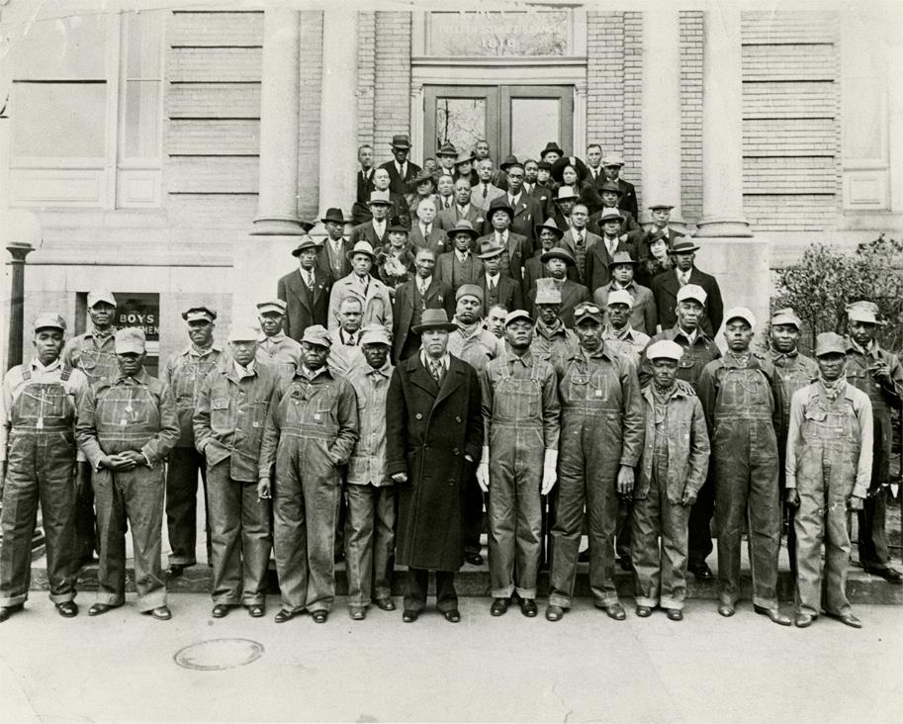
United Mine Workers, Teamsters, etc.
Most unions excluded black membership. At times, even using contract negotiations, and the threat of job actions or strikes, to compel employers to bar or limit the number of black workers.
Founded in Pittsburgh, PA in 1935, following the BSCP victory, the emergence of the CIO (Congress of Industrial Organizations) as a more inclusive alternative, or rival, to the AFL meant that tens of thousands of black workers joined unions in the auto, steel, packinghouse, and other industries.
Numerically, they vastly outnumbered porters and unionized black railroad workers.

Slide 33
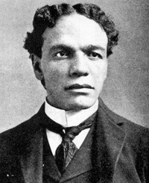
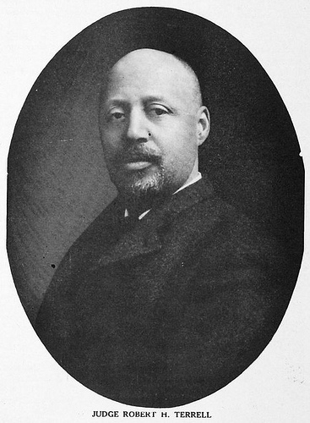
The “Progressive Era”
“Teddy” Roosevelt introduces the “Square Deal” which did not speak out forcefully against American lynching or discrimination.
President William H. Taft appointed an advisory “Black Cabinet” consisting of:
  Poet and diplomat, James Weldon Johnson
  Educator Booker T. Washington
  Attorney William H. Lewis, Assistant Attorney General of the United States
  Harvard graduate, attorney Robert Terrell.
Amherst graduate William H. Lewis (1868-1849) America’s first black Assistant Attorney General
Harvard graduate Judge Robert Terrell (1857-1925) appointed first American judge in Washington, DC

Slide 34
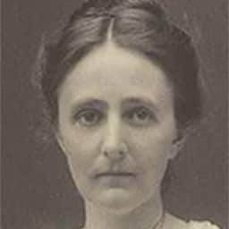
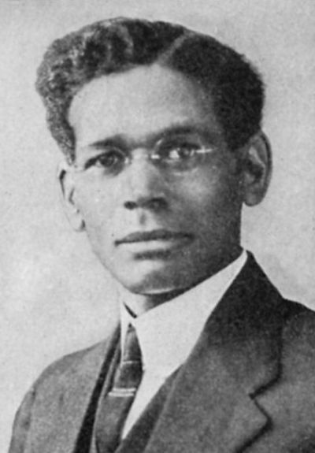
Growth of NAACP and the Urban League
New York scholar and Fisk graduate Dr. George Haynes and Ruth Standish Baldwin sought to reduce black overcrowding and poverty in industrial centers.
In 1911 Haynes and Baldwin joined with other black and white leaders to establish the Urban League to improve the health, housing, job, and recreational opportunities of African Americans.
Their basic goal: “inter-racial cooperation”
Ruth Standish Baldwin
(1865-1934), wife of railroad tycoon, William Henry Baldwin.
Dr. George E. Haynes (1880-1986)

Slide 35
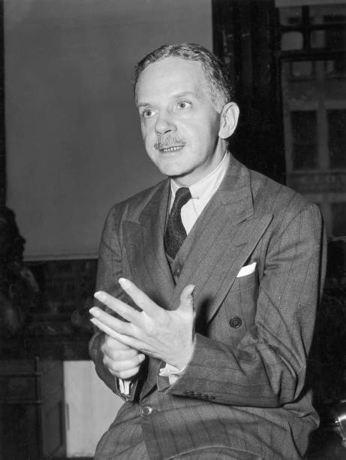
NAACP
1905: W. E. B. DuBois organized the “Niagara Movement” in Niagara Falls, Canada to address civil rights issues of African Americans.
1908: a bloody Springfield, IL race riot killed several African Americans. Following, DuBois’ efforts were joined by black, white, and Jewish leaders to organize the NAACP.
1929: NAACP hires African American Walter White to investigate American lynching and hate crimes.
Walter White (1893-1955)

Slide 36
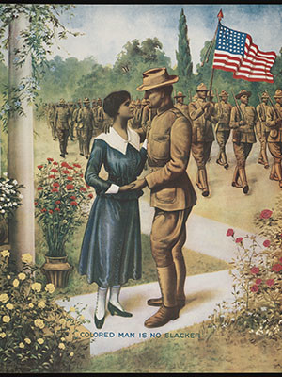
Impact of World War I
African Americans among the first to volunteer
100,000 African Americans sent overseas as stevedores, artillerymen, machine gunners, and infantrymen.
Kentuckian Colonel Charles Young appointed the highest ranking black officer in the Army.
Four black regiments awarded the French Croix de Guerre.
The 369th Infantry spent 191 days on the firing line, more time than any other American military unit.
1932: unemployed black veterans march on Washington DC

Slide 37
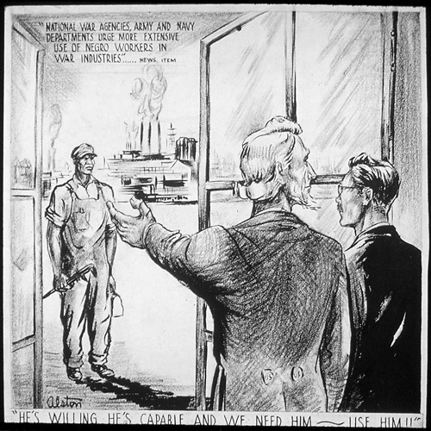
Impact of World War II
Black men served in every branch of the military.
Black women served as Army nurses, WACs, WAVEs, and SPARs.
7,000 black men and women served as officers
Contributing to the war effort, Dr. Charles Drew (1904-1950), a black surgeon in charge of the Red Cross Blood Bank, perfected the modern blood bank system. He died from blood loss when refused treatment at a Burlington, NC hospital following a car accident.

Slide 38
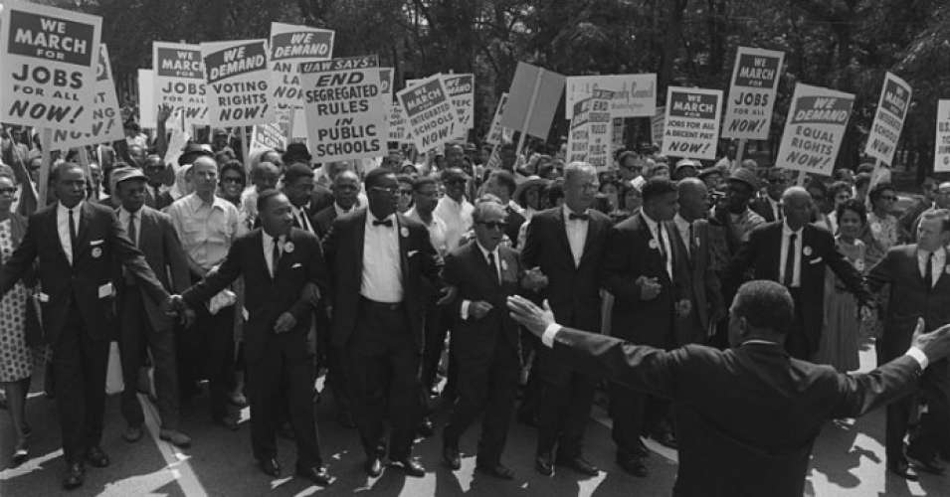
Labor and Civil Rights Leadership Unite

Slide 39
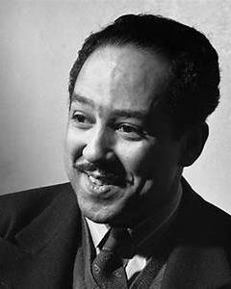
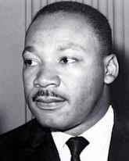
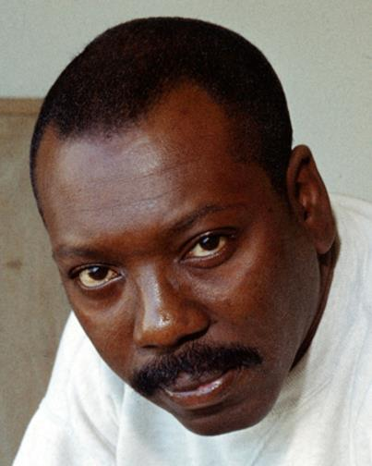
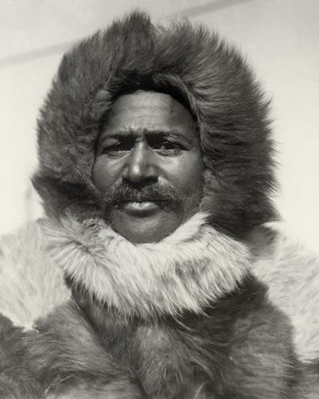
Pioneering Men of the 20th Century
Novelist, Playwright, Social Activist Langston Hughes (1901-1967)
Civil Rights Activist Rev. Martin Luther King, Jr.
(1929-1968)
Artist Jacob Lawrence
(1917-2000)
Explorer Matthew Henson (1866-1955)
Reached the North Pole in 1909

Slide 40
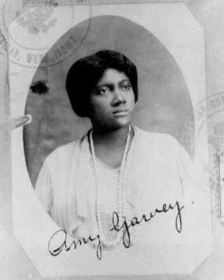
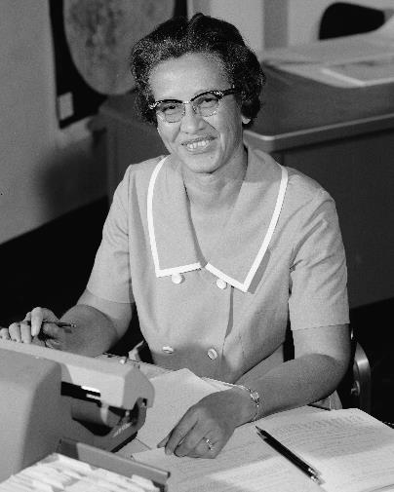


Pioneering Women of the 20th Century
Pan-Africanist and Activist Amy Ashwood Garvey (1897-1969)
NASA Mathematician Katherine Johnson (1918-2020)
Gospel Singer Mahalia Jackson (1911-1972)
Poet, Memoirist, and Activist Maya Angelou (1928-2014)

Slide 41

Struggle for Labor and Civil Rights
World War I and World War II pulled black migrants North, to fill labor shortages in northern factories brought about by war.
As a result, thousands of African American men and women gained employment in steel mills, railroads, meatpacking plants, and the automobile industry.
Successfully established a black American middle class.

Slide 42

Birth of the American Civil Rights Movement
The Civil Rights Movement starts in the 1950s as returning African American World War II veterans demand equal rights.
Many questioned how they could fight to protect a country that refused to honor their civil liberties.
The 1950s saw the rise of Martin Luther King Jr. and the nonviolent protest movement
Rosa Parks’ 1955 groundbreaking decision not to give up her bus seat to a white man in Montgomery, Alabama.

Slide 43

1957 Birmingham Bus Boycott
On December 20, 1956, Reverend Fred Shuttlesworth and members of the Alabama Christian Movement for Human Rights demanded Birmingham do away with Jim Crow bus laws.
On Christmas Day of that year, Shuttlesworth’s Birmingham home was bombed.
The Shuttlesworths’ fortunes turned for the better when they affiliated with the Southern Christian Leadership Conference in 1957. Shuttlesworth connected immediately with SCLC leaders Rev. Martin Luther King Jr. and Ralph Abernathy, combining their missions for the greater good.
Rosa Parks’ arrest photo, 1955

Slide 44
Thank you for joining us today!
We are partnering with the National Humanities Alliance to document the impact of the Freedom Stories initiative. Your feedback is very important in this regard. Please visit www.StorytellingCenter.net/FreedomStories
to complete this important survey!
Responses are voluntary and confidential. Thank you!

Slide 45
For more information on this and other Freedom Stories events, please contact us.
Web: www.StorytellingCenter.net/FreedomStories
Email: FreedomStories@StorytellingCenter.net
Join us again Saturday, May 8 at 1:00pm (Eastern) for our next public discussion.

Slide 46




Today’s Music
“Crossroads” written by Robert Johnson, 1936. Recorded by James “Sparky” Rucker. From the album American Folk Blues Festival ’83 by L+R Records ©1992
“Summertime” written by George Gershwin, Ira Gershwin, and DuBose Heyward, 1935. Recorded by Billie Holiday, 1936. From the album The Complete Billie Holiday by X5 Music Group ©2009
“Feeling Good” written by Anthony Newley and Leslie Bricusse, 1964. Recorded by Nina Simone, 1965. From the album I Put A Spell On You by Verve Reissues ©2018
“Grandma’s Hands” written and recorded by Bill Withers. From the album Just As I Am by Columbia/Legacy ©1971

Slide 47

Out-Migration: Spreading Appalachia Abroad
60. And the migrants kept coming. 1940-41

