Slide 1


Slide 2



This Freedom Stories discussion is being recorded for use by the International Storytelling Center (ISC.) This recording will be owned and managed by ISC and will be used for any educational purpose that ISC deems appropriate. By participating in this public discussion, you acknowledge this recording and its subsequent uses.
Closed captioning is provided today by ACS.

Slide 3

Freedom Stories
Unearthing the Black Heritage of Appalachia
This project is proudly supported by the National Endowment for the Humanities and produced by the International Storytelling Center.

Slide 4










Thanks and appreciation to our supporters:
Appalachian
African-American
Cultural Center
Black / White Dialogue
Langston Education and
Arts Development, Inc.
Leadership and Civic Engagement
Northeast Tennessee Tourism
Association (NETTA)

Slide 5
“Separate but Equal?
Race-based Bias in Education”
Freedom Stories
International Storytelling Center
March 13, 2021 1-2:30 p.m.

Slide 6
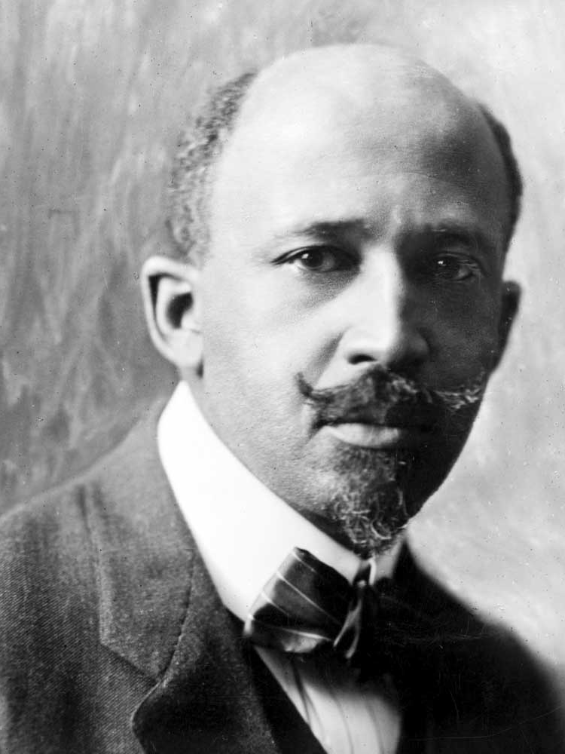
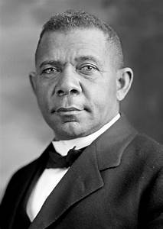
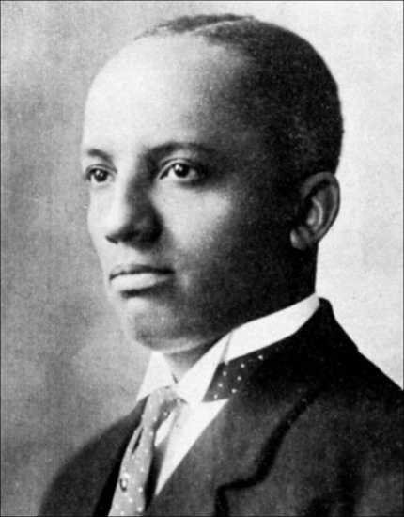

The American Educational System
1787-2021
W.E.B. DuBois
Booker T. Washington
Carter G. Woodson

Slide 7
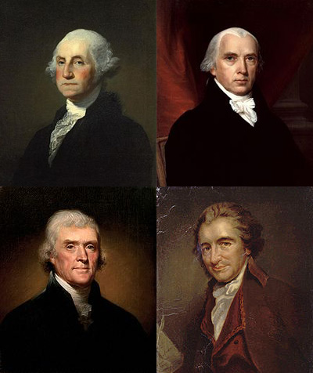
American Educational Policy and the Founding Fathers
Education is necessary to build a strong democracy.
Federal dollars should not support public education.
States are responsible for educating their citizens.

Slide 8
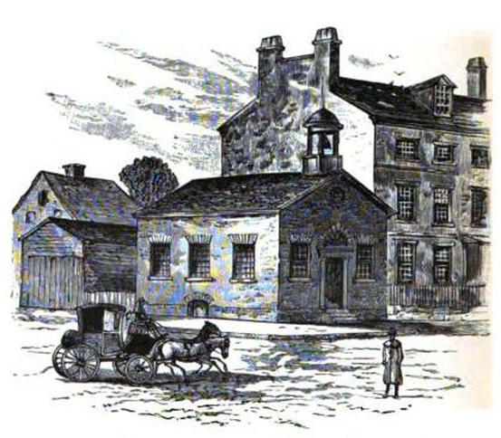
First Public School in America
Privately Funded
Established in Boston, Massachusetts, April 23, 1635
Boys Only
College Preparation
Every town of 50 families should have a public elementary school
Education not mandatory
Boston Latin Secondary School 1635-2021

Slide 9
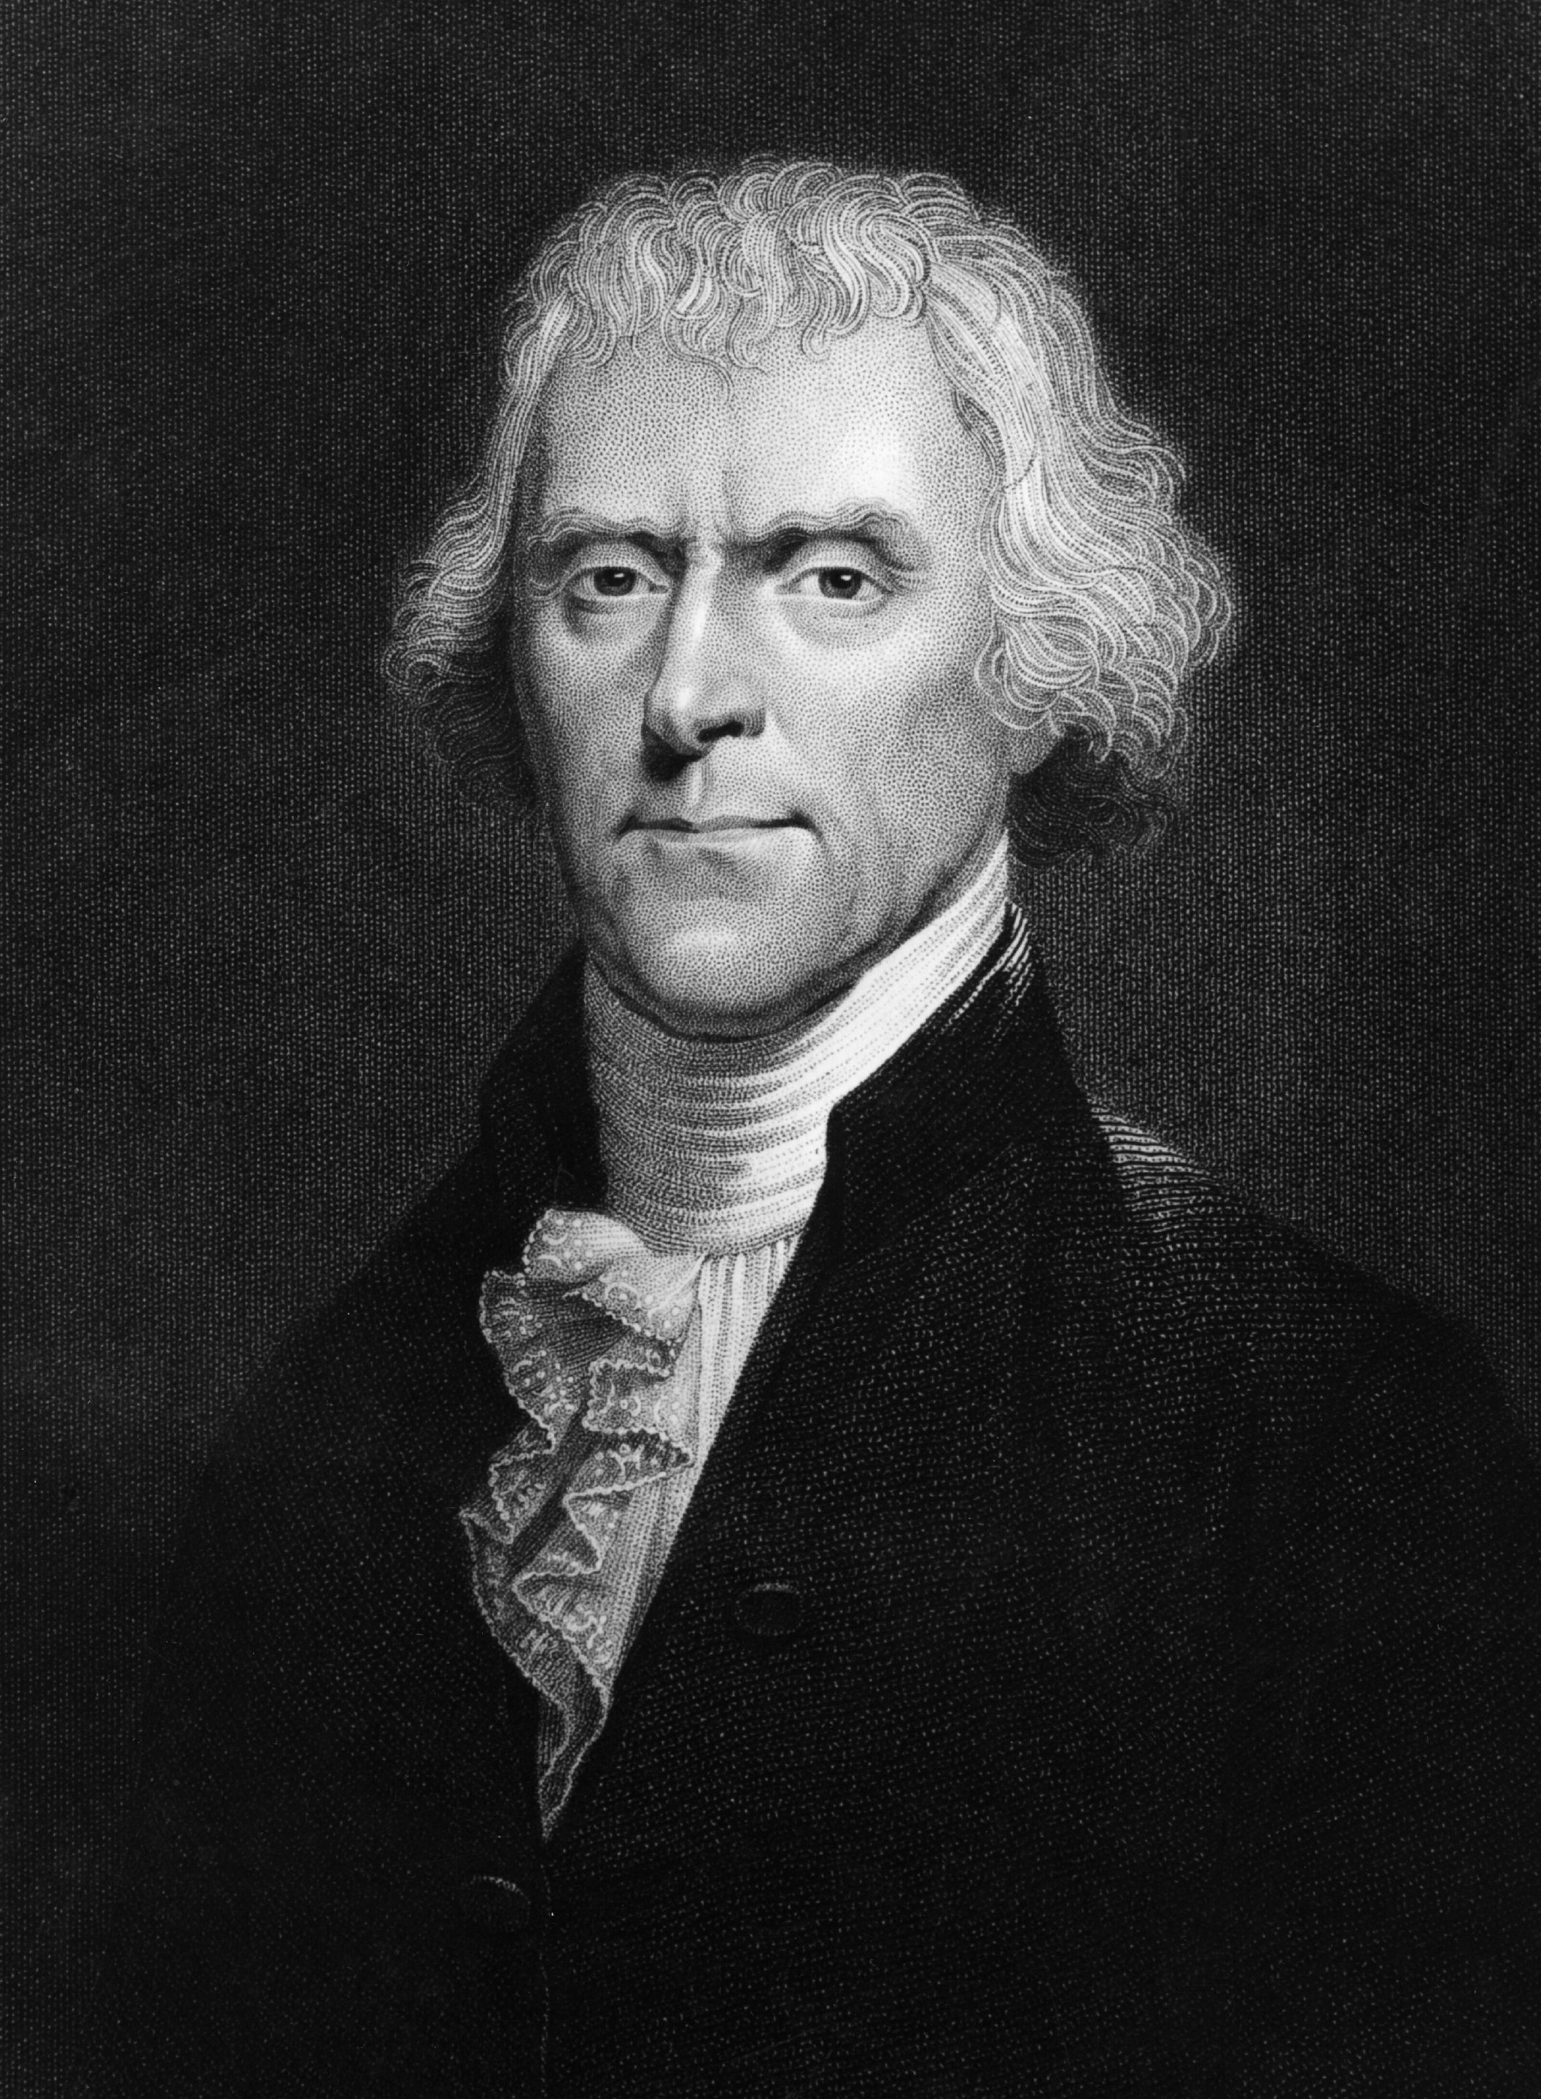
American Public Education
1779: Thomas Jefferson proposes an American educational system for the “laboring and the learned” in order to “rake a few geniuses from the rubbish.”

Slide 10
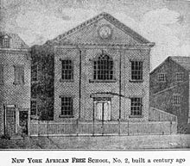
African Free School
Built by New York Manumission Society as a One-Room Schoolhouse, 1794, with 40 black students.
John Jay, Alexander Hamilton sponsors.

Slide 11
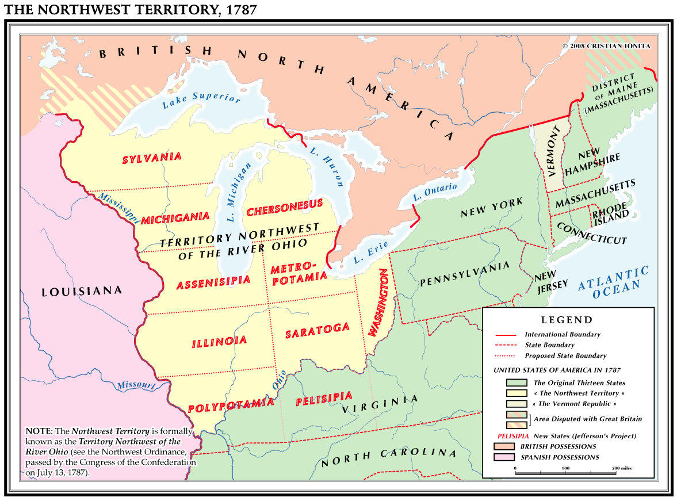
1787-1803:
The Northwest Territory

Slide 12
Northwest Territory, cont’d
The First “American” system of social organization
  All land held by fee simple
  Prohibition of slavery
  Established concepts of Universal Public Education - included the education of Indians.

Slide 13
American Public Education
Second Great Awakening religious reforms
Mandatory, free, public education
Traditional school subjects included moral principles and civics
1837: Horace Mann, Massachusetts Secretary of Education, reformed the state's school system, creating grade levels, common standards and mandatory attendance to ensure all citizens could become virtuous, educated voters.

Slide 14
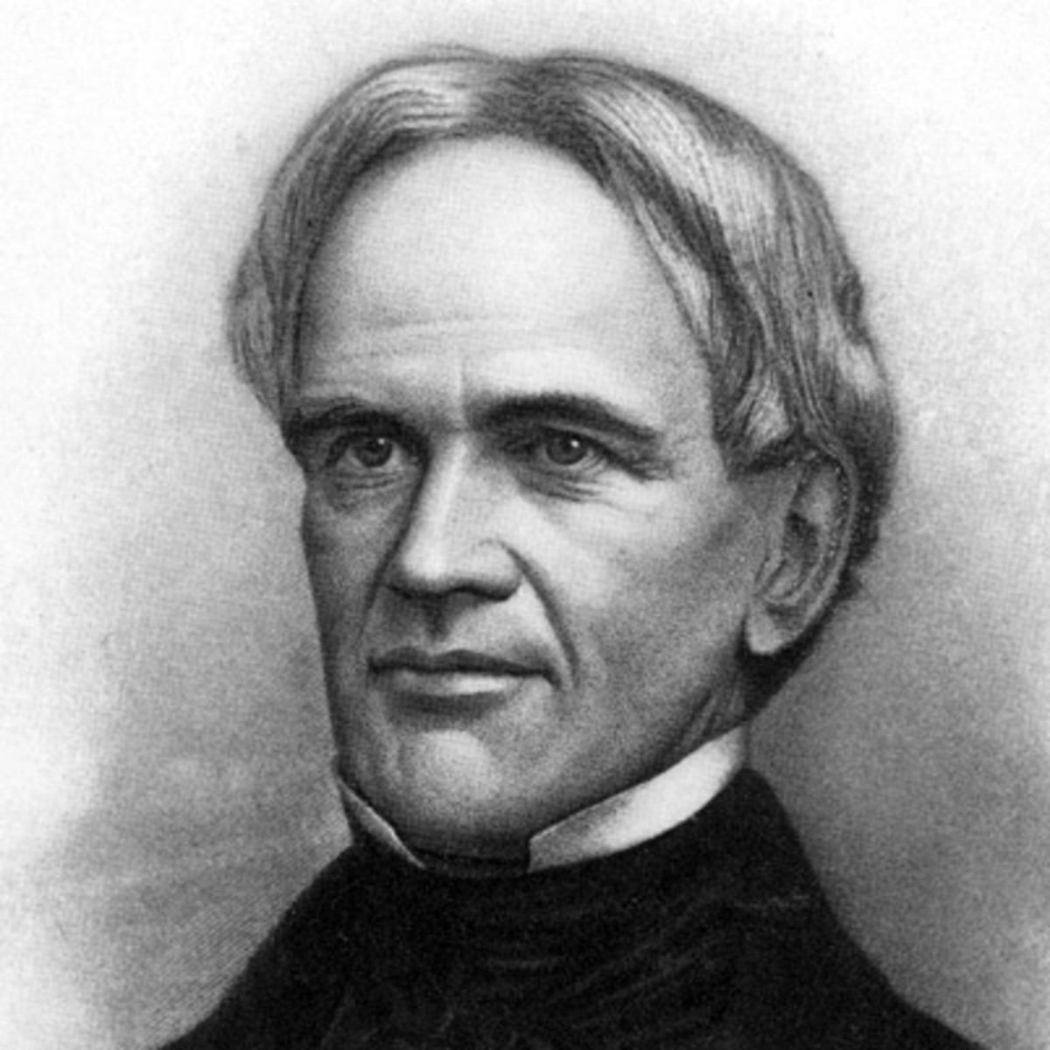
American Public Education, cont’d
Others states copied Horace Mann’s system, and by 1870, all states had tax-supported, locally controlled elementary schools, though attendance was still not mandatory.
None insured the education of Negroes
Horace Mann (1796-1859)

Slide 15
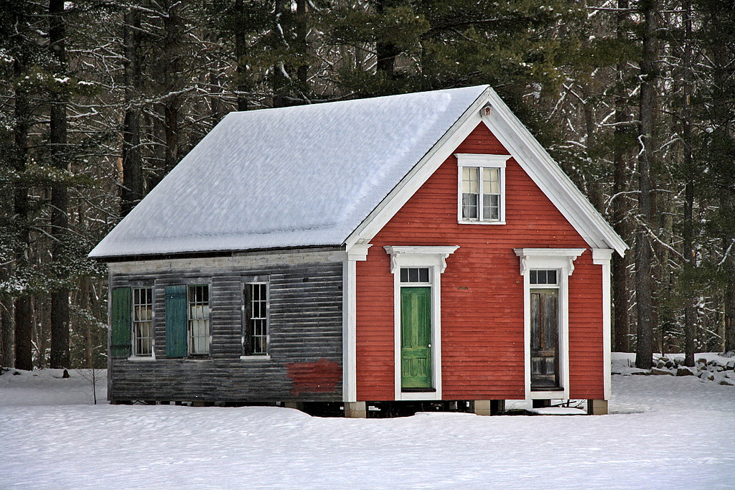
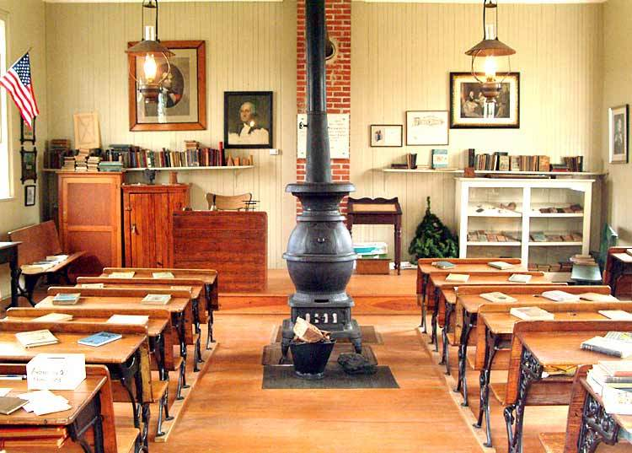
Birth of One-Room Schoolhouses
Northwest Territory Land Ordinance of 1785 innovated public education by reserving land for local public schools.
Birth of the One-Room Schoolhouse

Slide 16
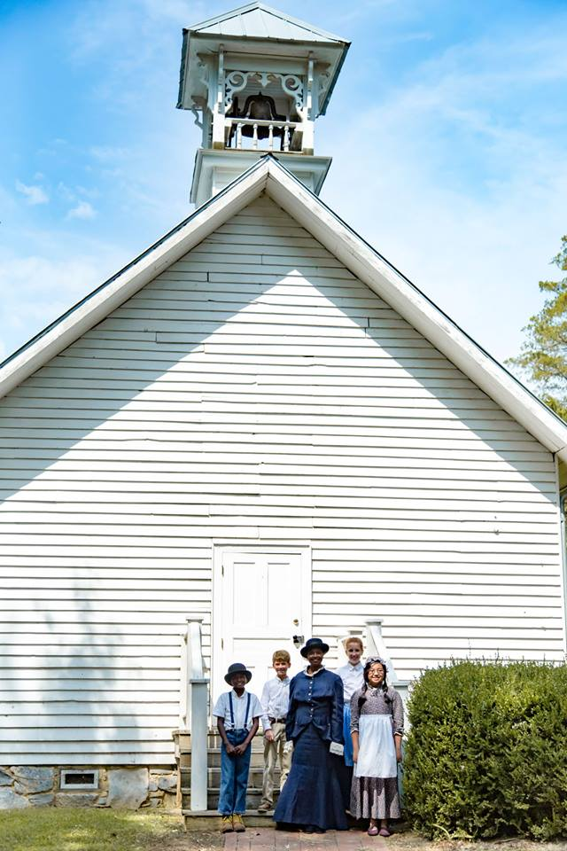
Education in the South
Private academies for the children of landed gentry and slaveowners
No provision for universal public education
Church sponsored education and subscription schools

Slide 17
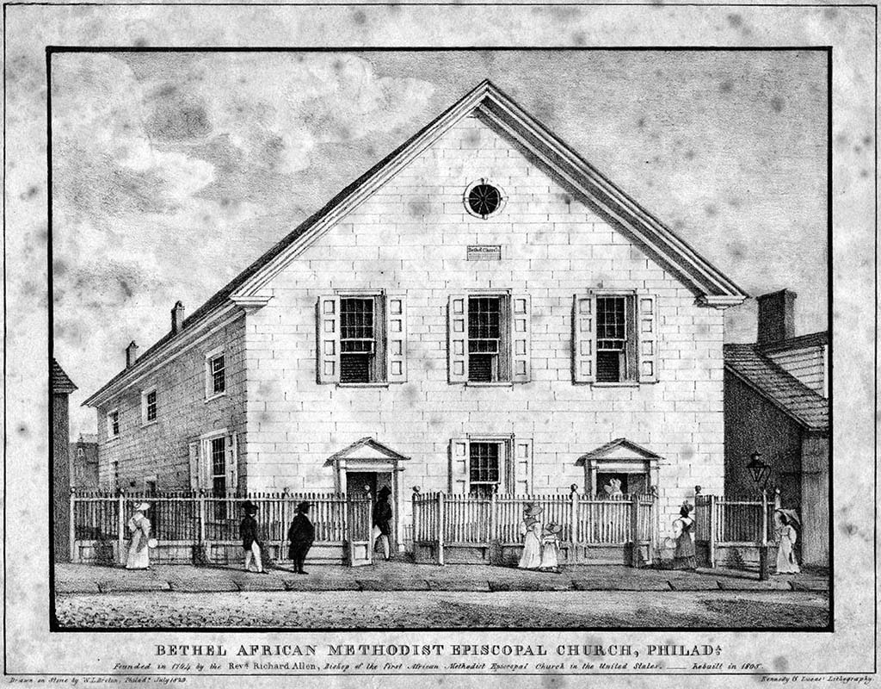
Black Education in America
Church-sponsored black schools emerged as early as 1815
African Institute, (Cheney College) becomes America’s first black school of higher education
Mother Bethel AME Church, Philadelphia, PA

Slide 18
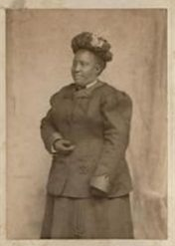

Black Education in America, cont’d
Sarah Mapp Douglass selected Cheney College’s first principal
Cheney established in 1837 by Blacks and Pennsylvania Quakers

Slide 19
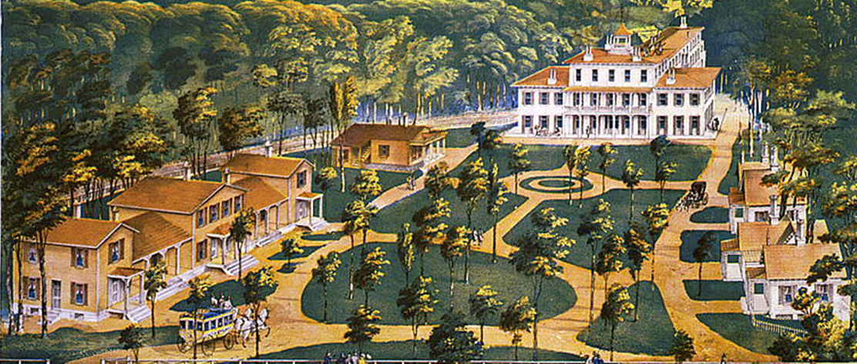
Wilberforce University, America’s first black-owned and operated college
Established 1856 near Xenia, OH. AME Bishop Daniel Payne, a founder and first president.
Image courtesy Library of Congress.

Slide 20
Growth of Industry = Growth of Black Education
1870: African American illiteracy rate is 79.9 percent
1897: Booker T. Washington makes an “Atlanta Compromise”
Education becomes essential to building a new American labor force.
Black students are to be “trained,” white students are to be “educated.”

Slide 21
American Reconstruction
1865-1877: African Americans mobilize to bring public education to the South for the first time.
End of the Civil War, African Americans align with white Republicans, rewriting state constitutions to guarantee free public education.
In practice, white children benefit more from the plan than black children.

Slide 22
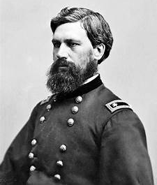
American Reconstruction, cont’d
1865-1874: General O. O. Howard makes black education a priority for the Freedmen’s Bureau until ousted by President Andrew Johnson
Freedmen’s Bureau funds poor southern white and black schools.
O.O. Howard, head of the Freedmen’s Bureau

Slide 23
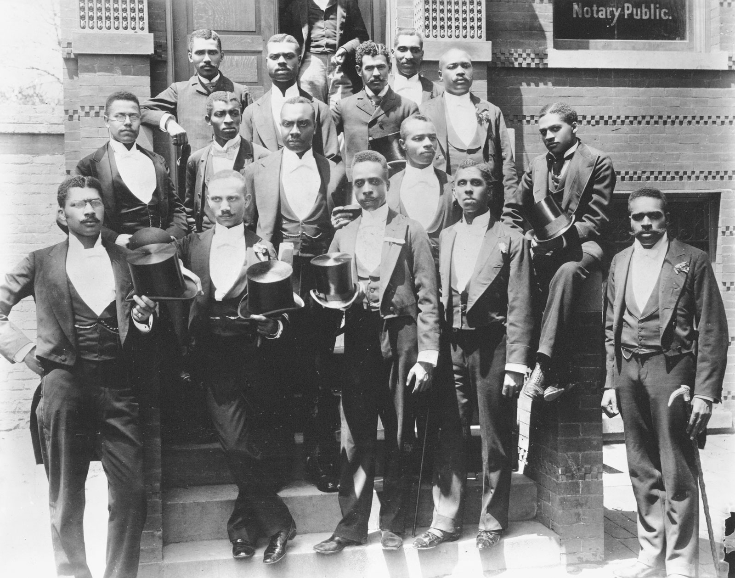
Freedmen’s Sponsored
Howard University
Established in 1867 as a theological seminary
General Oliver O. Howard first president, 1867-1874
America’s first black law school, medical college
1900 Howard University Law School Graduates.
Image courtesy Library of Congress

Slide 24
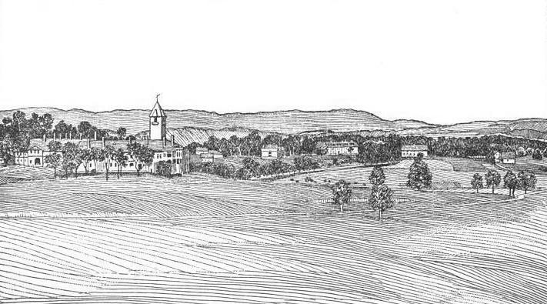
Lincoln University
Established 1896 by General O. O. Howard and others
To honor Lincoln and poor whites of East Tennessee, the majority of whom remained loyal to the Union
1915, Lincoln University, Harrogate, TN

Slide 25
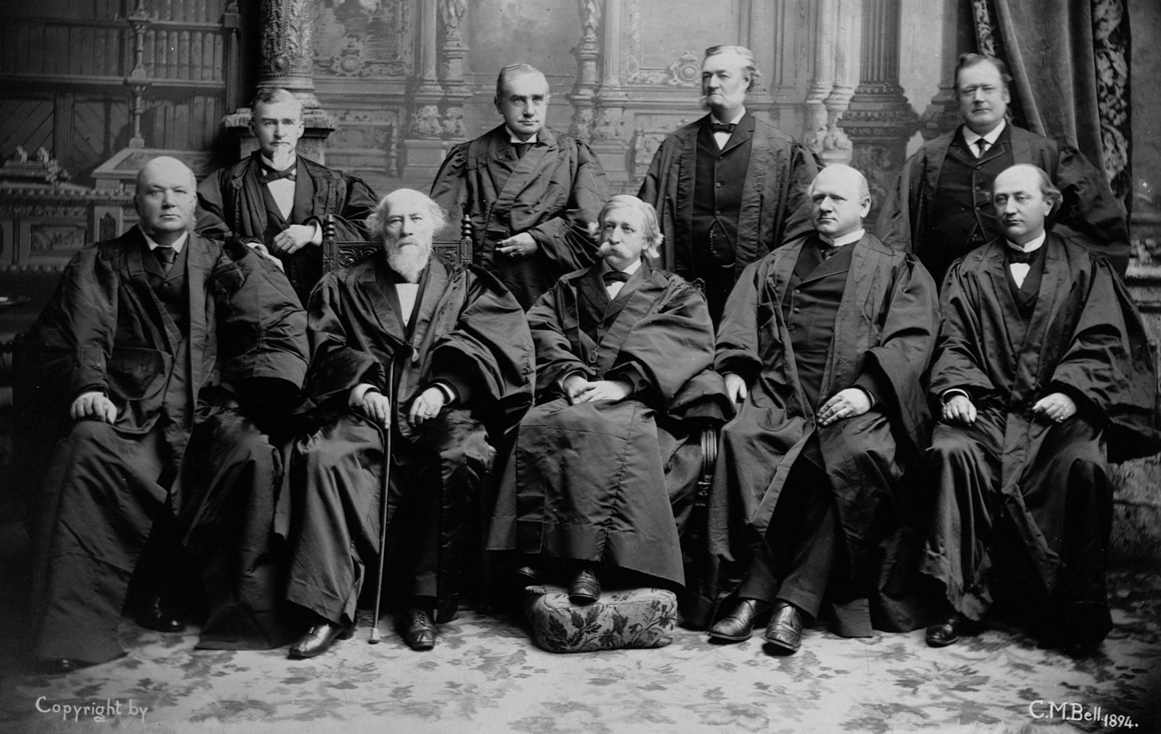
“Separate but Equal”
1896: Plessy v. Ferguson - U.S. Supreme Court rules “separate but equal” legal.
Southern states pass laws requiring racial segregation in public schools.
1900 U.S. Supreme Court

Slide 26
Kentucky Negro Education Association (K.N.E.A.)
1874: Legislative Act established KY “Colored Common Schools” the first continuous system of black public education in America
1877-1946: KNEA formed in Danville, KY; followed the 1870 “Georgia Model” for black education
First KNEA Presidents: USCT W. J. Simmons and John H. Jackson
First KNEA Secretary former USCT C. C. Vaughn

Slide 27
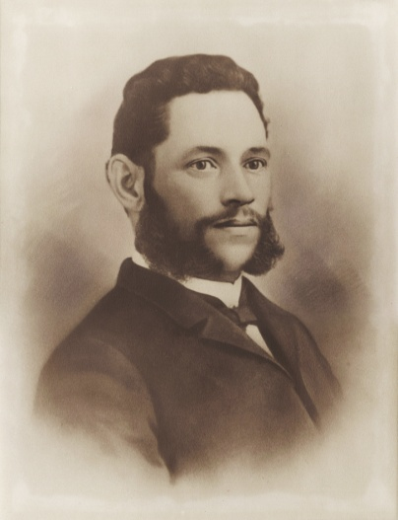
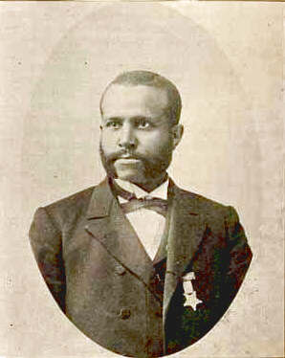
National Goals of K.N.E.A.
Training black teachers
Pushing for single per-capita distribution of public school tax dollars
Promotion of statewide Rosenwald School building programs
President John H. Jackson
Secretary C. C. Vaughn

Slide 28
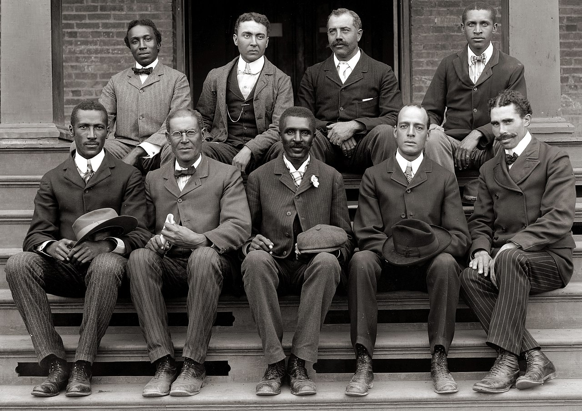
Tuskegee Institute
Established 1881 in Tuskegee, AL
“Genius of Tuskegee” George Washington Carver, leading agricultural scientist and inventor
1902 Tuskegee Faculty

Slide 29
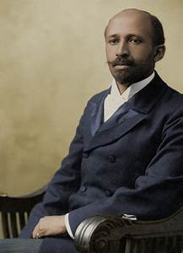
W. E. B. DuBois
Harvard graduate
America’s biggest proponent of black liberal arts education.
An opponent of the Tuskegee industrial education model as a tool of the former “slaveocracy.”

Slide 30
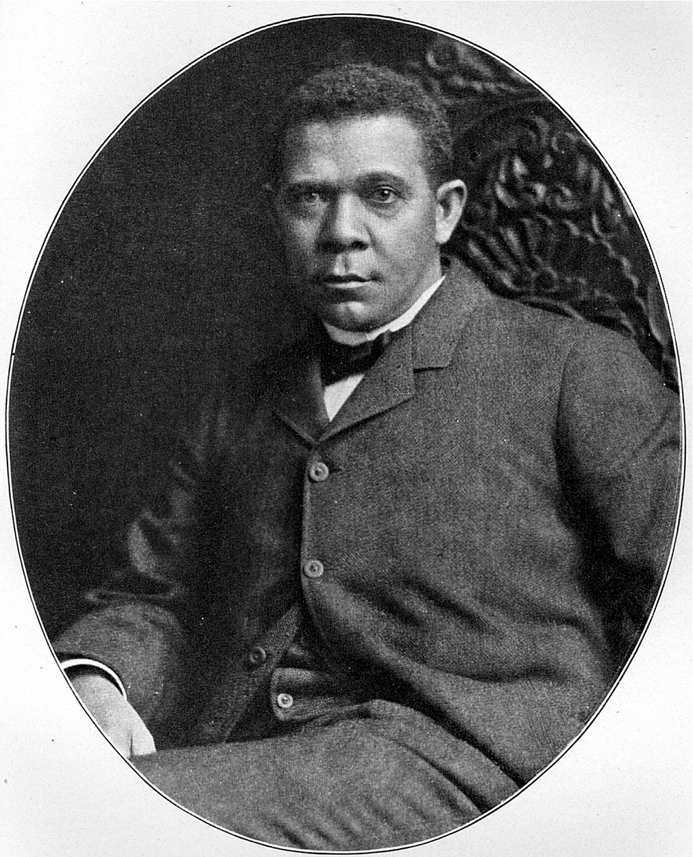
Booker T. Washington
“The Wizard of Tuskegee”
Leading American proponent of industrial education.
Circa 1904, Washington develops plan for rural school buildings funded by local government, African Americans, and philanthropy

Slide 31
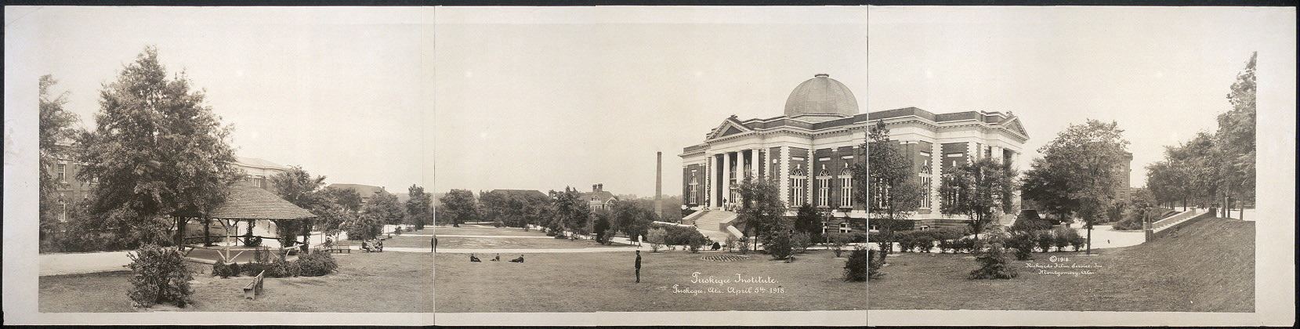
Tuskegee Institute, April 5, 1918
Image courtesy Library of Congress

Slide 32
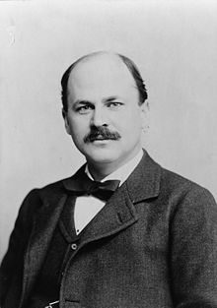
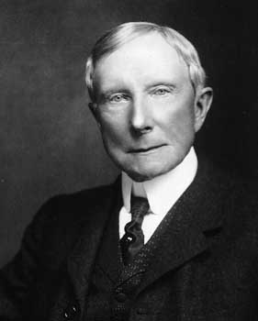
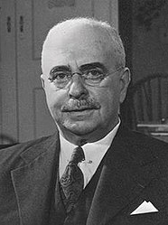
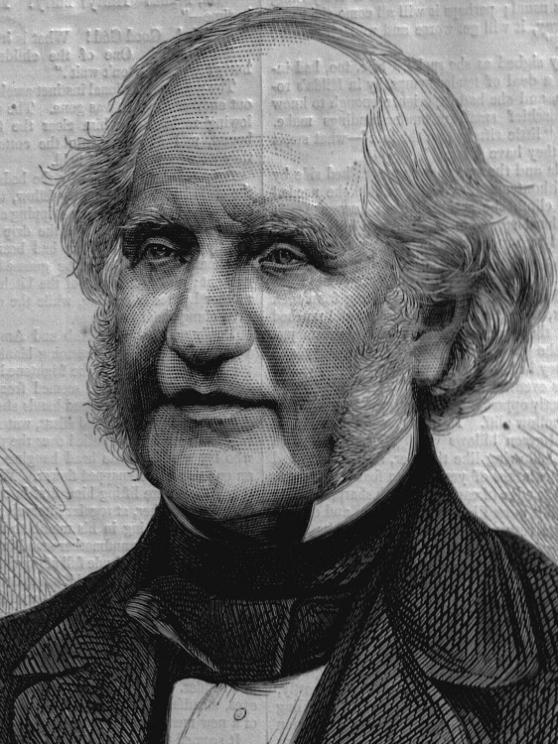
Major Funders of Black Industrial Education
William Henry Baldwin, Long Island Railroad
John D. Rockefeller, Sr., Standard Oil
Paul J. Sachs, Fogg Museum
George Peabody, J. P. Morgan & Company
William Baldwin
John D. Rockefeller, Sr.
Paul J. Sachs
George Peabody

Slide 33
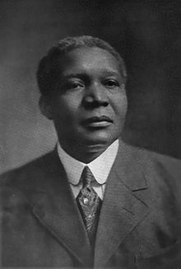
Rural School Funding
1912: Washington and Julius Rosenwald develop plans to build new schools throughout the South designed by Robert R. Moton, director of the Tuskegee Extension Department.
The program operates until Washington’s death in 1915.
Robert Russa Moton

Slide 34
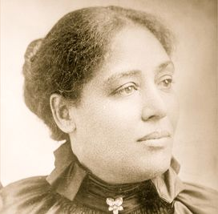
Julius Rosenwald Fund
1920: Julius Rosenwald Fund Office opens in Nashville, TN
1928: the Fund reorganized from private to corporate philanthropy following Rosenwald’s death.
Largest black school building program in the nation.
Margaret Murray Washington continued her husband’s school building efforts following his death, from 1915-1920.
Margaret Murray Washington

Slide 35
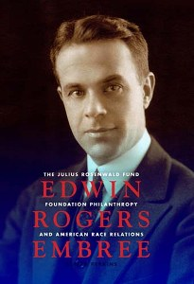
Edwin Rogers Embree
(1883-1950)
Grandson of Reverend John G. Fee, founder of Berea College
President of the Julius Rosenwald Fund
Vice President of the Rockefeller Foundation

Slide 36
Rosenwald Fund
From 1915-1932 the Rosenwald Fund and Tuskegee Institute built:
  4,977 schools
  217 teacher’s homes
  163 shops in fifteen southern states
  expending $28,408,520.
1909: Northern corporate funders discontinue financial aid to Washington and Tuskegee Institute

Slide 37
State by State Use of
Rosenwald School Building Funds

Slide 38
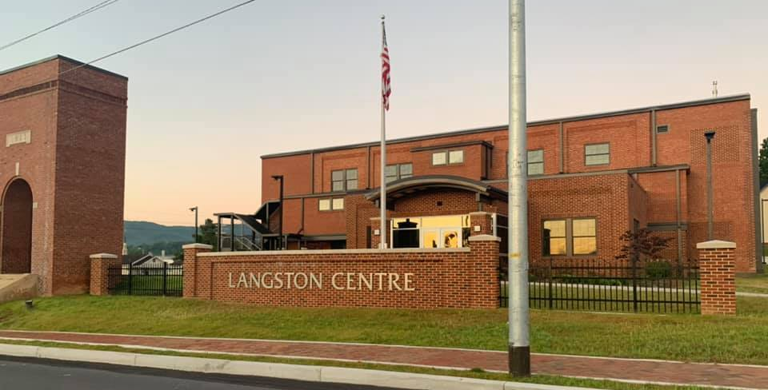
Langston Centre, former Langston High School, Johnson City, TN (supported by Rosenwald funding)

Slide 39
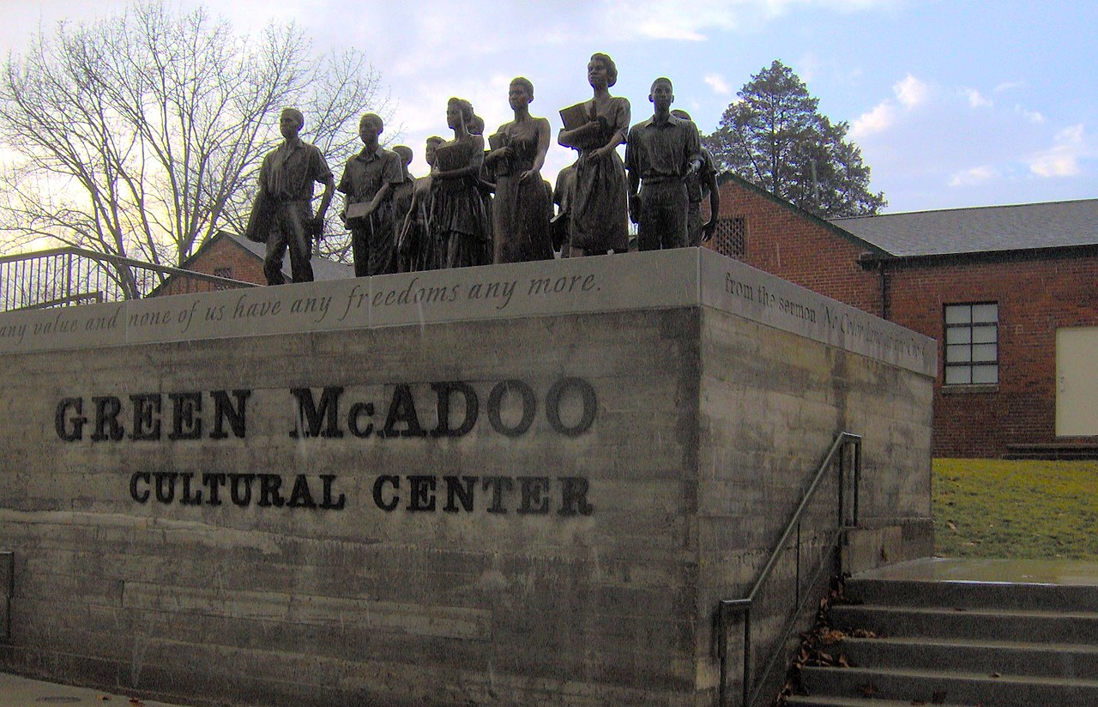
1954: Brown v. Board of Education
U. S. Supreme Court rules school segregation unconstitutional.
Creates the cornerstone of the American Civil Rights Movement.
Brian Stansberry, WikiCommons

Slide 40
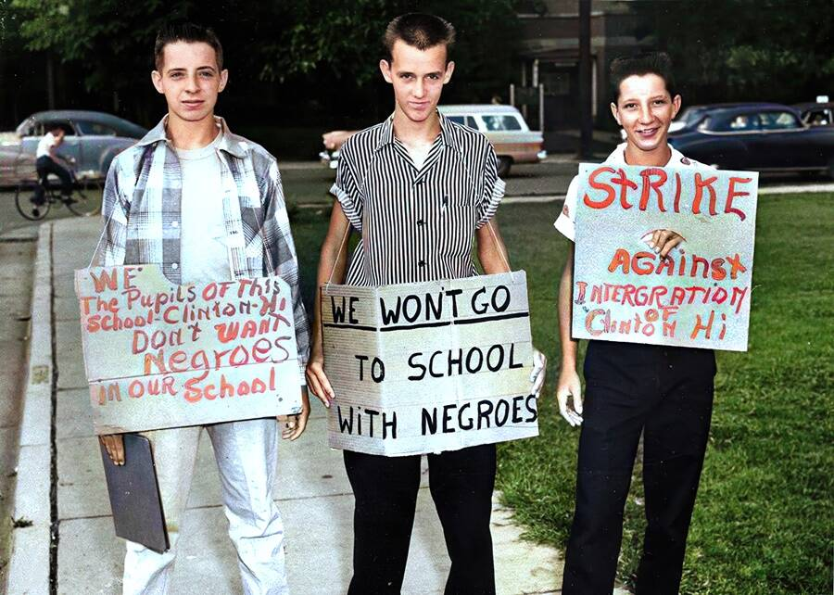
Anti-integration protestors
Clinton, TN, 1957

Slide 41
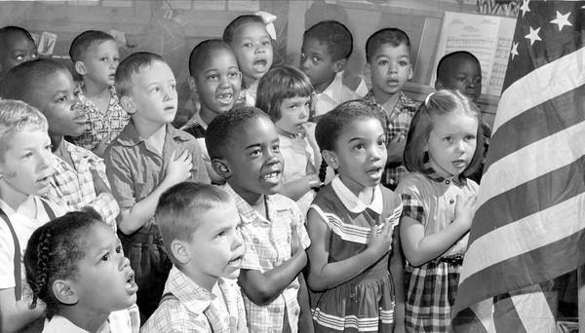
1968: Green v. Board of Education
U. S. Supreme Court unanimously rules “freedom of choice” plans following Brown v. Board of Education did not adequately comply with the responsibility to establish non-racial basis in admission to public schools.

Slide 42
Thank you for joining us today!
We are partnering with the National Humanities Alliance to document the impact of the Freedom Stories initiative. Your feedback is very important in this regard. Please visit www.StorytellingCenter.net/FreedomStories
to complete this important survey!
Responses are voluntary and confidential. Thank you!

Slide 43
For more information on this and other Freedom Stories events, please contact us.
Web: www.StorytellingCenter.net/FreedomStories
Email: FreedomStories@StorytellingCenter.net
Join us again Saturday, April 10 at 1:00pm (Eastern) for our next public discussion.

Slide 44

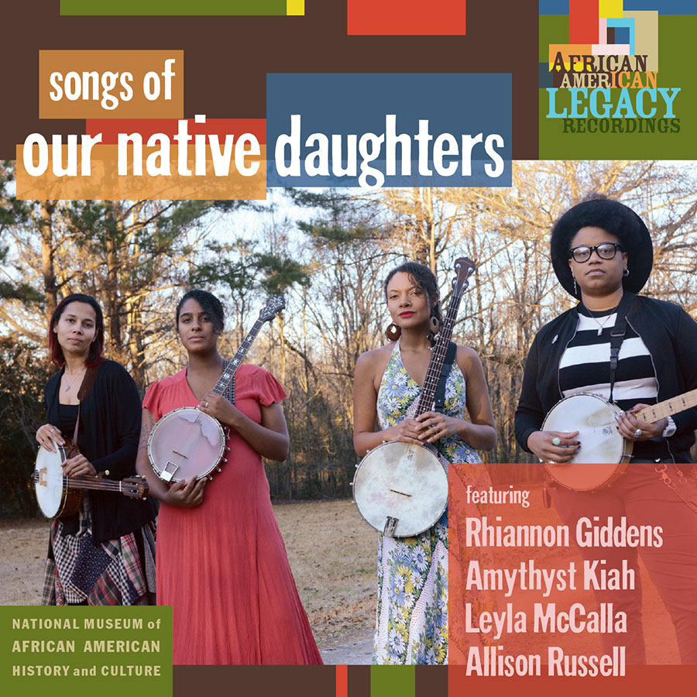
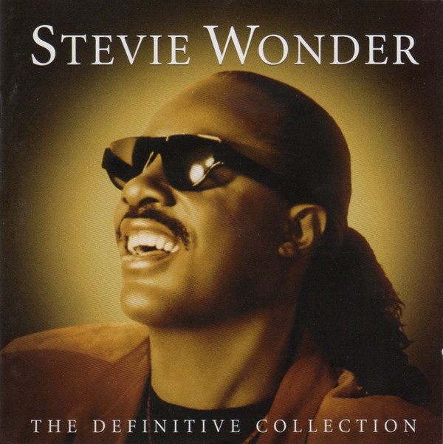
Today’s Music
“The Preamble” written and recorded by Lynn Ahrens. From the television show Schoolhouse Rock! created by David McCall. © 1975, ABC - American Broadcasting Corporation.
“Better Git Yer Learnin’” written by Rhiannon Giddens, recorded by Our Native Daughters. From the album Songs of Our Native Daughters, © 2019 Smithsonian Folkways Recordings.
“Higher Ground” written and recorded by Stevie Wonder, © 1973 Motown Records, a Division of UMG Recordings, Inc. Track from The Definitive Collection, released 2002.

Slide 45
Education as Freedom
“If a nation expects to be ignorant and free, in a state of civilization, it expects what never was and never will be.”
Thomas Jefferson, 1816
Letter to Colonel Charles Yancey

