Slide 1
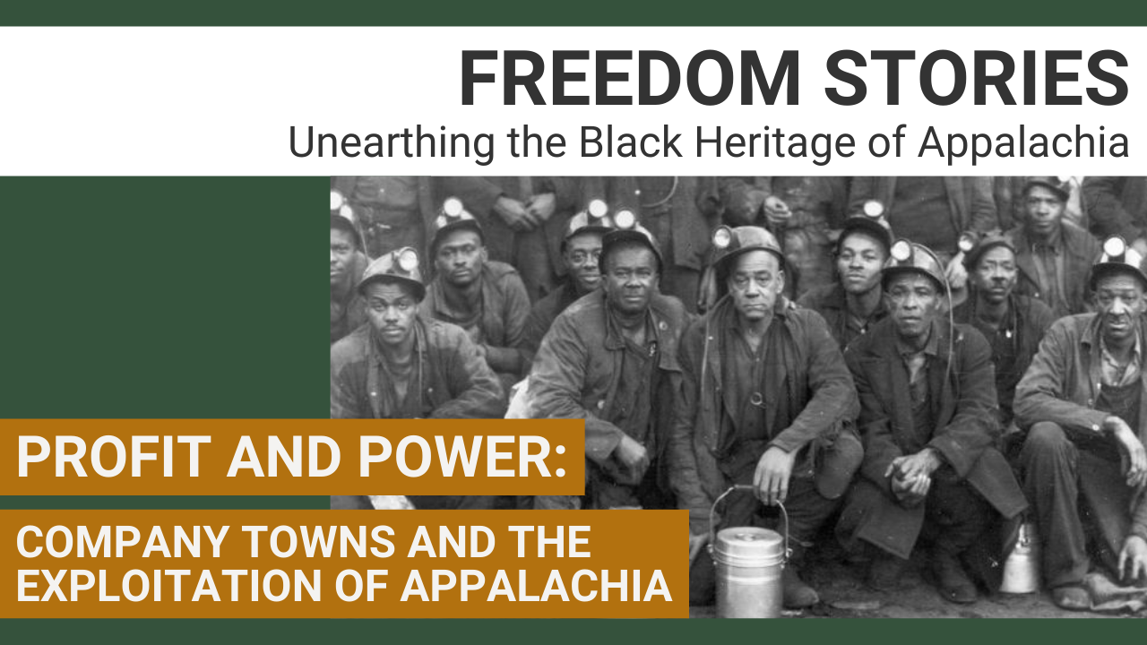

Slide 2



This Freedom Stories discussion is being recorded for use by the International Storytelling Center (ISC.) This recording will be owned and managed by ISC and will be used for any educational purpose that ISC deems appropriate. By participating in this public discussion, you acknowledge this recording and its subsequent uses.
Closed captioning is provided today by ACS.

Slide 3

Freedom Stories Unearthing the Black Heritage of Appalachia
This project is proudly supported by the National Endowment for the Humanities and produced by the International Storytelling Center.

Slide 4



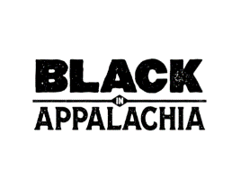


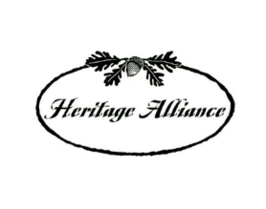
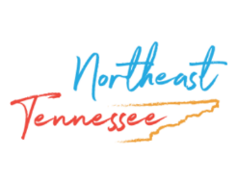


Thanks and appreciation to our supporters:
Appalachian
African-American
Cultural Center
Black / White Dialogue
Langston Education and
Arts Development, Inc.
Leadership and Civic Engagement
Northeast Tennessee Tourism
Association (NETTA)

Slide 5
Profit and Power: Company Towns and the Exploitation of Appalachia Saturday, February 13, 2021 1-2:30 p.m.

Slide 6


You live in a company house. You go to a company school. You work for this company according to the company rules. You all drink company water and all use company lights. The company preacher teaches us what the company thinks is right.
“The Company Towns” by Carl Sandburg, native of Flat Rock, NC

Slide 7
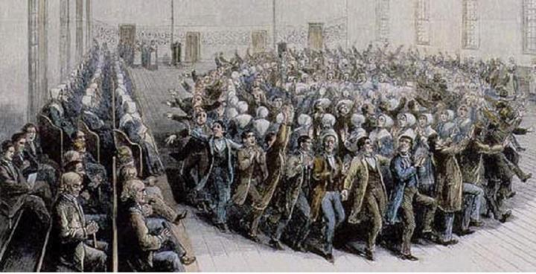
Company Towns: A Community Model Adapted from Shakers
Basic Tenets of Utopian Shaker Communal Living:
All Property and Profits Shared in Common
Racial and Gender Equality
Separation from the Outside World
Controlled Rural Social and Work Environments
Shakers organized in England in 1747. 1840 Shaker Dance Image courtesy NPS https://www.nps.gov/articles/history-of-the-shakers.htm

Slide 8
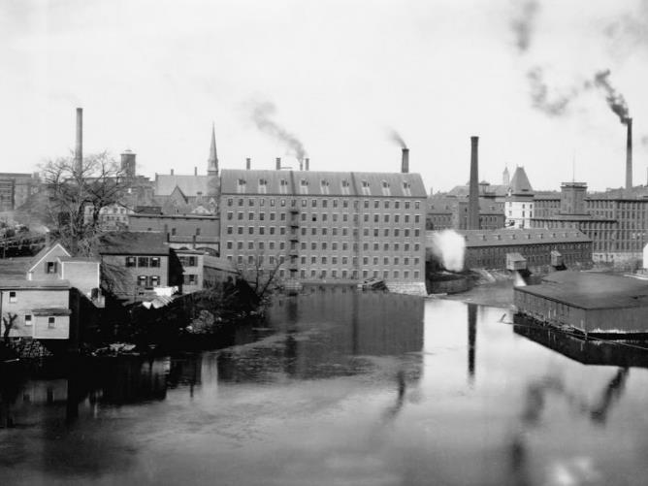
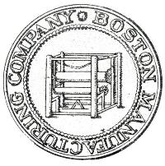
Birth of an 1820 American Company Town
Francis Cabot Lowell
Textile production
Founder of Boston Manufacturing Company, considered America’s first planned company town.
Lowell, Massachusetts

Slide 9
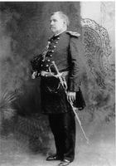
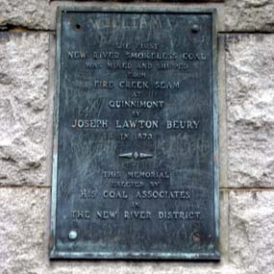
West Virginia, Heart of the American Coal Boom
1873 Joseph Beury opened the first large-scale mine in Quinnimont, Fayette County, West Virginia
Beury pioneered Flat Top-Pocahontas Coalfield.
By the end of the 1870s, the New River Coalfield produced more than 365,000 tons of coal annually.
Union soldier, Joseph L. Beury (1842-1903) Owner/Operator New River Coal Company

Slide 10
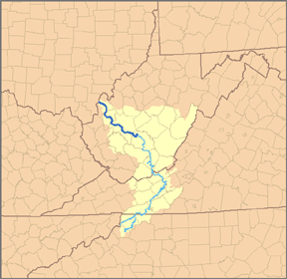
Central Appalachia: Railroads, Forests, Coal, Iron Ore, Oh My!
Big, Little Coal River
Kanawha River Valley
1850-1861 Beginning of Appalachian Coal Production
In 1860, over 850,000 bushels of coal shipped.
1905 Coal River and Western Railway Company established by Western Mining and Manufacturing Company

Slide 11
Railroads Expand Coal Production
Baltimore & Ohio Railroad shaped West Virginia boundaries.
1873, the Chesapeake & Ohio (C&O) Railway did the same for southern West Virginia.
Norfolk & Western (N&W) emerged in 1881
Pennsylvania Investors expanded coal production.
By 1892, the N&W sparked rapid growth of towns along its path.
Bramwell, WVa became “home of millionaires.”

Slide 12
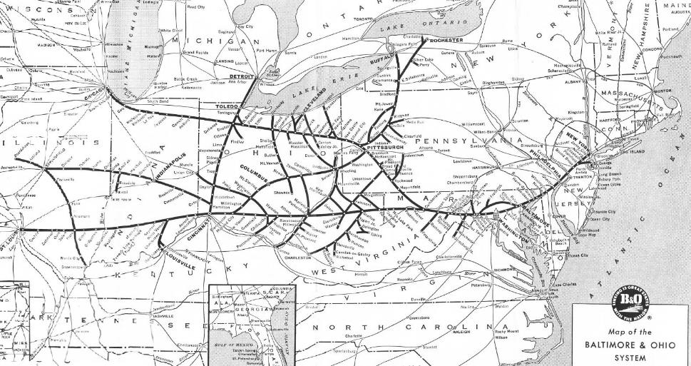
Baltimore & Ohio Railroad
Baltimore & Ohio - Collection of JG Howes - B&O System Time Tables published April 30, 1961, without any copyright notice., Public Domain, https://commons.wikimedia.org/w/index.php?curid=6651494

Slide 13
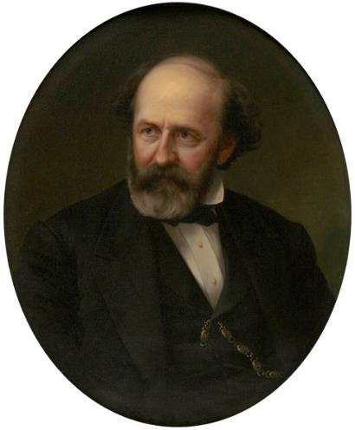
Railroads, cont’d
C&O acquired valuable coal lands in the smokeless coalfields of Mercer and McDowell Counties, WVa.
In 1895, the economic dominance of railroads caused West Virginia Legislature to prohibit rail companies from engaging in the coal industry.
In response, the railroads sold their property to railroad stockholders.
Colis P. Huntington (1821-1900)
American Industrialist, Founder of Huntington, WVa

Slide 14
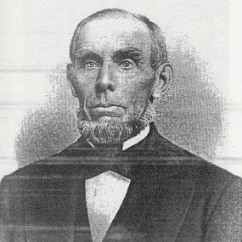
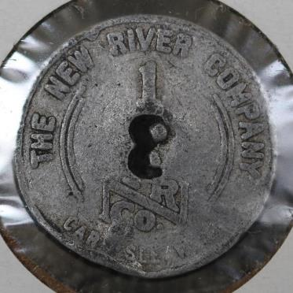
1880s: King Coal!
Kanawha Valley
New River
Winding Gulf
Flat Top-Pocahontas
Logan
Williamson
Southern West Virginia
Eastern Kentucky
Northern Alabama
British born industrialist John Nuttall (1817-1873), Founder, Owner/Operator, Nuttallburg Coal Mines, New River, WVa
New River Company Scrip

Slide 15
1890-2021 Defining Company Towns
Southern coalfield company towns are distinctly West Virginian.
Towns were built in a matter of weeks.
Buildings were simply designed, all within close proximity of the company and each other.
To cut costs, almost all houses were built identically, often of cheap materials.
Since most towns, were built in isolated areas, miners and their families were totally dependent on the companies for all services.

Slide 16
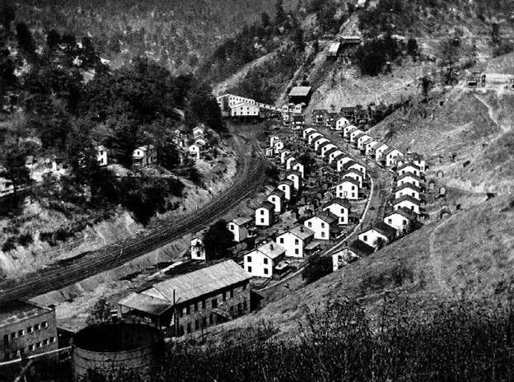
Hardburley Coal Camp
Perry County, Kentucky; 1918

Slide 17
Risks and Rewards
Model company towns built swimming pools, movie theaters and parks. Houses included indoor plumbing, electricity and sewer systems.
All life revolved around the company-owned store.
Most company stores also contained the local post office and payroll office.
Charged exorbitant prices compared to what others paid for the same items.

Slide 18
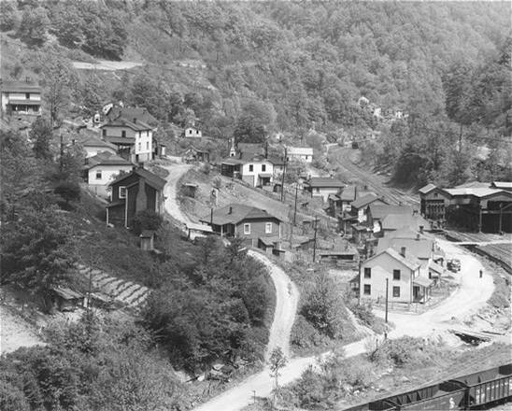
Weeksbury Coal Camp Floyd County, Kentucky

Slide 19
Segregated Living, Learning, Worship, Travel
African Americans and various immigrant groups typically forced to live in separate sections of company towns.
Racial and ethnic violence occurred in a number of communities.
To maximize productivity, maintain peace, coal companies tried to keep a balance among native whites, blacks and immigrants—a “judicious mixture,” as dubbed by operator Justus Collins.

Slide 20
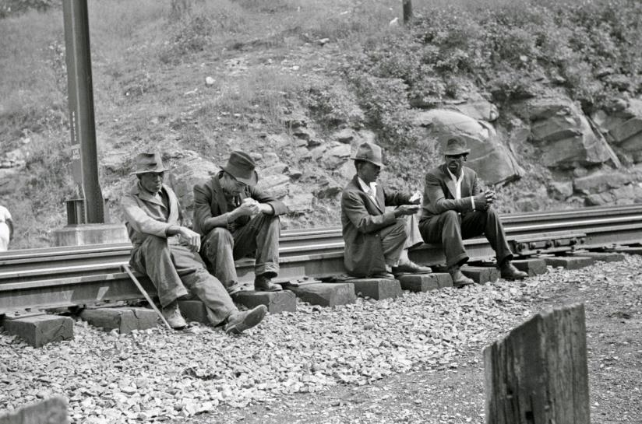
1938 West Virginia Coal Mining Life

Slide 21
Five Major West Virginia Company Towns 1880-1960
Cass, WVa: West Virginia Paper and Pulp Company
Coalwood, West Virginia, owned by the Olga Coal Company
Gary, West Virginia, formerly owned by U.S. Steel
Grant Town, West Virginia built by the Federal Coal and Coke Company, which built and operated the Federal No. 1 Mine.
Kay Moor or Kaymoor, West Virginia, owned by the Low Moor Iron Company

Slide 22
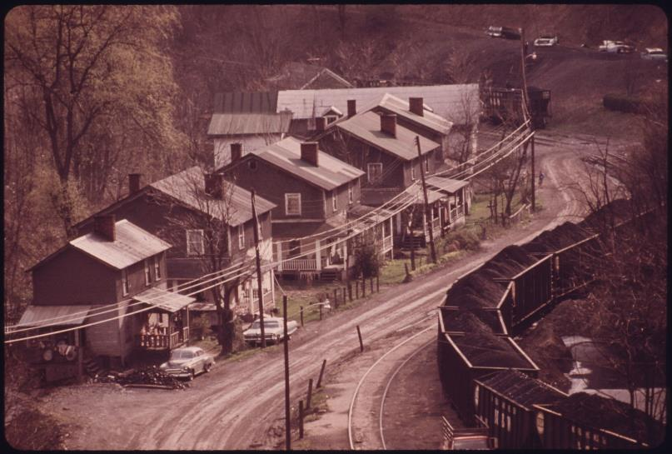
Red Ash, Virginia Company Town

Slide 23
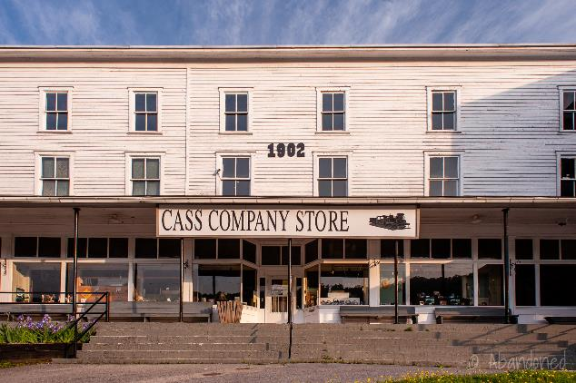
Company Town: West Virginia Pulp and Paper Company
Founded by Joseph Kerr Cass in 1901 in Cass, Pocahontas County, WVa, vice president and co-founder.
Logging, paper production, fence rails, mill and locomotive repair.

Slide 24
Company Town: U.S. Steel—Gary, West Virginia
Formed March 1901
At one time, the largest steel producer and largest corporation in the world.
Largest competitor, Tennessee Coal, Iron and Railroad Company, headquartered in Birmingham, AL.

Slide 25
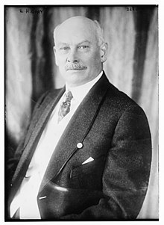
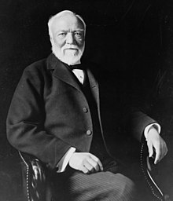
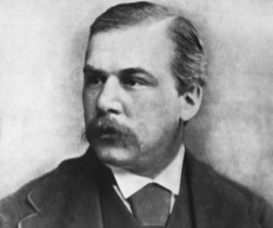
The Men of Steel
John Pierpont Morgan (1837-1913), American financier and banker
Elbert Henry Gary (1846-1927), lawyer, founder U.S. Steel
Andrew Carnegie
(1835-1919), Carnegie Steel

Slide 26
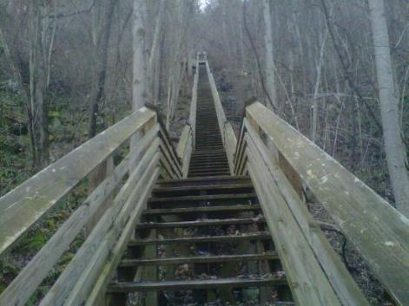
Company Town: Kay Moor Mines, Kaymoor, WVa
Opened in 1899
Supplied coal and coke to company blast furnaces
In 1925 the mine was sold to the New River and Pocahontas Consolidated Coal Company, a subsidiary of Berwind-White Corporation of Philadelphia.
Closed by fire in 1960. Now a NPS site.

Slide 27
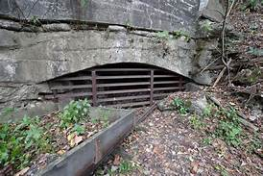
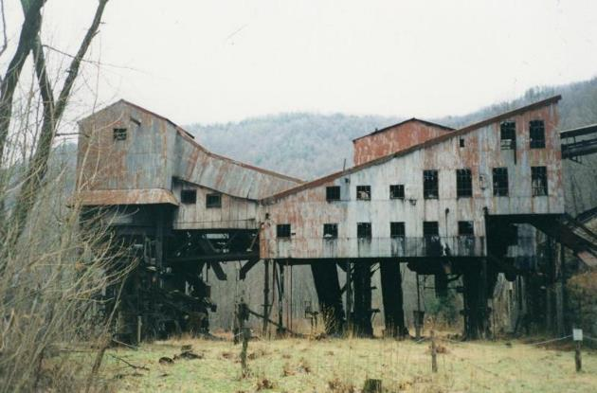
Kay Moor Mines

Slide 28
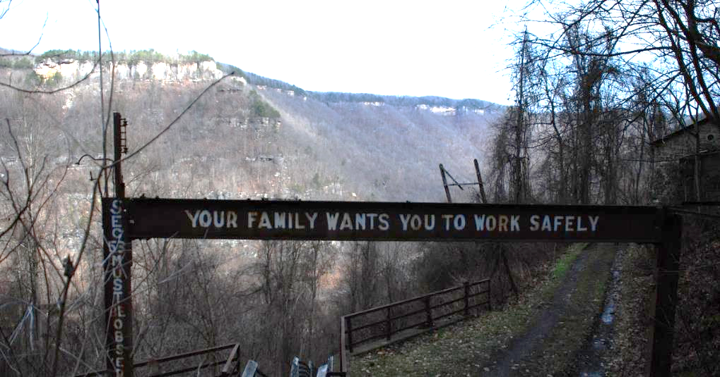
Kay Moor Mine Signage
http://www.casabrian.com/images/medium/2007/west_virginia/kaymoor/636-3680_IMG_med.jpg

Slide 29
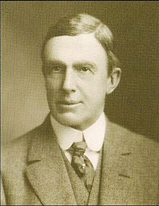
17 Major Kentucky Company Towns
Barthel, Stearns Coal and Lumber Company.
Benham, International Harvester.
Jenkins, Consolidation Coal Company
Lynch, U.S. Steel.
Justus S. Stearns
(1845-1933) owned coal and lumber mines in Scott, Pickett, and Fentress Counties, TN, and McCreary, Wayne Counties, KY

Slide 30
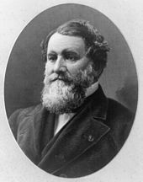
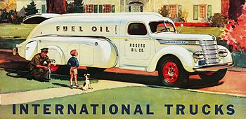
Company Town of Benham, KY
Home of International Harvester
Manufacturer of agricultural equipment, automobiles, commercial trucks, lawn and garden products, household equipment, and more.
Cyrus Hall McCormick (1809-1894), Inventor / Businessman, McCormick Harvesting Machine Company

Slide 31
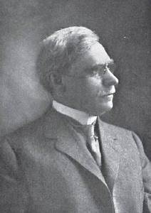
Company Town of Lynch, KY
Lynch, plotted in 1917 by the U.S. Coal and Coke Company to house coal mine workers.
Named for then-head of the company, Thomas Lynch.
In 1996, Lynch and nearby Benham were officially abandoned.
Thomas Lynch (1854-1914)

Slide 32
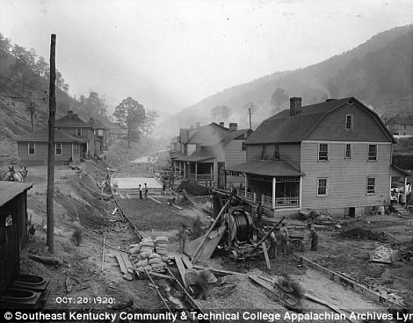
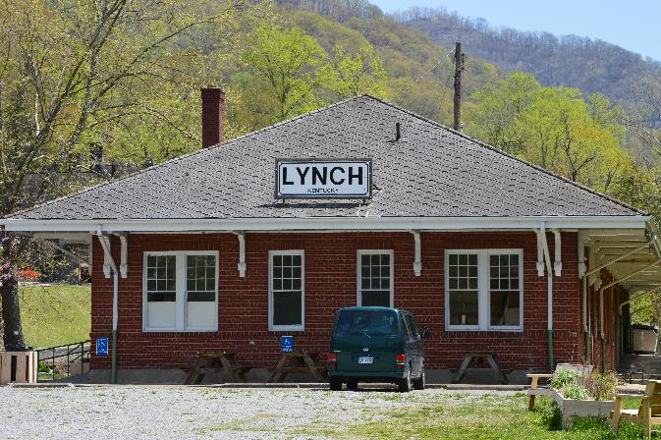
Lynch, Kentucky

Slide 33
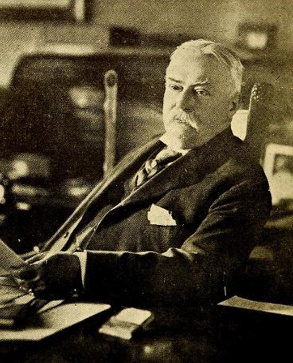
Four Major North Carolina Company Towns
Bunn, NC: Montgomery Lumber Company
Bynum, NC: J. M. Odell Manufacturing Company
Canton, NC: Champion International Paper Company
Kannapolis, NC: Cannon Mills Company
James W. Cannon (1852-1921)

Slide 34
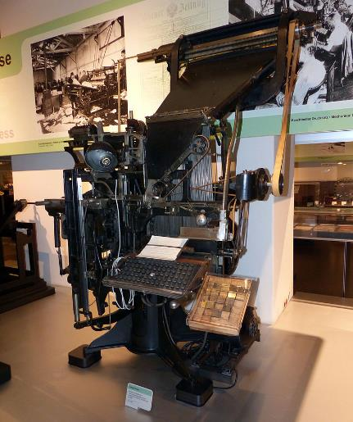
Company Town of Canton, NC
International Paper Company, incorporated January 31, 1898, upon the merger of 17 pulp and paper mills in the northeastern United States.
The invention of the Linotype dramatically increased the size of newspapers and the need for newsprint.
56,000 employees, headquartered in Memphis, TN
1895 Linotype Machine

Slide 35
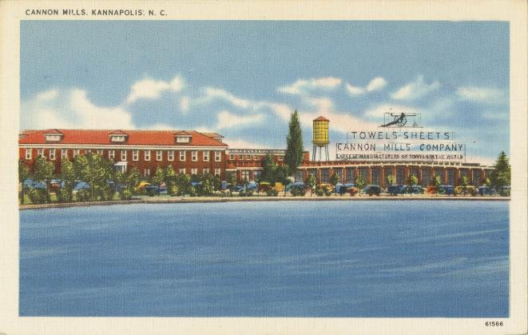
Company Town of Kannapolis, NC
The American textile company Cannon Mills Company, mainly produced towels and bed sheets.
Founded in 1887 by James William Cannon, by 1914 the company was the largest towel and sheets manufacturer in the world.
Family owned until 1982.

Slide 36
Four Major Tennessee Company Towns
Alcoa, TN: formerly and still economically dominated by the Aluminum Company of America (ALCOA)
Norris, TN: Tennessee Valley Authority
Oak Ridge, TN: built in secret by the United States government for the Manhattan Project; controlled by the federal government until 1959
Old Hickory, TN: DuPont, now a suburb of Nashville.

Slide 37
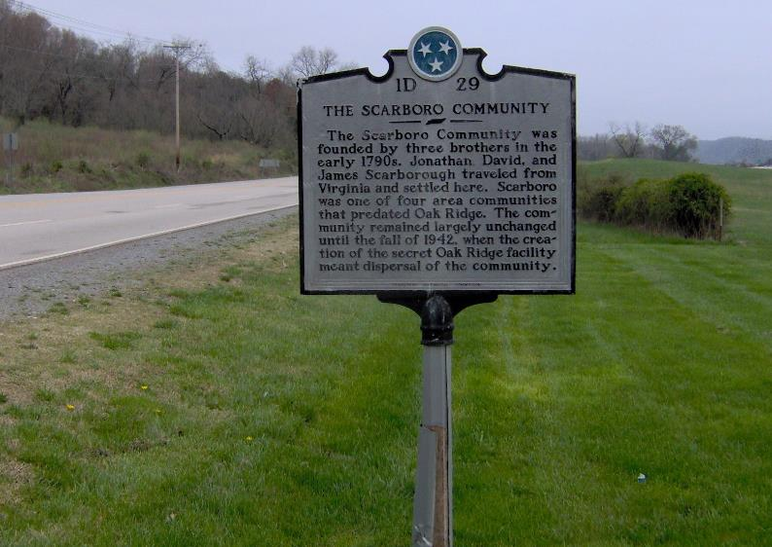
Oak Ridge, Tennessee
Created from a combination of small
rural communities in 1942.

Slide 38
Company Town of Alcoa, TN
Pittsburgh Reduction Company in 1888, the company changed its name in 1907 to the Aluminum Company of America
Began using the acronym “ALCOA” in the early 1900s after applying the acronym to company-owned sites in Tennessee.
The company officially changed its name to ALCOA, Inc., in January 1999.

Slide 39
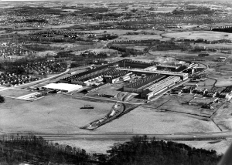
West Plant; Alcoa, Tennessee; 1970

Slide 40
Company Town of Old Hickory, TN
Original DuPont Company founded in 1802.
Considered the world's largest chemical sales company.
98,000 employees (2018)
The film, Dark Waters dramatized a legal case against the predecessor DuPont related to contaminating a West Virginia town with unregulated toxic chemicals.

Slide 41
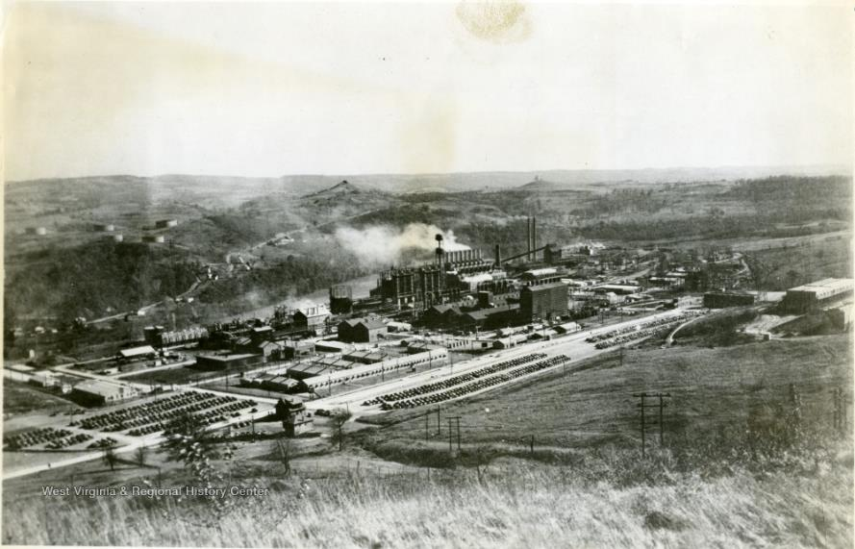
DuPont, Morgantown, WVa

Slide 42
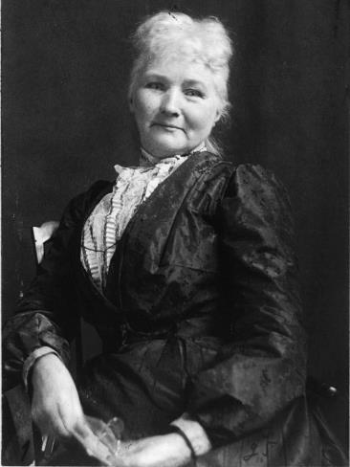
United Mine Workers Formed, 1890
National labor leader Mary Harris “Mother” Jones was one of the principal leaders and agitators in the West Virginia labor movement from 1902 until 1921.
President Franklin Roosevelt’s New Deal allowed the UMWA to organize Mingo, McDowell and other counties in 1933.
The UMWA’s membership dropped during the 1950s and 1960s as mining jobs disappeared.
Mary G. Harris Jones (1837-1930), labor organizer, schoolteacher, dressmaker

Slide 43
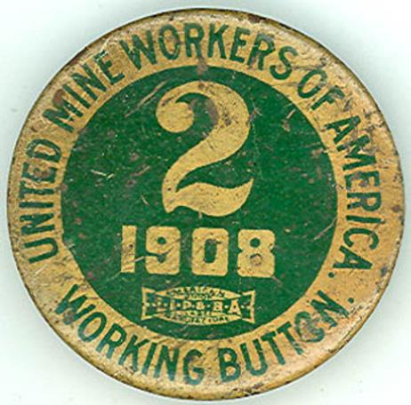
United Mine Workers, cont’d
West Virginia miners organized first coal mining strikes.
For the next 43 years, the UMWA tried to organize southern West Virginia miners into the union.
During the late 19th and early 20th centuries, strikes became increasingly violent.

Slide 44
Thank you for joining us today!
We are partnering with the National Humanities Alliance to document the impact of the Freedom Stories initiative. Your feedback is very important in this regard. If you are interested in completing a brief, anonymous survey, please email us at FreedomStories@StorytellingCenter.net.
Responses are voluntary and confidential. Thank you!

Slide 45
For more information on this and other Freedom Stories events, please contact us.
Web: www.StorytellingCenter.net/FreedomStories
Email: FreedomStories@StorytellingCenter.net
Mark your calendars for Saturday, March 13 at 1:00pm (Eastern) for our next public discussion.

Slide 46
Today’s music:
“Nine Pound Hammer,” “Sixteen Tons,” “Dark as a Dungeon”
written by Merle Travis, recorded by Tennessee Ernie Ford for Capitol Records, 1956
“Paradise”
written and recorded by John Prine for Atlantic Records, 1971

Slide 47
